Slide 1
Introduction to Health Care and
Public Health in the U.S.
Meaningful Use
Lecture c
This material (Comp 1 Unit 10) was developed by Oregon Health & Science University, funded by the Department of Health and Human Services, Office of the National Coordinator for Health Information Technology under Award Number 90WT0001.
This work is licensed under the Creative Commons Attribution-NonCommercial-ShareAlike 4.0 International License. To view a copy of this license, visit http://creativecommons.org/licenses/by-nc-sa/4.0/.
Notes:
Welcome to Introduction to Health Care and Public Health in the U.S.: Meaningful Use. This is lecture c.
This component, Introduction to Health Care and Public Health in the U.S., is a survey of how health care and public health are organized and how services are delivered in the U.S. It covers public policy, relevant organizations and their interrelationships, professional roles, legal and regulatory issues, and payment systems. It also addresses health reform initiatives in the U.S.

Slide 2
Meaningful Use
Learning Objectives - 1
Define meaningful use (MU) of health information technology in the context of the Health Information Technology for Economic and Clinical Health (HITECH) Act (Lecture a)
Describe the major goals of meaningful use (Lecture a)
Notes:
The objectives for this unit, Meaningful Use, are to:
Define meaningful use, or MU, of health information technology in the context of the Health Information Technology for Economic and Clinical Health, or HITECH, Act.
Describe the major goals of meaningful use

Slide 3
Meaningful Use
Learning Objectives - 2
Discuss the criteria for Stages 1-3 of meaningful use for eligible professionals, eligible hospitals, and critical access hospitals (Lecture b)
Describe the standards specified for MU (Lectures b and c)
Discuss the likely evolution of the MU program (Lecture c)
Notes:
Discuss the criteria for Stages 1-3 of meaningful use for eligible professionals and eligible hospitals
Describe the standards specified for MU
And discuss the likely evolution of the MU program

Slide 4
Clinical Quality Measures (CQMs) – Before 2011
Eligible Professionals (EPs) had to
report on:
  3 core measures
    Can substitute alternate core measures if denominator of any core measure is 0
  3 of 38 additional measures
Eligible Hospitals (EHs) had to report
on 15 measures
Notes:
In this lecture, we turn our attention to clinical quality measures, or CQMs. Remember that there were clinical quality measures specified in 2011 when the meaningful use program started, and then new measures that came in 2014 that were required of all meaningful use program participants, no matter what stage they were in. In the original CQMs, eligible professionals, or EPs, had to report on three core measures. For some EPs, those core measures were inappropriate, for example they might have a denominator of zero. Therefore some substitute measures were allowed. There was also a list of 38 additional measures, of which 3 need to be reported on. Eligible hospitals, or EHs, had to report on 15 measures.

Slide 5
Core EP Clinical Quality Measures (CQMs)
Core
  Hypertension: Blood Pressure Measurement
  Preventive Care and Screening Measure Pair
    Tobacco Use Assessment
    Tobacco Cessation Intervention
  Adult Weight Screening and Follow-up
Notes:
This slide shows the core CQMs for eligible professionals. Recall that there were three core and three alternatives that could be used if the core measures could not be measured. The core measures included blood pressure measurement; tobacco use screening, and cessation intervention; and adult weight screening and follow-up.

Slide 6
Core EP CQMs
Alternatives
  Weight Assessment and Counseling for Children and Adolescents
  Preventive Care and Screening: Influenza Immunization for Patients 50 Years Old or Older
  Childhood Immunization Status
Notes:
The alternatives were weight assessment and counseling for children and adolescents, influenza immunization, and childhood immunization status. There were also an additional 38 measures for eligible professionals that are not listed here, of which three needed to be measured.

Slide 7
EH CQMs - 1
Anticoagulation overlap therapy
Emergency Department Throughput – admitted patients – Admission decision time to ED departure time for admitted patients
Emergency Department Throughput – admitted patients – Median time from ED arrival to ED departure for admitted patients
Notes:
This slide and the next two slides show the CQMs for eligible hospitals in the 2011 meaningful use rules.

Slide 8
EH CQMs - 2
Incidence of potentially preventable venous thromboembolism
Intensive Care Unit venous thromboembolism prophylaxis
Ischemic or hemorrhagic stroke
  Antithrombotic therapy by day 2
  Rehabilitation assessment
  Stroke education
Notes:
Each hospital needed to report on all fifteen of these measures…

Slide 9
EH CQMs - 3
Ischemic stroke
  Anticoagulation for atrial fibrillation/flutter
  Discharge on anti-thrombotics
  Discharge on statins
  Thrombolytic therapy for patients arriving within 2 hours of symptom onset
Platelet monitoring on unfractionated heparin
Venous thromboembolism discharge instructions
Venous thromboembolism prophylaxis within 24 hours of arrival
Notes:
…to achieve meaningful use.

Slide 10
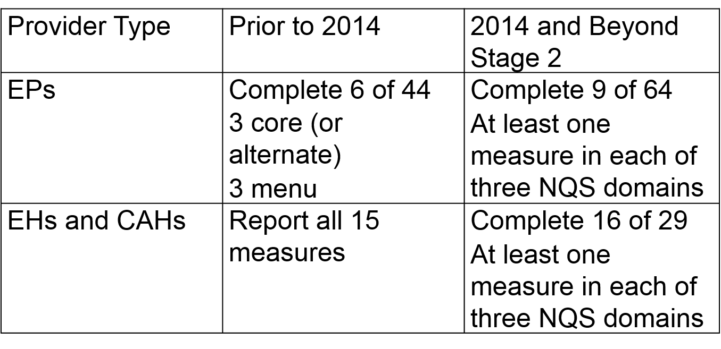
CQMs – Starting in 2014 for All Stages
http://www.cms.gov/Regulations-and-Guidance/Legislation/EHRIncentivePrograms/2014_ClinicalQualityMeasures.html
Notes:
Starting in 2014, the measurement of CQMs was expanded. No matter which stage of meaningful use one was in, eligible professionals and eligible hospitals were required to move to the 2014 CQMs. For eligible professionals, that required the use of 9 out of 64 measures, with at least one measure coming from each of three National Quality Strategy, or NQS, domains, which are shown on the next slide. Eligible hospitals and critical access hospitals now needed to complete 16 of the 29 measures, with at least one measure being in each of the three NQS domains.

Slide 11
National Quality
Strategy (NQS) Domains
Patient and Family Engagement
Patient Safety
Care Coordination
Population and Public Health
Efficient Use of Health Care Resources
Clinical Processes/Effectiveness
Notes:
The National Quality Strategy, or NQS, domains are:
Patient and Family Engagement
Patient Safety
Care Coordination
Population and Public Health
Efficient Use of Health Care Resources
Clinical Processes/Effectiveness
Within these domains, there are different quality measures that must be used, based on the rules described on the previous slide.

Slide 12
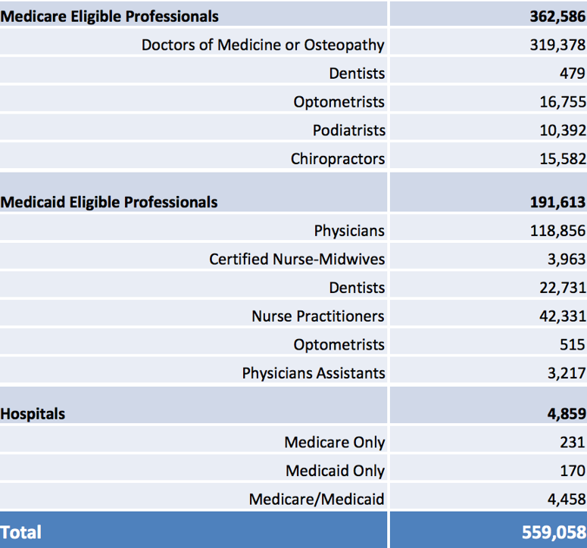
MU Registrations through 2015
http://www.cms.gov/Regulations-and-Guidance/Legislation/EHRIncentivePrograms/DataAndReports.html
Notes:
In the next few slides, we will look at the number of registrations and payments made through the meaningful use program. This data is released monthly by the Centers for Medicare and Medicaid Services, or CMS, and then periodically summarized. What we will look at here is the data through the end of 2015. As we can see, there have been over 362,000 Medicare-eligible professionals registered, 191,000 Medicaid-eligible professionals, and nearly 5,000 eligible hospitals.

Slide 13
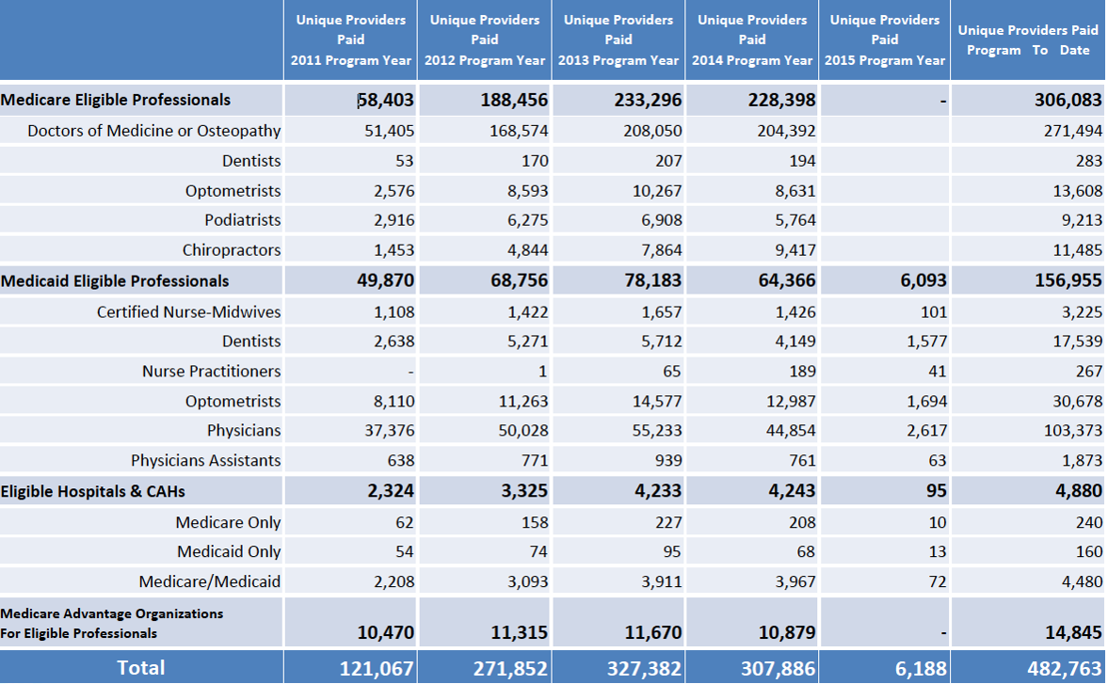
MU Providers Paid through 2015
Notes:
This table shows the number of providers who were actually paid for meaningful use through 2015. The data show there was a large uptick in the early years and then somewhat of a saturation with fewer new unique providers joining the program. But in total, there have been over 300,000 Medicare-eligible professionals, over 156,000 Medicaid-eligible professionals, and almost 4,900 eligible hospitals paid for achieving meaningful use.

Slide 14
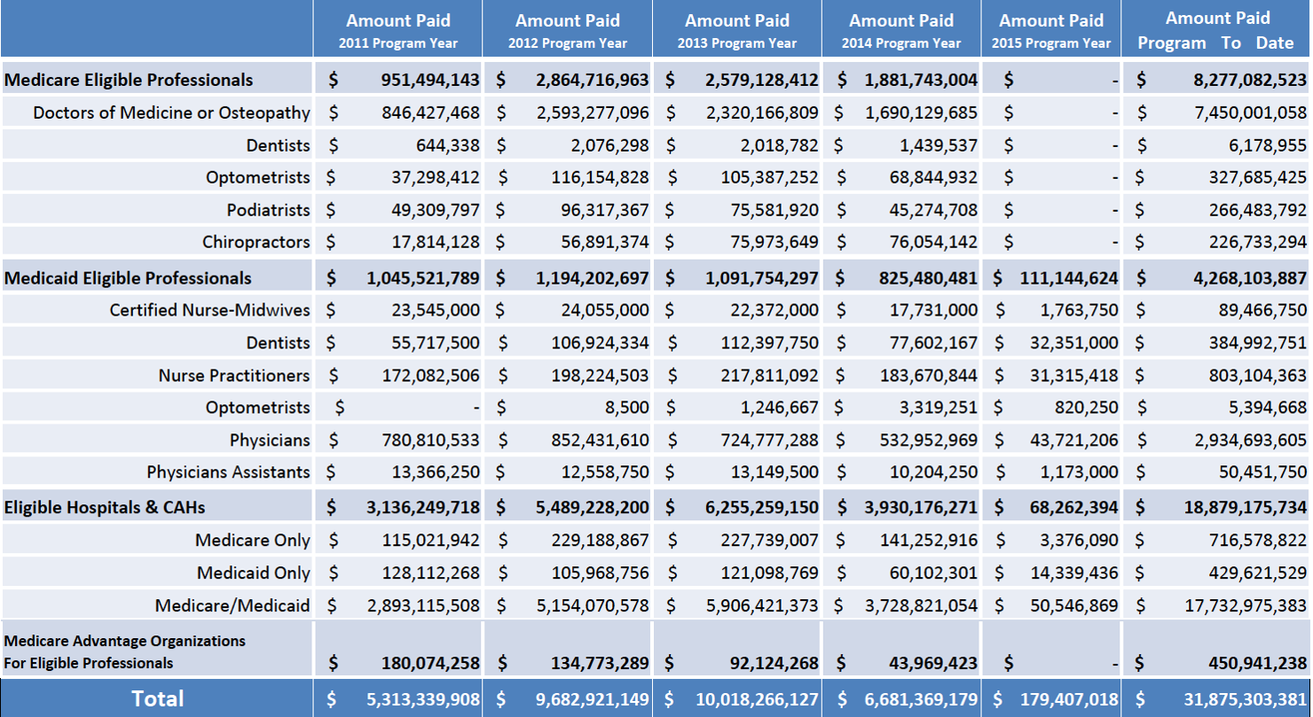
MU Dollars Paid through 2015
Notes:
This table shows the dollar amounts that have been paid out each year. Of note is that the program has ended up costing over $31 billion dollars, which is somewhat more than was expected. We can also see that the payments have tapered off as fewer EPs and EHs have achieved Stage 2 of meaningful use.

Slide 15
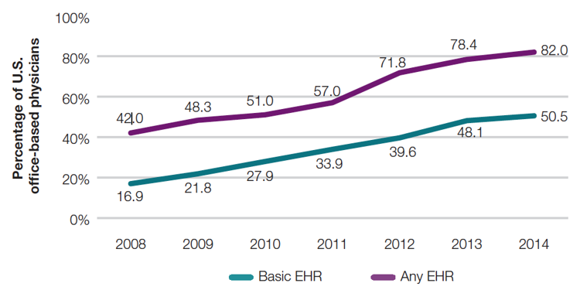
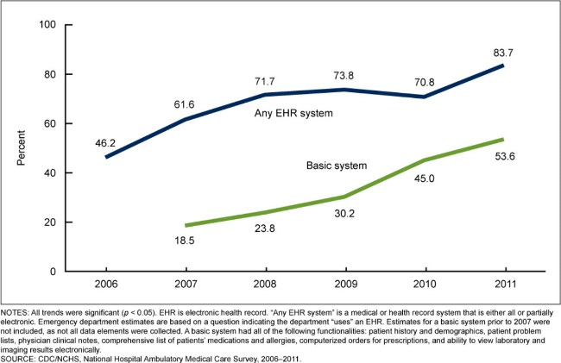
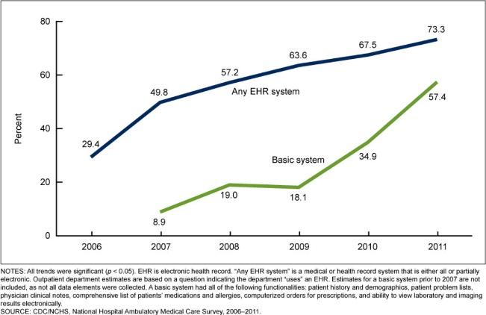
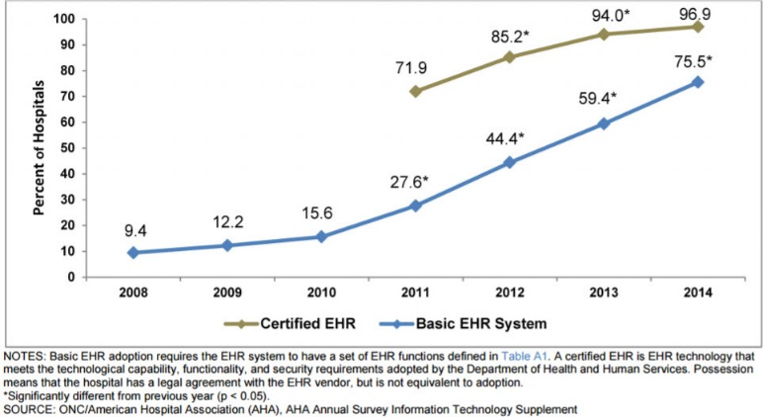
MU Resulted in Increased
EHR Adoption in U.S.
10.13 Chart. Office-Based Physicians (DesRoches, Painter, & Jha, 2015).
10.14 Chart. Emergency Departments (Jamoom & Hing, 2015).
10.15 Chart. Outpatient departments (Jamoom & Hing, 2015).
10.16 Chart. Non-Federal Hospitals (Charles, Gabriel, & Searcy, 2015).
Notes:
How successful has the meaningful use program been? In terms of spurring the adoption of electronic health records, or EHRs, it has been quite successful. Whether office-based physicians, emergency departments, outpatient departments, or hospitals, the proportion of those using electronic health records has increased substantially since the beginning of the program. Probably the most successful measure has been in hospitals, with 96.9% of all U.S. hospitals now having an electronic health record, even if they have not achieved meaningful use with it. That is, in essence, near universal adoption of EHRs in hospitals.

Slide 16
MU Challenges - 1
Some hospitals have had more challenges than others meeting MU
  Critical access, smaller, and public hospitals (DesRoches, Worzala, & Bates, 2013)
  Pediatric hospitals (Teufel et al., 2015)
Most “unruly workflows”/ challenging MU criteria:
  Clinical summaries to patients
  eRx
  CQMs
  Recording vital signs and smoking status
  (Patel & Hartley, 2012; Heisey-Grove et al., 2014)
Notes:
However, there have also been challenges for meaningful use. Some categories of hospitals have had more challenges than others. In particular, critical access hospitals, smaller hospitals, and public hospitals have had more difficulty meeting meaningful use requirements, as have pediatric hospitals. Many EPs and EHs have noted the challenging criteria, which some describe as “unruly workflows”. These criteria are things such as having to provide clinical summaries to patients, electronic prescribing, reporting clinical quality measures, recording vital signs, and recording smoking status.

Slide 17
MU Challenges - 2
Critical pediatric functions underrepresented (Spooner, 2012)
Compared with manual chart review, CQM reporting had variations in accuracy (Kern et al., 2013)
Stage 2 challenging even for hospitals with EHRs
(Adler-Milstein, 2014)
Notes:
It has also been noted that some of the critical functions in the practice of Pediatrics are underrepresented in the meaningful use criteria.
It has also been shown that compared with manual chart review, the more automated clinical quality measure reporting had some variations in its accuracy.
Finally, in general, achieving Stage 2 has been challenging even for hospitals that already had electronic health records.

Slide 18
MU Effect on Patient Care - 1
Positive
  Rates of adverse drug events 27-29% lower in EHs adopting core medication MU criteria (Encinosa & Bae, 2014)
  Hospitals with higher EHR adoption had:
    Improved performance on process quality measures
    Higher patient satisfaction
    No improvement in efficiency
    (Adler-Milstein, Everson, & Lee, 2015)
Notes:
What about the effect of meaningful use on patient care? There have been both positive and negative studies. In terms of positive studies, one showed that rates of adverse drug events were lower in eligible hospitals that had adopted the core medication meaningful use criteria. Another study found that hospitals with higher EHR adoption had improved performance on process quality measures and higher patient satisfaction, although no demonstrable improvement in efficiency occurred.

Slide 19
MU Effect on Patient Care - 2
Negative
  Primary care physicians scored “better” than specialists, though 90% had one or more exclusions (Wright et al., 2014)
  Physicians achieving MU not more likely to provide higher quality care (Samal et al., 2014)
Notes:
On the negative side, other studies have shown that primary care physicians tended to score better than specialists when it came to meaningful use, although 90% of those primary care physicians had one or more exclusions. Another study found that physicians who had achieved meaningful use were not any better in providing higher quality care than those not achieving meaningful use.

Slide 20
Future of HITECH and MU - 1
Growing pushback regarding emphasis on functional use objectives and not enough focus on care innovation, vendor flexibility, or interoperability:
  36 medical societies (2015): http://www.acep.org/workarea/DownloadAsset.aspx?id=100984
  31 provider organizations (2016): http://geekdoctor.blogspot.com/2016/01/the-future-of-meaningful-use-stage-3.html
  And others (Yaraghi, 2015; Basch & Kuhn, 2016)
Notes:
What about the future of HITECH and meaningful use? With the difficulties of achieving Stage 2 and the worries over the requirements for Stage 3, there has been growing pushback. In particular, there has been criticism of the functional use objectives, such as the requirement that one have 80% of patients with problem lists or 60% usage of computerized physician order entry, or CPOE. Many have argued that these functional use objectives are stifling innovation and flexibility of vendors, and are not giving sufficient attention to interoperability, which many considered to be the most important aspect of EHR use. In 2015, 36 medical societies wrote a letter to the Secretary of Health and Human Services expressing these sentiments, and in 2016, 31 provider organizations wrote a similar letter. Others have also written of shortcomings of the meaningful use program and how it can be modified going forward.

Slide 21
Future of HITECH and MU - 2
Is it time to declare victory and move on? (Wachter, 2014)
Leaders of CMS and ONC note changes will occur with MACRA (Slavitt, 2016)
Notes:
Robert Wachter has stated perhaps it's just time to declare victory and move on. Even the leaders of CMS and the Office of the National Coordinator, or ONC, have been responding to these criticisms and, in fact, in early 2016, the head of CMS stated that with the Medicare Access and CHIP Authorization Act, or MACRA, there would be changes in meaningful use, although meaningful use won't go away because it's enshrined in legislation.

Slide 22
Meaningful Use
Summary – Lecture c
Reviewed:
  CQMs used prior to 2011 and after 2014
  Core and Alternative CQMs for EPs and EHs
  National Quality Strategy domains and related quality measures
  Registrations and payments made through meaningful use program
  Challenges for MU, and its effect on patient care
  What lies ahead for HITECH and MU
Notes:
This concludes lecture c of the unit on Meaningful use.
In this lecture, we reviewed clinical quality measures that are used as the standard for meaningful use. We discussed which CQMs were used prior to and after 2011, what core and alternative CQMs applied to both eligible providers and eligible hospitals, and the stages of change to CQMs that started in 2014.
We went over the National Quality Strategy domains and their related quality measures.
We looked at the number of registrations and payments made through the meaningful use program.
We examined the challenges for meaningful use, as well as its effect on patient care, both positive and negative.
Finally, we briefly touched on the future of the HITECH act and meaningful use.

Slide 23
Meaningful Use
Summary
HITECH Act’s goal: Provide incentive to eligible physicians and hospitals to adopt EHRs
Eligibility for HITECH Act incentives is provided by meeting the criteria for meaningful use in three stages
Meaningful use also requires the reporting of quality measures
The HITECH Act has provided over $31B in incentives and substantially increased the adoption of EHRs in the US
Notes:
This also concludes the unit titled Meaningful Use.
In summarizing this unit,
The goal of the HITECH Act is to provide incentive for the adoption of EHRs by eligible physicians and hospitals
Eligibility for HITECH Act incentives is provided by meeting the criteria for meaningful use in three stages
Meaningful use also requires the reporting of quality measures
And, the HITECH Act has provided over 31 billion dollars in incentives and substantially increased the adoption of EHRs in the U.S.

Slide 24
Meaningful Use
References – 1 – Lecture c
References
Adler-Milstein, J., 2014 Clinical Quality Measures. (n.d.). Retrieved February 3, 2017, from https://www.cms.gov/Regulations-and-Guidance/Legislation/EHRIncentivePrograms/2014_ClinicalQualityMeasures.html
Adler-Milstein, J., Everson, J., & Lee, S. (2015). EHR adoption and hospital performance: time-related effects. Health Services Research, 50, 1751-1771.
Basch, P., & Kuhn, T. (2016). It’s Time To Fix Meaningful Use. Retrieved February 3, 2017, from http://healthaffairs.org/blog/2016/01/14/its-time-to-fix-meaningful-use/
Charles, D., Gabriel, M., & Searcy, T. (2015). Adoption of Electronic Health Record Systems among U.S. Non-Federal Acute Care Hospitals: 2008-2014. Retrieved February 3, 2017 from Washington, DC: http://www.healthit.gov/sites/default/files/data-brief/2014HospitalAdoptionDataBrief.pdf
Comments of CMS Acting Administrator Andy Slavitt at the J.P. Morgan Annual Health Care Conference, Jan. 11, 2016. (2016, January 12). Retrieved February 3, 2017, from http://medtecheng.com/comments-of-cms-acting-administrator-andy-slavitt-at-the-j-p-morgan-annual-health-care-conference-jan-11-2016/
Notes:
No Audio.

Slide 25
Meaningful Use
References – 2 – Lecture c
References
DesRoches, C., Audet, A., Painter, M., & Donelan, K. (2013, June 4). Meeting Meaningful Use Criteria and Managing Patient Populations: A National Study of Practicing Physicians. Annals of Internal Medicine, 158(11). doi:10.7326/0003-4819-158-11-201306040-00003
DesRoches, C., Furukawa, M., Worzala, C., Charles, D., Kralovec, P., . Jha, A. (2014). More than half of US hospitals have at least a basic EHR, but stage 2 criteria remain challenging for most. Health Affairs, 33, 1664-1671.
DesRoches, C., Painter, M., & Jha, A. (2015). Health Information Technology in the United States 2015 - Transition to a Post-HITECH World. Retrieved February 3, 2017, from Princeton, NJ: http://www.rwjf.org/en/library/research/2015/09/health-information-technology-in-the-united-states-2015.html
DesRoches, C., Worzala, C., & Bates, S. (2013). Some hospitals are falling behind in meeting 'meaningful use' criteria and could be vulnerable to penalties in 2015. Health Affairs, 32, 1355-1360.
Encinosa, W., & Bae, J. (2014). Meaningful use IT reduces hospital-caused adverse drug events even at challenged hospitals. Healthcare, 3, 12-17.
Notes:
No Audio.

Slide 26
Meaningful Use
References – 3 – Lecture c
References
Heisey-Grove, D., Danehy, L., Consolazio, M., Lynch, K., & Mostashari, F. (2014). A national study of challenges to electronic health record adoption and meaningful use. Medical Care, 52, 144-148.
Jamoom, E., & Hing, E. (2015). Progress With Electronic Health Record Adoption Among Emergency and Outpatient Departments: United States, 2006–2011. Retrieved from Hyattsville, MD http://www.cdc.gov/nchs/data/databriefs/db187.htm
Kern, L., Malhotra, S., Barrón, Y., Quaresimo, J., Dhopeshwarkar, R., Pichardo, M., . . . Kaushal, R. (2013). Accuracy of electronically reported "meaningful use" clinical quality measures: a cross-sectional study. Annals of Internal Medicine, 158, 77-83.
Samal, L., Wright, A., Healey, M., Linder, J., & Bates, D. (2014). Meaningful use and quality of care. JAMA Internal Medicine, 174, 997-998.
Notes:
No Audio.

Slide 27
Meaningful Use
References – 4 – Lecture c
References
Spooner, S. (2012). We are still waiting for fully supportive electronic health records in pediatrics. Pediatrics, 130, e1674-e1676.
Teufel, R., Yu, F., Nakamura, M., Harper, M., & Menachemi, N. (2015). Factors associated with meaningful use incentives in children's hospitals. Pediatrics, 135, e1409-e1416.
Wachter, R. (2014, November 13). Meaningful Use: Born 2009 - Died 2014? Retrieved February 6, 2017, from http://www.healthcareitnews.com/blog/meaningful-use-born-2009-died-2014
Wright, A., Feblowitz, J., Samal, L., McCoy, A., & Sittig, D. (2014). The Medicare Electronic Health Record Incentive Program: provider performance on core and menu measures. Health Services Research, 49, 325-346.
Yaraghi, N. (2015, March 5, 2015). Where HITECH’s $28 billion of investment has gone. Retrieved from http://www.brookings.edu/blogs/techtank/posts/2015/03/5-hitech-response-onc-yaraghi
Notes:
No Audio.

Slide 28
Meaningful Use
References – 5 – Lecture c
Charts, Tables, Figures
10.10 Table. MU Registrations through 2015
10.11 Table. MU Providers Paid through 2015
10.12 Table. MU Dollars Paid through 2015
10.13 Chart. EHR Adoption by Office-Based Physicians. Chart reprinted from DesRoches, Painter, & Jha, 2015.
10.14 Chart. EHR Adoption by Emergency Departments. Chart reprinted from Jamoom & Hing, 2015.
10.15 Chart. EHR Adoption by Outpatient departments. Chart reprinted from Jamoom & Hing, 2015.
10.16 Chart. EHR Adoption by Non-Federal Hospitals. Chart reprinted from Charles, Gabriel, & Searcy, 2015.
Notes:
No Audio.

Slide 29
Introduction to Health Care and Public Health in the U.S.
Meaningful Use
Lecture c
This material was developed by Oregon Health & Science University, funded by the Department of Health and Human Services, Office of the National Coordinator for Health Information Technology under Award Number 90WT0001.
Notes:
No Audio.

