Slide 1
Introduction to Health Care and
Public Health in the U.S.
Meaningful Use
Lecture b
This material (Comp 1 Unit 10) was developed by Oregon Health & Science University, funded by the Department of Health and Human Services, Office of the National Coordinator for Health Information Technology under Award Number 90WT0001.
This work is licensed under the Creative Commons Attribution-NonCommercial-ShareAlike 4.0 International License. To view a copy of this license, visit http://creativecommons.org/licenses/by-nc-sa/4.0/.
Notes:
Welcome to Introduction to Health Care and Public Health in the U.S.: Meaningful Use. This is lecture b.
This component, Introduction to Health Care and Public Health in the U.S., is a survey of how health care and public health are organized and how services are delivered in the U.S. It covers public policy, relevant organizations and their interrelationships, professional roles, legal and regulatory issues, and payment systems. It also addresses health reform initiatives in the U.S.

Slide 2
Meaningful Use
Learning Objectives - 1
Define meaningful use (MU) of health information technology in the context of the Health Information Technology for Economic and Clinical Health (HITECH) Act (Lecture a)
Describe the major goals of meaningful use (Lecture a)
Notes:
The objectives for this unit, Meaningful Use, are to:
Define meaningful use, or MU, of health information technology in the context of the Health Information Technology for Economic and Clinical Health, or HITECH, Act.
Describe the major goals of meaningful use.

Slide 3
Meaningful Use
Learning Objectives - 2
Discuss the criteria for Stages 1-3 of meaningful use for eligible professionals and eligible hospitals, and critical access hospitals (Lecture b)
Describe the standards specified for MU (Lectures b and c)
Discuss the likely evolution of the MU program (Lecture c)
Notes:
Discuss the criteria for Stages 1-3 of meaningful use for eligible professionals, eligible hospitals, and critical access hospitals
Describe the standards specified for MU
And, discuss the likely evolution of the MU program

Slide 4
MU Operationalized - 1
(Warning: Information overload!)
For EPs and EHs, there are three requirements to receive MU funds:
  Meet meaningful use objectives
    Stage 1 (two sets of objectives)
      Core objectives, all of which must be met
      Menu requirements, choose 5 of the 10
    Stage 2
      Originally had core and menu objectives but Modified Stage 2 announced in 2015 had only core objectives
      Draft criteria for Stage 3 also have only core objectives
Notes:
In this lecture, we will continue our discussion of the HITECH Act and achieving meaningful use. We will discuss how the meaningful use program has been operationalized, with the warning that there is a great deal of detail included here. It's most important, though, to keep your eye on the big picture.
In the meaningful use program, recall that there are eligible professionals, eligible hospitals, and critical access hospitals, and that they need to meet three requirements to receive reimbursement funds:
One requirement is meeting the meaningful use objectives in the various stages. In the original Stages 1 and 2, each had two sets of objectives. The first set of objectives were the core objectives. All of the core objectives had to be met.
For the second set of objectives, users could choose a required number from a larger menu of options.
Recently, Stage 2 has been modified to have only core objectives.
In addition, the criteria for Stage 3 have been released. In this new setup, those seeking remuneration via the meaningful use program must meet all of the objectives; there are no choices.

Slide 5
MU Operationalized - 2
(Warning: Information overload!)
For EPs and EHs, there are three requirements to receive MU funds:
  Meet Clinical Quality Measures (CQMs)
    Original set in 2011, superseded by new set in 2014 for all stages of MU
  Meet standards designated by Office of the National Coordinator (ONC)
Notes:
In addition to meeting the meaningful use objectives, there are clinical quality measures, or CQMs, that had to be met as part of the three requirements.
In the 2011 release of the original CQMs, there was one set of CQMs for eligible hospitals and another for eligible providers.
These were superseded in 2014 by expanded sets of clinical quality measures.
No matter what stage an EP or EH was in, starting in 2014, all those seeking remuneration through the meaningful use program needed to meet the new clinical quality measures.
The third requirement for qualifying to receive meaningful use reimbursement funds was meeting standards designated by ONC via certified electronic health records.

Slide 6
MU Stages 1-2
Stage 1 (Blumenthal & Tavenner, 2010)
  Objectives announced in 2010
  Program began payments on
    January 1, 2011 for EPs
    October 1, 2010 for EHs
Stage 2 (Metzger, 2012)
  Objectives announced in 2012
  Start pushed back to 2014
  Raised the bar, additional emphasis on patient engagement and health information exchange (HIE)
Notes:
The original Stages 1 and 2 were announced in 2010 and 2012 respectively. The program started making payments for Stage 1 in October 2010 for eligible hospitals and in January 2011 for eligible professionals.
Stage 2 was delayed a year from its original start date and began in 2014. The Stage 2 objectives were announced in 2012 and raised the bar on many of the objectives.
There was also additional emphasis on patient engagement and health information exchange, or HIE.

Slide 7
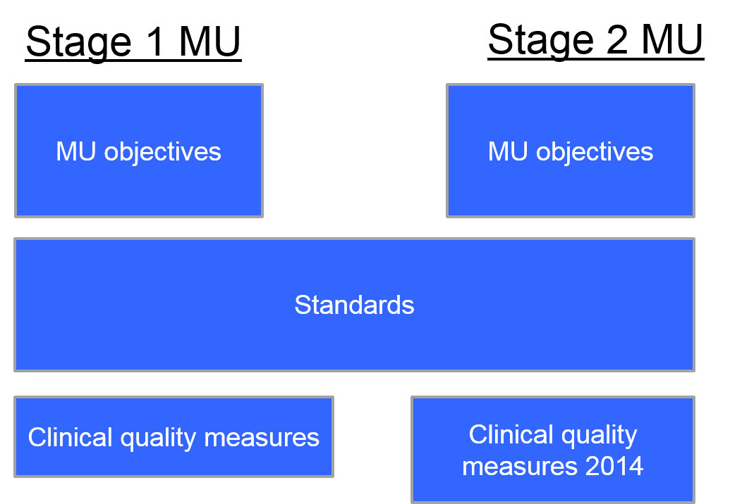
MU Stages 1-2 Overview
10.1 Figure. MU stages 1-2 overview.
Notes:
Here is another way of looking at Stages 1 and 2. Each of these stages had its specific objectives, the standards that needed to be used to achieve those objectives, and the clinical quality measures - both the original CQMs and the 2014 update.

Slide 8
MU Modified Stage 2 and Stage 3
Objectives finalized in 2015
Stages 1-2 combined into Modified Stage 2, required from 2015-2017
EPs and EHs can attest to Stage 3 starting in 2017
Uncertainty due to Medicare Access & CHIP Reauthorization Act (MACRA) of 2015 - combine all CMS quality programs, including MU, into a single program
(O’Neill, 2015)
Notes:
In 2015, the rules for Modified Stage 2 and for Stage 3 were released.
Modified stage 2, in essence, combined the original Stages 1 and 2, so any EP or EH just starting down the meaningful use road, or still in Stage 1, now had to meet the objectives of Modified Stage 2, through 2017.
Starting in 2017, eligible professionals and eligible hospitals can begin attesting to Stage 3.
Today there is some uncertainty over the future of the meaningful use program due to the Medicare Access and CHIP Reauthorization Act, or MACRA, that was passed by Congress in 2015. MACRA calls for combining all CMS quality programs, including meaningful use, into a single program, so it's possible that meaningful use will change further in the year or two ahead. But for now, this is how the stages of meaningful use must be met to become eligible for or maintain eligibility in the meaningful use program. We will talk more about the future of the meaningful use program at the end of the last lecture.

Slide 9
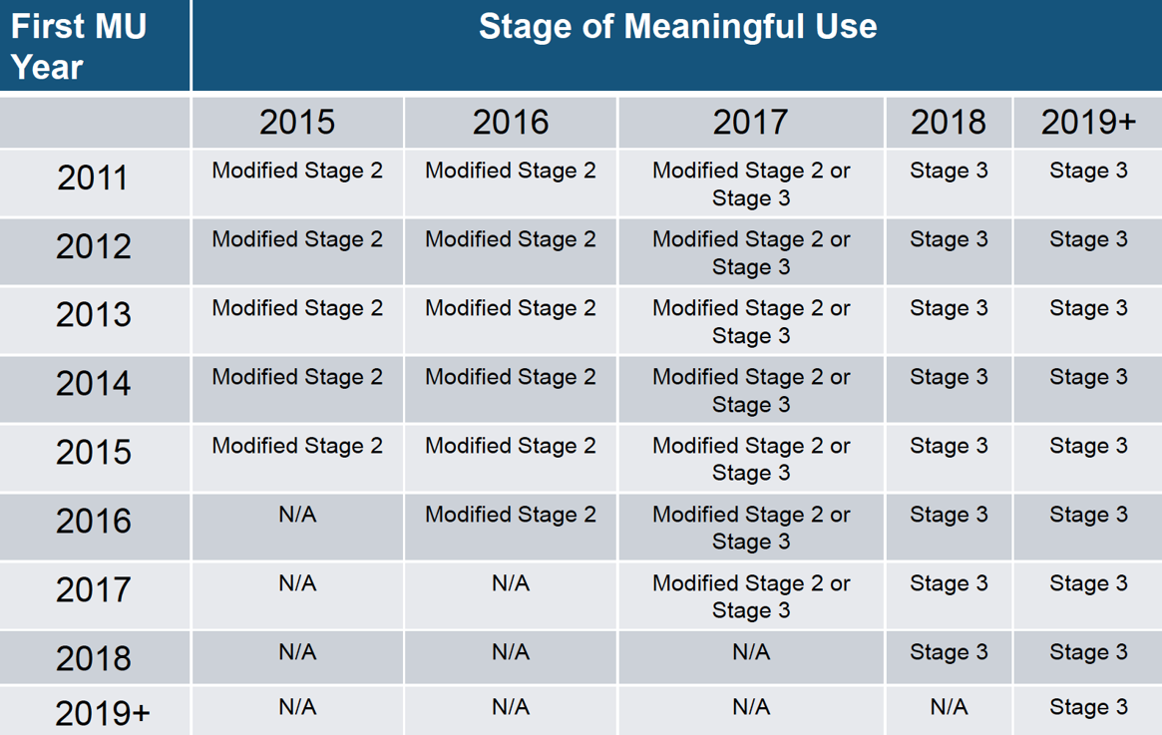
Stages 2-3 Going Forward
10.1 Table. Stages 2-3 Going Forward. Table reprinted from Centers for Medicare & Medicaid Services, n.d., retrieved September 28, 2016, from https://www.cms.gov/Regulations-and-Guidance/Legislation/EHRIncentivePrograms/index.html
Notes:
As seen in the table on this slide, everyone already in meaningful use should be in Modified Stage 2. Those starting in 2016 and 2017 would start in Modified Stage 2. In 2017 they could actually start in Stage 3. By 2018, everyone should be in Stage 3, although this is all subject to any changes that might come from the MACRA legislation.

Slide 10
Original Stages 1-2 MU – 1
Stage 1
  EPs must meet 15 core and 5 of 10 menu objectives
  EHs must meet 14 core and 5 of 10 menu objectives
  For EPs and EHs, one menu objective must be a public health measure
Stage 2
  EPs must meet 17 core and 3 of 6 menu objectives
  EHs must meet 16 core and 3 of 6 menu objectives
(Blumenthal & Tavenner, 2010; Metzger, 2012)
Notes:
Let's go back to the original Stages 1 and 2. In Stage 1, eligible professionals had to meet 15 core and 5 of 10 menu objectives. Eligible hospitals had to meet 14 core and 5 of 10 menu objectives. These were essentially the same, although hospitals were not required to carry out electronic prescribing, since they tended to prescribe within their hospital by their computerized provider order entry systems. It was also specified that for eligible professionals and eligible hospitals, one of the menu objectives needed to be a public health measure.
In Stage 2, some of the measures were consolidated and some new ones were added. Now, eligible professionals had to meet 17 core and 3 of 6 menu objectives, and eligible hospitals had to meet 16 core and 3 of 6 menu objectives.

Slide 11
Original Stages 1-2 MU – 2
Most EPs and EHs met Stage 1
Stage 2 has proven more difficult
(Blumenthal & Tavenner, 2010; Metzger, 2012)
Notes:
Stage 1 requirements were achievable by most eligible professionals and eligible hospitals. Stage 2 requirements proved more difficult for many eligible professionals and eligible hospitals to meet.

Slide 12
Stage 1 MU – Core Objectives
Computerized provider order entry (CPOE)
E-Prescribing (eRx)
Report ambulatory clinical quality measures to CMS/ States
Implement one clinical decision support rule
Provide patients with an electronic copy of their health information, upon request
Provide clinical summaries for patients for each office visit
Drug-drug and drug-allergy interaction checks
Record demographics
Maintain up-to-date problem list of current and active diagnoses
Maintain active medication and medication allergy lists
Record and chart changes in vital signs
Record smoking status for patients 13 years or older
Capability to exchange key clinical information among providers of care and patient-authorized entities electronically
Protect electronic health information
Notes:
This slide shows the original core objectives for Stage 1 of meaningful use. You can see the various objectives, such as recording demographics, problem lists, medication lists, and allergy lists. Also required was providing clinical summaries. Another requirement was using, to a certain level, computerized provider order entry, or CPOE, implementing clinical decision support, carrying out a security risk analysis, and reporting clinical quality measures. This was the Stage 1 of meaningful use that the early meaningful use program participants had to achieve to get their first payments under the HITECH Act.

Slide 13
Stage 1 MU – Menu Objectives - 1
For EPs and EHs
  Drug-formulary checks
  Incorporate clinical lab test results as structured data
  Generate lists of patients by specific conditions
  Medication reconciliation
  Summary of care record for each transition of care/referrals
  Use certified EHR technology to identify patient-specific education resources and provide to patient, if appropriate
  Capability to submit electronic data to immunization registries/systems
  Capability to provide electronic syndromic surveillance data to public health agencies
Notes:
This slide lists the menu objectives for Stage 1. The objectives common to both eligible professionals and eligible hospitals are at the top of the list…

Slide 14
Stage 1 MU – Menu Objectives - 2
For EPs only
  Send reminders to patients per patient preference for preventive/follow up care
  Provide patients with timely electronic access to their health information
For EHs only
  Record advanced directives for patients 65 years or older
  Capability to provide electronic submission of reportable lab results to public health agencies
Notes:
…then there are a couple that are specific to eligible professionals and another couple that are specific to eligible hospitals.

Slide 15
Stage 2 Changes from Stage 1 - 1
Consolidated some objectives, raised threshold for others, and added some new ones
Patient engagement
  A core objective required 50% of patients (or authorized representatives) be given access to health information and 5% actually viewing, downloading, or transmitting information to a third party
Notes:
Moving on to Stage 2, there were changes from Stage 1. Some objectives were consolidated, some objective thresholds were raised, and seven objectives were added around patient engagement and health information exchange. One of the new core objectives required that 50% of patients or their authorized representative be given access to health information and, of those, 5% had to view, download, or transmit health information to a third party.

Slide 16
Stage 2 Changes from Stage 1 - 2
HIE
  Certified EHRs must be capable of supporting Direct protocol
  A menu objective required exchange of clinical care summaries for 10% of encounters
Notes:
For health information exchange, the certification process now required supporting the Direct protocol of point-to-point secure transmission of information and a new menu objective required the exchange of clinical care summaries for 10 percent of all patient encounters.

Slide 17
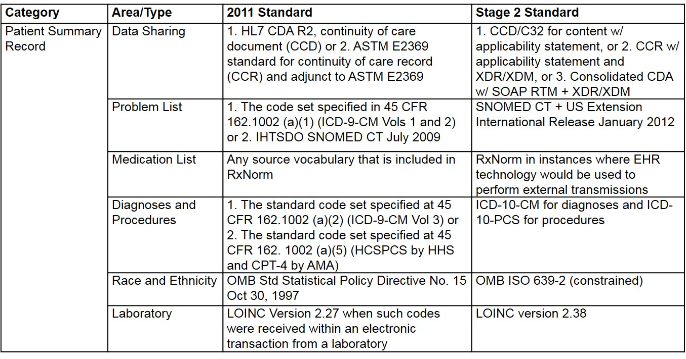
Standards for Stages 1 and 2 – 1
10.2 Table. Standards for Stages 1 and 2 . Data from Metzger, 2012.
Notes:
As noted before, there have also been standards specified to achieve meaningful use. There were standards in the original Stage 1 of meaningful use and then in the new Stage 2. The tables on this and the next two slides show the types of standards required for meaningful use. For example the patient summary record had to use the Continuity of Care Document, or CCD. The problem list needed to be in SNOMED CT, the medication list must be in RxNorm, diagnoses and procedures must be in ICD-10, and laboratory results must be in LOINC.

Slide 18
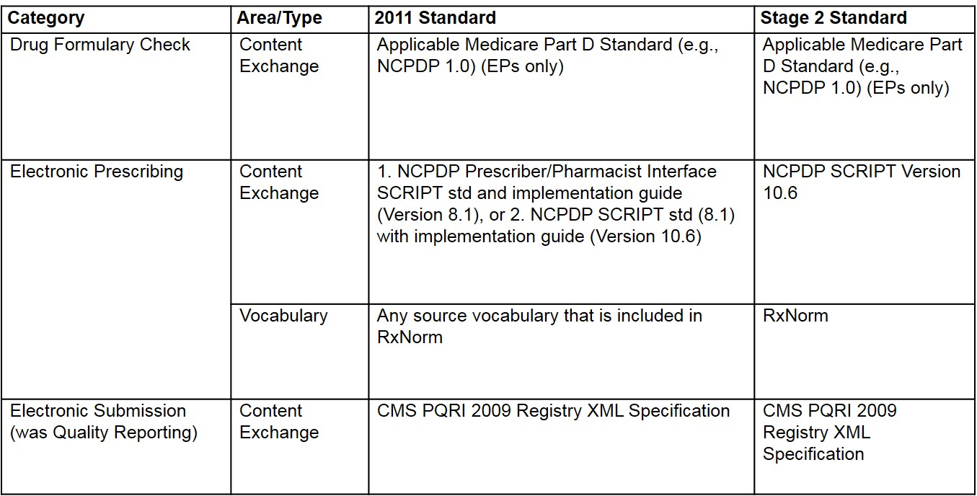
Standards for Stages 1 and 2 – 2
10.3 Table. Standards for Stages 1 and 2 . Data from Metzger, 2012.
Notes:
Some of the prescribing functions use standards such as NCPDP and RXNorm. The electronic submission for quality reporting required certain formats from CMS.

Slide 19
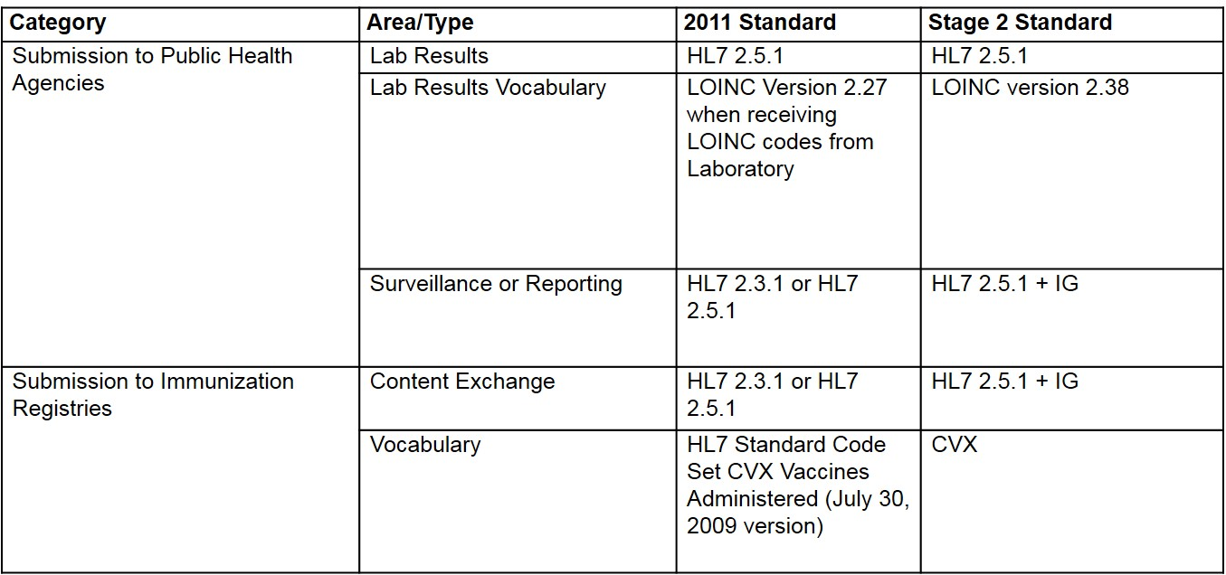
Standards for Stages 1 and 2 – 3
10.4 Table. Standards for Stages 1 and 2 . Data from Metzger, 2012.
Notes:
There were also standards required for various public health functions, whether lab results, surveillance, or immunization registry reporting. For these, various versions of HL7 were required.

Slide 20
Additional Standards for Stage 2 - 1
Amendments: To support HIPAA compliance, EHR must accept patient-supplied information in both free text and scanned format and append/amend EHR
Encryption of data on end-user devices: any electronic health information on end-user devices must encrypt such information when it is no longer being actively used
Notes:
There were additional standards for Stage 2. One concerned amendments to the EHR required to support HIPAA compliance, with the patient being able to supply information either in free text or scanned format that could be appended to the EHR. Another was the need for the encryption of data on end-user devices, such as computers and mobile devices.

Slide 21
Additional Standards for Stage 2 - 2
View, download, and transmit to third party
  EHR must be able to:
    Transmit ambulatory and inpatient summary to a third party
    Include “patient accessible log” to track use of the view, download, and transmit capabilities and make that information available to the patient
Notes:
For the process of viewing, downloading, and transmitting to a third-party, the EHR had to be able to transmit either an ambulatory summary or inpatient summary, and also had to include a log that would track the viewing, downloading, and transmitting, with the patient required to have access to that log if they wanted to view it.

Slide 22
Additional Standards for Stage 2 - 3
Transitions of care:
  EHR must be able to:
    Receive, display, and incorporate transition of care/referral summaries
    Create and transmit transition of care/referral summaries
Notes:
Finally, for transitions of care, there was a requirement for the ability to receive, display, and incorporate summaries, as well as to create and transmit them.

Slide 23
Stage 2 Common Data Set for Summary Care Record
Patient Name
Sex
Date of Birth
Race
Ethnicity
Preferred language
Smoking Status
Problems
Medication List
Medication Allergies
Laboratory test(s)
Laboratory value(s)/result(s)
Vital signs: height, weight, blood pressure, BMI
Care plan field(s), including goals and instructions
Procedures
Care team member(s)
Notes:
Stage 2 also specified a common data set for the summary care record. This was the minimum amount of information that could be included in a patient’s transmitted summary care record. The elements of the data set are listed on this slide.

Slide 24
Stage 2 Required Privacy/
Security - 1
Encryption/Decryption
  Any approved algorithm in FIPS 140-2
  HIE requires encryption and integrity-protected link
Record actions
  Date, time, patient, and user recorded for creation, modification, access, and deletion
Notes:
Stage 2 also introduced some privacy and security measures. One was specifications around algorithms for encryption and decryption, with any information transmitted through the HIE, needing to be encrypted, and the sender and receiver needing to be integrity protected. Another rule was that all accesses and modifications needed to have certain information collected, such as the date, time, patient, and user.

Slide 25
Stage 2 Required Privacy/
Security - 2
Verification of no alteration in transit
  SHA-1 algorithm or stronger, as specified in FIPS 180-3
Record TPO disclosures
  Date, time, patient, and user recorded for HIPAA-allowed activities
Notes:
Also, various algorithms had to verify that information was not altered in transit.
Another was that all disclosures, including treatment, payment, and operations, or TPO, disclosures, needed to be recorded as well.

Slide 26
Modified Stage 2 Overview - 1
Protect Patient Health Information: Protect electronic health information created or maintained by the CEHRT through the implementation of appropriate technical capabilities
Clinical Decision Support (CDS): Use clinical decision support to improve performance on high priority health conditions
Notes:
Modified Stage 2 consolidates many of the meaningful use criteria from Stages 1 and 2. The major categories are listed on this slide and the eight slides that follow.
Patient health information must be protected by appropriate technical capabilities.
Clinical decision support must be used and applied to a group of priority health conditions.

Slide 27
Modified Stage 2 Overview - 2
Computerized Provider Order Entry (CPOE): Use computerized provider order entry for medication, laboratory, and radiology orders directly entered by any licensed healthcare professional who can enter orders into the medical record per state, local, and professional guidelines
Notes:
And CPOE must be used to a specified level.

Slide 28
Modified Stage 2 Overview - 3
Electronic Prescribing (eRx):
  EPs generate and transmit permissible prescriptions electronically
  EHs generate and transmit permissible discharge prescriptions electronically
Notes:
Also required is electronic prescribing, which means transmission of prescriptions electronically by EPs and of discharge prescriptions by EHs.

Slide 29
Modified Stage 2 Overview - 4
Health Information Exchange (HIE):
  The EP or EH that transitions their patient to another setting of care or provider of care or refers their patient to another provider of care provides a summary care record for each transition of care or referral
Notes:
Modified Stage 2 also requires the capability to carry out health information exchange for the summary of care record.

Slide 30
Modified Stage 2 Overview - 5
Patient Specific Education: Use clinically relevant information from CEHRT to identify patient specific education resources and provide those resources to the patient
Notes:
Additional criteria include the use of certified EHR technology to provide educational resources to patients

Slide 31
Modified Stage 2 Overview - 6
Medication Reconciliation: The EP or EH that receives a patient from another setting of care or provider of care or believes an encounter is relevant performs medication reconciliation
Notes:
Another Modified Stage 2 criterion is the ability to perform medication reconciliation.

Slide 32
Modified Stage 2 Overview - 7
Patient Electronic Access:
  EPs provide patients the ability to view online, download, and transmit their health information within 4 business days of the information being available to the EP
  EHs provide patients the ability to view online, download, and transmit their health information within 36 hours of hospital discharge.
Notes:
The Modified Stage 2 criteria also include providing patients with electronic access to their health information…

Slide 33
Modified Stage 2 Overview - 8
Secure Electronic Messaging:
  EPs use secure electronic messaging to communicate with patients on relevant health information
Notes:
…and the use of secure electronic messaging.

Slide 34
Modified Stage 2 Overview - 9
Public Health Reporting: The EP or EH is in active engagement with a public health agency to submit electronic public health data from CEHRT, except where prohibited and in accordance with applicable law and practice
Notes:
Finally, Modified Stage 2 requires appropriate reporting to public health agencies.

Slide 35
Meaningful Use
Summary – Lecture b
The original Stages 1 and 2 of meaningful use have given way to Modified Stage 2 for 2015-2017 and Stage 3 thereafter
Stage 2 of meaningful use added a number of standards, a common data set, and requirements for privacy and security
Notes:
This concludes lecture b of the unit on Meaningful Use.
To summarize this lecture:
The original Stages 1 and 2 of meaningful use have given way to Modified Stage 2 for 2015 through 2017, and Stage 3 thereafter
Stage 2 of meaningful use added a number of standards, a common data set, and requirements for privacy and security

Slide 36
Meaningful Use
References – Lecture b - 1
References
Blumenthal, D., & Tavenner, M. (2010, August 5). The "Meaningful Use" Regulation for Electronic Health Records. The New England Journal of Medicine, 501-504. doi:10.1056/NEJMp1006114
Electronic Health Records (EHR) Incentive Programs. (n.d.). Retrieved February 1, 2017, from https://www.cms.gov/Regulations-and-Guidance/Legislation/EHRIncentivePrograms/index.html
Metzger, J., & Rhoads, J. (2012, November 28). Summary of Key Provisions in Final Rule for Stage 2 HITECH Meaningful Use. Retrieved February 1, 2017, from http://docplayer.net/12471625-Hitech-meaningful-use.html
O'Neill, T. (2015, October 28). Primer: EHR Stage 3 Meaningful Use Requirements. Retrieved February 1, 2017, from https://www.americanactionforum.org/research/primer-ehr-stage-3-meaningful-use-requirements/
Notes:
No Audio.

Slide 37
Meaningful Use
References – Lecture b - 2
Charts, Tables, Figures
10.1 Figure. MU Stages 1-2 Overview
10.1 Table. Stages 2-3 Going Forward. Table reprinted from Centers for Medicare & Medicaid Services, n.d., retrieved February 1, 2017, from https://www.cms.gov/Regulations-and-Guidance/Legislation/EHRIncentivePrograms/index.html
10.2 Table. Standards for Stages 1 and 2 . Data from Metzger, 2012.
10.3 Table. Standards for Stages 1 and 2 . Data from Metzger, 2012.
10.4 Table. Standards for Stages 1 and 2 . Data from Metzger, 2012.
Notes:
No Audio.

Slide 38
Introduction to Health Care and Public Health in the U.S.
Meaningful Use
Lecture b
This material was developed by Oregon Health & Science University, funded by the Department of Health and Human Services, Office of the National Coordinator for Health Information Technology under Award Number 90WT0001.
Notes:
No Audio.

