Slide 1
Introduction to Health Care and
Public Health in the U.S.
Meaningful Use
Lecture a
This material (Comp 1 Unit 10) was developed by Oregon Health & Science University, funded by the Department of Health and Human Services, Office of the National Coordinator for Health Information Technology under Award Number 90WT0001.
This work is licensed under the Creative Commons Attribution-NonCommercial-ShareAlike 4.0 International License. To view a copy of this license, visit http://creativecommons.org/licenses/by-nc-sa/4.0/.
Notes:
Welcome to Introduction to Health Care and Public Health in the U.S.: Meaningful Use. This is Lecture a.
This component, Introduction to Health Care and Public Health in the U.S., is a survey of how health care and public health are organized and how services are delivered in the U.S. It covers public policy, relevant organizations and their interrelationships, professional roles, legal and regulatory issues, and payment systems. It also addresses health reform initiatives in the U.S.

Slide 2
Meaningful Use
Learning Objectives - 1
Define meaningful use (MU) of health information technology in the context of the Health Information Technology for Economic and Clinical Health (HITECH)
Act (Lecture a)
Describe the major goals of meaningful use (Lecture a)
Notes:
The objectives for this unit, Meaningful Use, are to:
Define meaningful use, or MU, of health information technology in the context of the Health Information Technology for Economic and Clinical Health, or HITECH, Act
Describe the major goals of meaningful use

Slide 3
Meaningful Use
Learning Objectives - 2
Discuss the criteria for Stages 1-3 of meaningful use for eligible professionals, eligible hospitals, and critical access hospitals (Lecture b)
Describe the standards specified for MU (Lectures b and c)
Discuss the likely evolution of the MU program
Notes:
Discuss the criteria for Stages 1 through 3 of meaningful use for eligible professionals, eligible hospitals, and critical access hospitals
Describe the standards specified for meaningful use
And, discuss the likely evolution of the meaningful use program

Slide 4
HITECH and Achieving
Meaningful Use
HITECH Act of the American Recovery and Reinvestment Act (ARRA) (Blumenthal, 2010; Blumenthal, 2010)
Notes:
In this lecture, we begin our discussion of the HITECH Act. The HITECH Act was part of the American Recovery and Reinvestment Act, or ARRA. ARRA was the economic stimulus legislation passed as one of the first acts of the presidency of Barack Obama.

Slide 5
HITECH Act of ARRA
Incentives for “meaningful use” (MU) of the electronic health record (EHR) by physicians and hospitals (up to $27B)
Direct grants administered by federal agencies ($2B)
“Enhancements” to Health Insurance Portability and Accountability Act (HIPAA) Privacy and Security Rules
Notes:
The HITECH Act provided up to 27 billion dollars in incentives for the meaningful use of the electronic health record, or EHR by physicians and other health care professionals, as well as hospitals.
In addition, HITECH included direct grants administered by federal agencies, and enhancements to the privacy law called the Health Insurance Portability and Accountability Act, or HIPAA.

Slide 6
Meaningful Use
Driven by health care system’s underlying goals
Conceptually originated in legislation by Stark (2010)
Notes:
Although meaningful use consists of specific criteria that must be achieved to obtain the incentive funding available under the HITECH act, the meaningful use criteria are driven by underlying goals for the health care system. The notion of meaningful use as a concept originated in legislation sponsored by Representative Rodney Pete Stark. This legislation was not passed when it was originally introduced in 2008, but was then incorporated into the ARRA legislation of 2010.

Slide 7
Meaningful Use Criteria
All MU criteria must “map” to one or more of five goals for the health care system
  Improving quality, safety, and efficiency
  Engaging patients in their care
  Increasing coordination of care
  Improving the health status of the population
  Ensuring privacy and security
Notes:
The idea is that all meaningful use criteria must map to one or more of five goals for the health care system. These goals are:
Improving quality, safety, and efficiency;
Engaging patients in their care;
Increasing coordination of care;
Improving the health status of the population;
And ensuring privacy and security.

Slide 8
Meaningful Use Examples
Implementing drug-drug interaction checks leads to improved quality, safety, and efficiency
Providing summary of care to patients leads to engaging patients in their own health care
Notes:
Some examples of meaningful use criteria and their mapping to the five goals for the health care system follow:
Implementing drug-to-drug interaction checks is a criterion that maps to the goal of improving quality, safety, and efficiency.
Likewise, providing a summary of care to patients maps to the goal of engaging patients in their care.

Slide 9
Overall Requirements for MU
Use certified EHR technology in a meaningful manner
Use certified EHR technology connected in a manner that provides for health information exchange
Using certified EHR technology, the provider submits information on clinical quality measures
Notes:
The overall requirements for meaningful use that come from the HITECH Act are that to obtain funding, the eligible professional or hospital must use certified EHR technology in a meaningful manner.
They must use certified EHR technology connected in a manner that provides for health information exchange.
And, they must also use certified EHR technology to submit information on clinical quality measures.

Slide 10
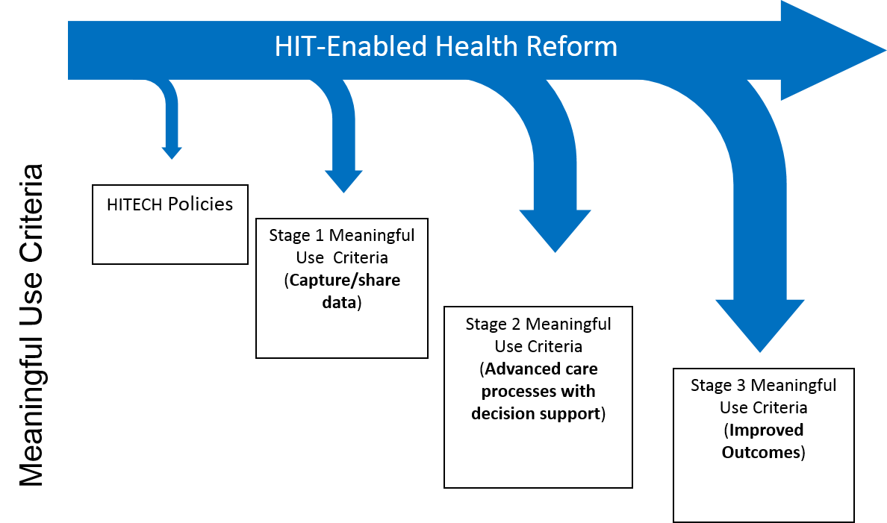
Three-Stage Implementation
Adapted from https://www.cms.gov/Regulations-and-Guidance/Legislation/EHRIncentivePrograms/downloads/MU_Stage1_ReqOverview.pdf
Notes:
The overall plan for implementing meaningful use was that it would be done in three stages, all as part of health IT-enabled health care reform.
Stage 1 would focus on the capturing and sharing of data, and we’ll see that from the criteria.
Stage 2 would focus on advanced care processes with decision support, while the goal of Stage 3 will be to focus on improved outcomes. The details of Stage 3 have not yet been finalized.

Slide 11
Qualified EHR - 1
A qualified EHR is an electronic record of health-related information on an individual that:
  Includes patient demographic and clinical health information, such as medical history and problem lists
Notes:
A qualified EHR is one that is able to carry out the functions required for meaningful use. In other words, an electronic record of health-related information about an individual that includes patient demographic and clinical health information, such as medical history and problem lists.

Slide 12
Qualified EHR - 2
A qualified EHR is an electronic record of health-related information on an individual that:
  Provides clinical decision support
  Supports physician/provider order entry
  Captures and query information relevant to health care quality
  Exchanges electronic health information with, and integrate such information from, other sources
Notes:
A qualified EHR also has the capacity to:
Provide clinical decision support,
Support physician or provider order entry,
Capture and query information relevant to health care quality, and
Exchange electronic health information with, and integrate such information from, other information sources.

Slide 13
Implementation - 1
Implemented through increased Medicare or Medicaid reimbursement to
  Eligible Professionals (EPs)
    Medicare: MD, DO, DDS/DMD, DPM, OD, DC
    Medicaid: MD, DO, DDS/DMD, Certified Nurse Midwives, Nurse Practitioners, Physicians Assistants operating at an FQHC/RHC
    Hospital-based EPs not eligible (>90% service in hospital, e.g., pathologist, emergency physician)
Notes:
The meaningful use program provides reimbursement to eligible professionals and eligible hospitals through the Medicare and Medicaid programs. Each program has slightly different rules.
Under Medicare, eligible professionals include MDs, DOs, dentists, podiatrists, optometrists, and chiropractors.
Under Medicaid, the list of eligible professionals is expanded to include certified nurse midwives, nurse practitioners, and physician assistants operating in certain health care environments.
One thing to note is that while hospital-based professionals, such as physicians who perform more than 90% of their service in a hospital, are not eligible for funding under the eligible professionals program, the organizations they work for are eligible for funding under the eligible hospitals program.

Slide 14
Implementation - 2
Implemented through increased Medicare or Medicaid reimbursement to:
  Eligible Hospitals (EHs)
    Medicare: Acute Care Hospitals, Critical Access Hospitals (CAHs)
    Medicaid: Acute Care Hospitals, CAHs, Children’s Hospitals
    Within the 50 states and D.C.
Various differences in Medicare vs. Medicaid for amount reimbursed, rules, and other aspects
Notes:
Eligible hospitals include acute care hospitals, which are the majority of hospitals in the United States, as well as critical-access hospitals that provide care in mainly rural areas under Medicaid. Children's hospitals are also included.
Unlike eligible professionals, who are eligible anywhere in the territories of the United States, the eligible hospitals program is available only to hospitals within the 50 states and the District of Columbia.
There are various other differences in whether the incentive funding is provided through Medicare or Medicaid in terms of the amount reimbursed, the rules, and some other aspects.

Slide 15
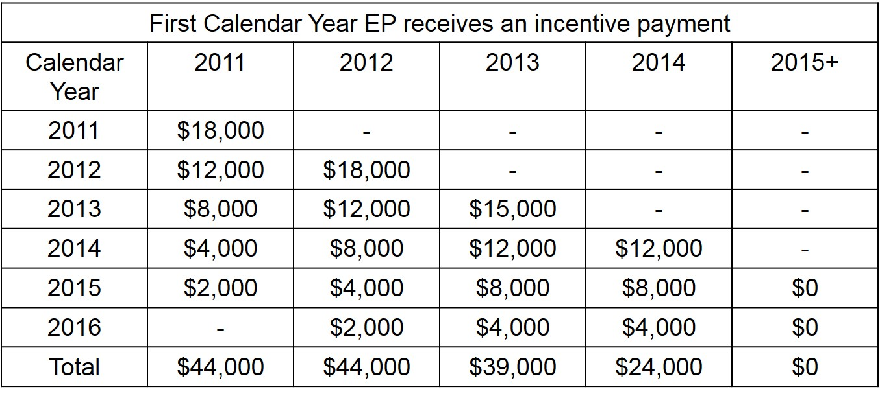
Payment for Medicare EPs
Starting in 2015, would face penalties increasing 1% per year up to 5% total for not meeting MU criteria
https://www.cms.gov/Regulations-and-Guidance/Legislation/EHRIncentivePrograms/Downloads/MLN_MedicareEHRProgram_TipSheet_EP.pdf
Notes:
The table on this slide shows the payment plan for eligible professionals paid under Medicare. The rows of the table indicate the calendar year of the payment being made. The columns of the table indicate when the incentive payment started, after meaningful use was achieved.
For those EPs who started in the very first year, 2011, they received $18,000 the first year and $12,000 the second year, then $8,000, $4,000, and $2,000 for a total of $44,000, which is the maximum.
EPs starting in 2012 were also able to receive the maximum.
Those EPs who started later, in 2013 and in 2014, were not able to receive the full $44,000, but still received some incentive payments.
However, starting in 2015, EPs who did not meet the meaningful use criteria, started to be penalized at 1% per year and increasing another 1% each year up to a 5% total.

Slide 16
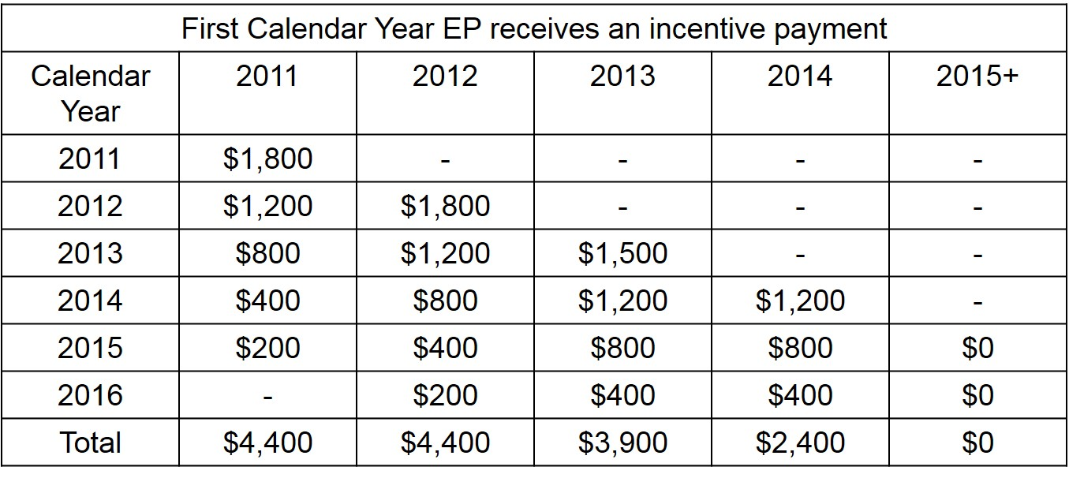
Additional Payment for Medicare EPs in Health Professional Shortage Areas
These EPs can receive up to $48,400
https://www.cms.gov/Regulations-and-Guidance/Legislation/EHRIncentivePrograms/Downloads/MLN_MedicareEHRProgram_TipSheet_EP.pdf
Notes:
Eligible professionals who are paid under Medicare and are practicing in Health Professional Shortage Areas received a 10% boost. In other words, they can receive up to an additional $4,400, or as much as $48,400 in total.

Slide 17
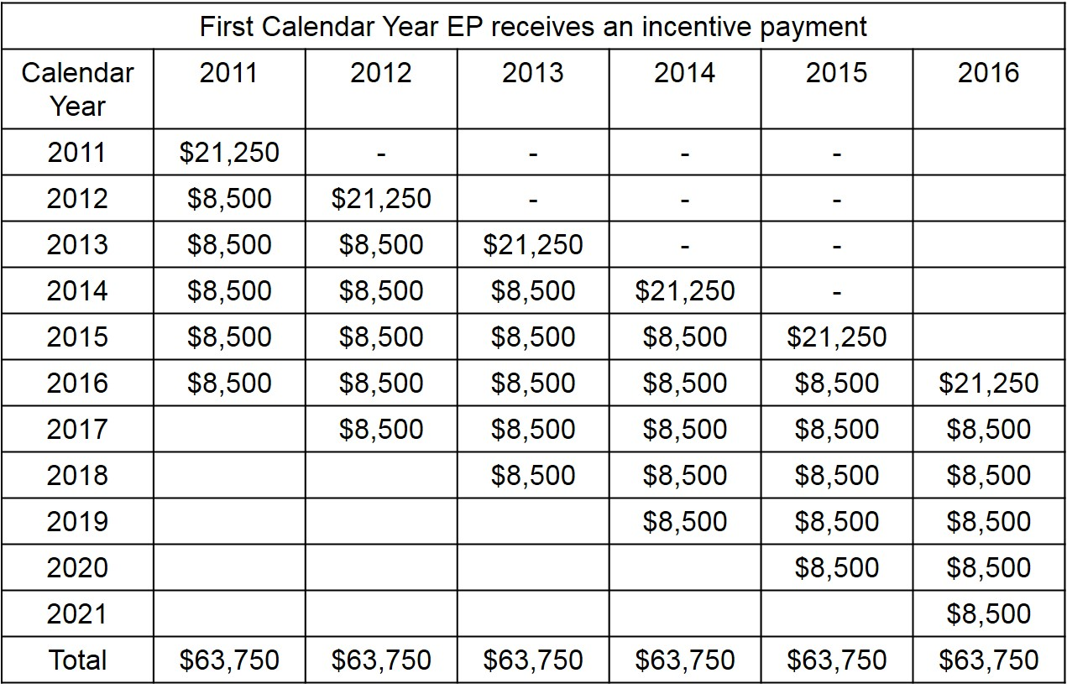
Payment for Medicaid EPs
https://www.cms.gov/Regulations-and-Guidance/Legislation/EHRIncentivePrograms/Downloads/MLN_MedicaidEHRProgram_TipSheet_EP.pdf
Notes:
The payment of eligible professionals under Medicaid is different. These individuals receive a much larger amount of money both overall and in the first year. They get $21,250 in the first year and then $8,500 for up to five years after that, and they get the full amount even if they qualify as late as 2016.

Slide 18
Payment for EHs - 1
More complex, depending on:
  Funding from Medicare vs. Medicaid
  Hospital type
  Share of patients in Medicare and Medicaid
Multi-campus hospitals count as one EH
Notes:
The payment for eligible hospitals is a little more complex and depends on whether the funding comes through Medicare or Medicaid, the hospital type, and the share of patients in Medicare or Medicaid.
One controversial aspect to this rule was that multi-campus hospitals were counted as if they were a single hospital.

Slide 19
Payment for EHs - 2
General formula is that payment is multiplication of:
  Initial amount: $2M + $200 per discharge for 1,150th to 23,000th discharge (maximum for 21,850 discharges is
  $2M + $4.37M = $6.37M)
  Medicare or Medicaid share
  Transition factor: 1.0, 0.75, 0.5, and 0.25 over four years, depending on eligibility date
Notes:
An overview of the general formula for payments is listed here. There is a base amount of $2 million for an eligible hospital, and then an incremental amount of money per discharge, starting at the 1,150th patient for a given year, up to 23,000 patients. This means that the maximum for 21,850 discharges would be $2 million dollars for the base and $4.37 million dollars, resulting in a maximum payment of $6.37 million dollars.
The money is then multiplied by the Medicaid or Medicare share that the hospital has. There is also a transition factor, with the full amount being paid in the first year, three quarters in the second year, half in the third year, and a quarter in the fourth year. Payment starts when the hospital becomes eligible, with no penalty for starting later.

Slide 20
Connecting CMS and ONC Rules - 1
CMS Rules
Payment Entity
Incentives
Notes:
Another aspect of the rules for meaningful use was the connection of the rules from the Centers for Medicare and Medicaid Services, or CMS, as the payment entity…

Slide 21
Connecting CMS and ONC Rules - 2
CMS Rules
Payment Entity
Incentives
ONC Rules
Standards Setter
Implementation Specifications
Certification Criteria
Notes:
…and the Office of the National Coordinator, or ONC, as the standards setter.

Slide 22

Connecting CMS and ONC Rules - 3
HITECH Act’s requirement for MU of certified EHR technology
CMS Rules
Payment Entity
Incentives
ONC Rules
Standards Setter
Implementation Specifications
Certification Criteria
Notes:
The HITECH Act tied standards to implementation specifications and certification criteria adopted in the ONC rules to the incentives under the CMS rules by requiring meaningful use of certified EHR technology.

Slide 23
Connecting CMS and ONC Rules - 4
ONC rules require specific standards in four areas:
  Vocabulary
  Content exchange
  Transporting of information
  Privacy and security
Notes:
The required standards from ONC are in the areas of vocabulary, content exchange, transporting of information, and privacy and security.

Slide 24
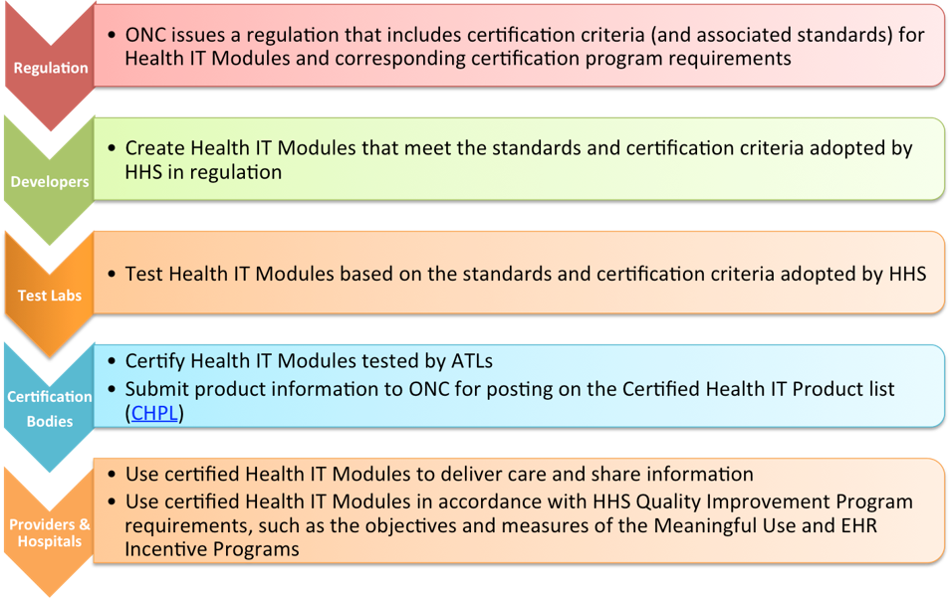
EHR Certification
Description of ONC Health IT Certification Program: https://www.healthit.gov/policy-researchers-implementers/onc-health-it-certification-program
List of certified EHR products
https://www.healthit.gov/policy-researchers-implementers/certified-health-it-product-list-chpl
Notes:
Recall that to be eligible for meaningful use funding, use of certified EHRs is required. A more detailed description of the ONC Health IT certification program is available on the healthit.gov website and includes a list of certified EHR products.
The complete links can be found in the References section of this lecture.
There are then Accredited Testing and Certification Bodies that test and then certify EHR products based on the ONC standards.
The ONC then posts the list of certified EHR products to their certified health IT product list.
Finally, eligible professionals and eligible hospitals use the EHR products in accordance with the meaningful use objectives and measures, attest to that, and collect their incentive payments from CMS.

Slide 25
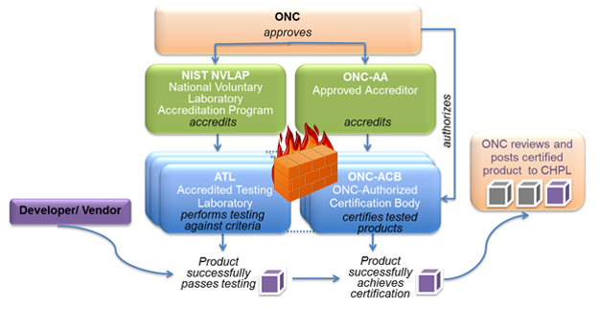
EHR Certification Process
Test procedures for EHR certification
https://www.healthit.gov/policy-researchers-implementers/permanent-certification-program-faqs
Notes:
The EHR certification process actually requires two steps: the testing of the system and then the actual certification. There is a firewall between the testing process and the certification process, but when that process is completed, the product is posted to the certified health IT product list. The detailed test procedures for EHR certification are also listed on the ONC website; they are organized around each of the meaningful use criteria. The complete web link is listed in the References section of this lecture.

Slide 26

How Does One Get the $$$?
Meet and report on the MU criteria!
Medicaid exceptions
  In first year, EP/EH can demonstrate they adopted, implemented, or upgraded (A/I/U) a certified EHR
  Can “skip” years but must begin by 2016
https://www.cms.gov/Regulations-and-Guidance/Legislation/EHRIncentivePrograms/index.html?redirect=/EHRIncentivePrograms
Notes:
How does an organization get the meaningful use money? It has to meet and report on the meaningful use criteria.
There's actually one exception under Medicaid. In the first year of Medicaid funding, an eligible professional or eligible hospital can demonstrate that they adopted, implemented, or upgraded a certified EHR, so they don't necessarily need to meet all the meaningful use criteria. In that first year, as long as they've either adopted, implemented, or upgraded to a certified system, they will get the incentive dollars. Medicaid also allows for opting out of, or skipping, years but the adopting, implementing, or upgrading process must start by 2016. The link on this slide provides more detailed information on obtaining the funding from CMS.

Slide 27
Cost Estimate - 1
Depends on how many achieve MU!
CMS estimates of EPs and EHs at onset of program
  477,500 eligible as Medicare EP
    95,500 of these eligible as Medicaid EP
  44,100 eligible as Medicaid-only EP
  5,011 EHs
    3,620 acute care
    1,302 CAH
    78 children’s
    11 cancer
Notes:
How much is this all going to cost? Remember that this was part of the economic stimulus package, so the goal was to actually spend the money. The total cost of the program will depend on how many eligible professionals and eligible hospitals achieve meaningful use.
When the program was initially launched, CMS made estimates of eligible professionals and eligible hospitals and made calculations based on how many would achieve meaningful use and be eligible for the funding. CMS estimated there were about 477,500 eligible professionals under Medicare, with 95,500 of those also eligible under Medicaid, and another 44,100 eligible professionals under Medicaid only. CMS estimated that there would be slightly over 5,000 eligible hospitals, most of them acute-care but some number of them critical access hospitals, and a much smaller number children's and cancer hospitals.

Slide 28
Cost Estimate - 2
Estimated achievement of MU in ten years
  Low – 95.6% of EHs and 36% of EPs
  High – 100% of EHs and 70% of EPs
Total cost: $9.7B (low) to $27.4B (high)
  Total spent actually exceeds $27.4B
Notes:
CMS then made some calculations based on low and high estimated achievement of meaningful use in 10 years. Low achievement was defined to be 95.6% of eligible hospitals and 36% of eligible professionals, with high achievement being all eligible hospitals and 70% of eligible professionals. For low achievement, the program would cost $9.7 billion dollars. For high achievement, it would cost $27.4 billion. That's where the figure of $27 billion spent on the HITECH Act over its lifetime comes from. We will see in subsequent lectures that the number has actually exceeded that figure.

Slide 29
Meaningful Use
Summary – Lecture a
The goal of the HITECH Act is to provide incentive for the adoption of EHRs by eligible physicians and hospitals
Eligibility for HITECH Act incentives is provided by meeting the criteria for meaningful use through the use of a certified EHR
The criteria for meaningful use are met in three stages
Notes:
This concludes lecture a of the unit on Meaningful Use.
In summarizing this lecture,
The goal of the HITECH Act is to provide incentives for the adoption of EHRs by eligible professionals and hospitals
Eligibility for HITECH Act incentives is provided by meeting the criteria for meaningful use through the use of a certified EHR
And, the criteria for meaningful use are met in three stages

Slide 30
Meaningful Use
References – 1 – Lecture a
References
  Blumenthal, D (2010). Launching HITECH. New England Journal of Medicine. 362: 382-385.
  Blumenthal, D and Tavenner, M (2010). The “meaningful use” regulation for electronic health records. New England Journal of Medicine. 363: 501-504.
  Certified Health IT Product List (CHPL). (n.d.). Retrieved February 1, 2017, from https://chpl.healthit.gov/#/search
  Electronic Health Records (EHR) Incentive Programs. (n.d.). Retrieved February 1, 2017, from https://www.cms.gov/Regulations-and-Guidance/Legislation/EHRIncentivePrograms/index.html
  ONC Health IT Certification Program. (n.d.). Retrieved February 1, 2017, from https://www.healthit.gov/policy-researchers-implementers/onc-health-it-certification-program
  Resources FAQs. (n.d.). Retrieved February 1, 2017, from https://www.healthit.gov/policy-researchers-implementers/permanent-certification-program-faqs
  Stark, P (2010). Congressional intent for the HITECH Act. American Journal of Managed Care. 16: SP24-SP28.
Notes:
No Audio.

Slide 31
Meaningful Use
References – 2 – Lecture a
References
  From slide 10: https://www.cms.gov/Regulations-and-Guidance/Legislation/EHRIncentivePrograms/downloads/MU_Stage1_ReqOverview.pdf
  From slide 15, 16, 17, : https://www.cms.gov/Regulations-and-Guidance/Legislation/EHRIncentivePrograms/Downloads/MLN_MedicareEHRProgram_TipSheet_EP.pdf
Notes:
No Audio.

Slide 32
Introduction to Health Care and Public Health in the U.S.
Meaningful Use
Lecture a
This material was developed by Oregon Health & Science University, funded by the Department of Health and Human Services, Office of the National Coordinator for Health Information Technology under Award Number 90WT0001.
Notes:
No Audio.

