Slide 1
Introduction to Computer Science
Computer Hardware
Lecture c
This material (Comp 4 Unit 2) was developed by Oregon Health & Science University, funded by the Department of Health and Human Services, Office of the National Coordinator for Health Information Technology under Award Number 90WT0001.
This work is licensed under the Creative Commons Attribution-NonCommercial-ShareAlike 4.0 International License. To view a copy of this license, visit http://creativecommons.org/licenses/by-nc-sa/4.0/.
Notes:
Welcome to the Introduction to Computer Science: Computer Hardware. This is lecture c.
The component, Introduction to Computer Science, provides a basic overview of computer architecture; data organization, representation and structure; structure of programming languages; networking and data communication. It also includes the basic terminology of computing.

Slide 2
Computer Hardware
Learning Objectives - 1
Describe the major components of a computer system (Lectures a, b)
Provide examples of input and output devices used in health care (Lecture a)
Discuss primary and secondary storage devices (Lecture b)
Introduce binary notation and describe data representation, storage, and manipulation in binary format (Lecture b)
Notes:
The learning objectives for this unit, Computer Hardware, are to:
Describe the major components of a computer system
Provide examples of input and output devices used in health care
Discuss primary and secondary storage devices
Introduce binary notation and describe data representation, storage, and manipulation in binary format

Slide 3
Computer Hardware
Learning Objectives - 2
Introduce data types and explain how different data types are stored and addressed (Lecture c)
Describe the functionality of the central processing unit (CPU) (Lecture c)
Provide examples of CPUs designed for health care applications (Lecture c)
Notes:
Introduce data types and explain how different data types are stored and addressed
Describe the functionality of the central processing unit, or CPU
And, provide examples of CPUs designed for health care applications

Slide 4
Data Types
Predefined data characteristics
  Range of values that data can assume
  Programming language used for processing
  Operations that can be performed on the data
Determine how data is stored in memory
Processed by software based on its type
Common types of data:
  Integers: 12
  Floating point numbers: 3.14159265
  Characters: “a”
Notes:
In this lecture, we’ll be discussing various data types and how each is stored and addressed, and describing the functionality of the CPU in detail.
Data types are predefined data characteristics. They include the range of values data can assume, the programming language used for its processing, and the operations that can be performed on it.
Data types determine how data is stored in memory.
Data is processed by software based on its type.
Some common data types include integers, for example, the whole number 12; floating point numbers, for example, 3.14159265; and characters, for example, the letter a.

Slide 5
Storage of Different Data Types
Integers stored as binary numbers
  Use "two's complement" that allows for the storage of negative and positive integers
Floating point numbers stored as floating point notation, similar to scientific notation
  Still stored in binary
  Exponent and mantissa stored in binary
Characters stored in ASCII or Unicode
  Each character represented by a binary value (code)
Notes:
Let's look at how those three data types are stored in a computer’s memory.
Integers are stored as binary numbers, and they use something referred to as two's complement, which allows for the storage of negative and positive integers.
Floating-point numbers are stored as floating point notation, which is similar to scientific notation, with the exponent and mantissa stored in binary format.
Characters are stored in the American Standard Code for Information Exchange or ASCII format or Unicode format. Each character, again, is represented by a binary value.

Slide 6
Storage of the Characters
ASCII encodes every character by an 8-bit binary integer
  8-bit word “01000001” is mapped to character capital “A”
  8-bit word “01100001” is mapped to character lower case “a”
Notes:
ASCII encodes every character by an 8-bit binary integer.
The eight-bit word 0100 0001, is mapped to the English language alphabet character capital A. Notice that this is a capital “A,” not the lowercase “a” that is mapped to the eight-bit binary word 0110 0001.
Each keyboard character is assigned its own distinct eight-bit word by ASCII.

Slide 7
Data Addressing
Each piece of data is provided a physical memory address by the CPU
When data is used by a program or device, this physical address is used as its reference
Addresses start with the first character of the file and end with the file’s last character
Characters are strung together
Notes:
An operating system can locate data that is stored in primary or secondary storage.
When data is stored in primary or secondary storage, each piece of data is provided a physical memory address by the CPU. Whenever data is subsequently used by a program - for example, to open or save a file - or device - for example, a print request from the user - then this physical address is used as its reference.
File addresses start with the first character of the file and end with the file's last character. Characters in the file are strung together like railroad cars that make up a train, where each car knows its head and its tail.
The physical address is represented in hexadecimal, which allows the address to be represented in fewer digits than in binary; however, a full discussion of hexadecimal representation is beyond the scope of this lecture.

Slide 8
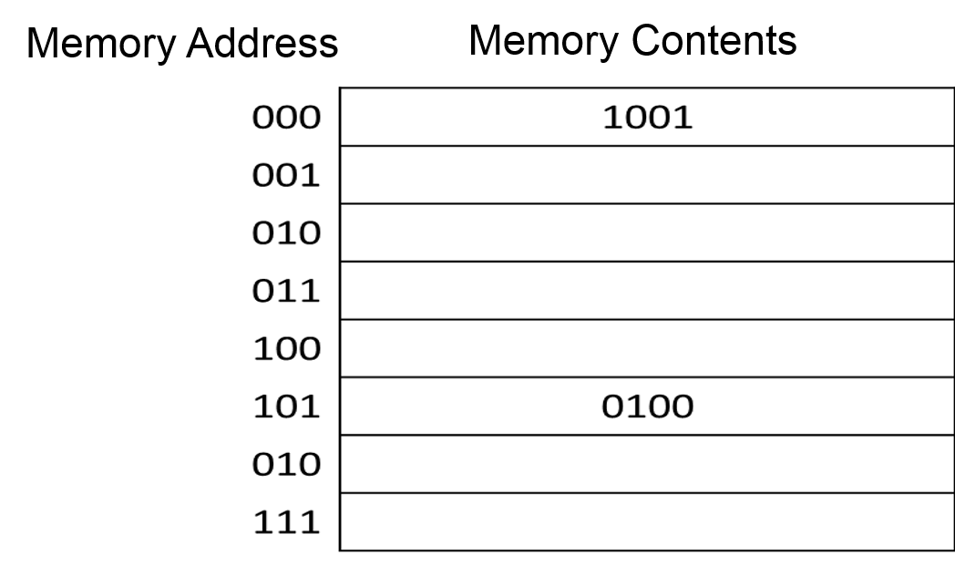
Data Addressing Example
Figure 4.1
(J. Blackwood, 2011, CC BY-NC-SA 3.0)
Notes:
Consider this example of data-addressing. The memory address 000 has the contents in binary of 1001.
In memory address 101, we have memory content in binary of 0100.

Slide 9
What is the CPU?
The most important computer component
  Interprets and executes instructions given by programs
  Computer’s “brain,” responsible for all operations
  Has its own memory called cache
Multi-core processor
  CPU with two or more actual processing units (known as “cores”) that act independently
  Modern motherboards support multiple processors
Notes:
Moving on to the second topic in this lecture, we will now discuss the central processing unit, or CPU. The CPU is the most important computer component. It interprets and executes instructions given by programs. The CPU is the brain of the computer and is responsible for the main operations of the entire computer system.
While all of the devices connected to a computer can typically send and receive information, they still need the CPU to process the information.
The CPU has its own small, very fast memory called the cache, which is usually implemented with synchronous dynamic RAM, or SD-RAM.
A multi-core processor is a CPU with two or more processing units, known as cores, that act independently. Also, multiple processors can be installed on modern motherboards.

Slide 10
CPU Functionality
Main function is to execute instructions
  Arithmetic instructions (addition, subtraction, multiplication, division, etc.)
  Load/store instructions (get values from memory/store values in memory)
  Branch instructions (move to another part of a program)
Notes:
The main function of the CPU is to execute instructions. These instructions are very simple, such as basic arithmetic operations like addition, subtraction, and multiplication.
Other instructions include load and store instructions, which retrieve values from memory or store values in memory.
The CPU also executes branch instructions, used to move from one part of a program to another part of a program.

Slide 11
CPU Components - 1
Arithmetic/Logic Unit (ALU)
  Performs arithmetic and logical operations
  Operands are stored in registers
  Some CPUs contain more than one ALU so that more than one math operation can be done at a time
Control Unit
  Manages all things being done by processor
  Fetches next instruction and decodes it
Notes:
The CPU is made up of two parts: the arithmetical logical unit, or ALU, and the control unit. The ALU performs arithmetic and logical operations. Some CPUs contain more than one ALU so that more than one math operation can be performed at a time.
The control unit manages all the things the processor does. It fetches the next instruction and then decodes it so that the CPU can operate on that instruction.

Slide 12
CPU Components - 2
Registers
  Fast, temporary storage
  Connected to ALU and memory
Memory
  Cache SD-RAM reserved for use by processor
Buses
  Carry data between CPU components
Notes:
Registers store the operands used by the ALU. Registers are fast, temporary storage connected to the ALU and to CPU memory. Computer programmers, specifically those who study assembly language programming, learn how to store values in these registers, how to retrieve them, and how to operate on them using values in other registers.
Another CPU component is its memory, called cache.
Finally, the CPU contains buses. Buses are used to carry data between CPU components.

Slide 13
CPU Operating Cycle
CPU instruction cycle or fetch-decode-execute cycle
Consists of four steps
  Fetch: Retrieve an instruction or data from memory
  Decode: Determine actions needed to execute the instruction
  Execute: Carry out the instruction
  Store: Write a result to the memory
Notes:
The CPU operates in cycles. The operating cycle is known as the CPU instruction cycle or fetch-decode-execute cycle. It consists of four steps:
Step one: The CPU, through the use of its control unit, retrieves an instruction or data from memory – this step is known as fetch. The CPU keeps track of the location of the current instruction in memory through the use of something called a program counter. The CPU needs to know which instruction it is executing and the memory address of the next instruction.
Step two: The CPU, through the use of its control unit, determines the actions needed to execute the instruction. This is called decoding. As the CPU finishes decoding the instruction, any values contained within the instruction are placed into registers.
Step three: The CPU executes the instruction.
Step four: The ALU stores any computed result in a register.

Slide 14
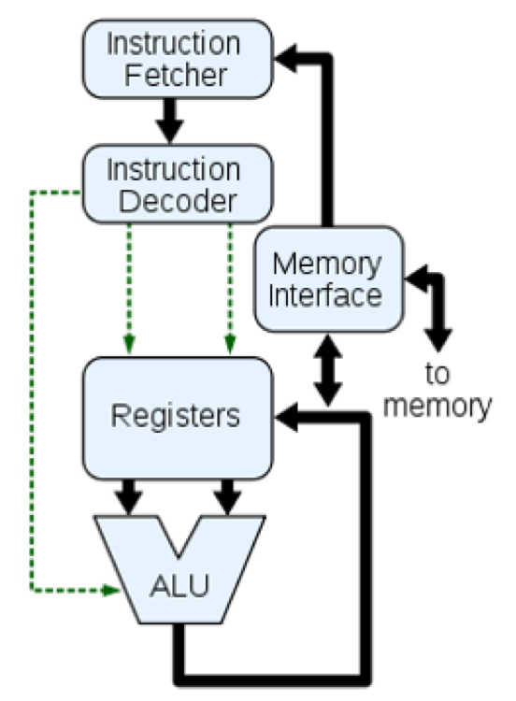
CPU Block Diagram
Figure 4.2
(J. Moore, 2005, CC BY-NC-SA 2.5)
Notes:
The image on this slide provides a logical view of how the CPU operates. The instruction fetcher is at the top. The instruction is then decoded and placed in registers. The ALU performs some type of an operation and writes the result to the registers.

Slide 15
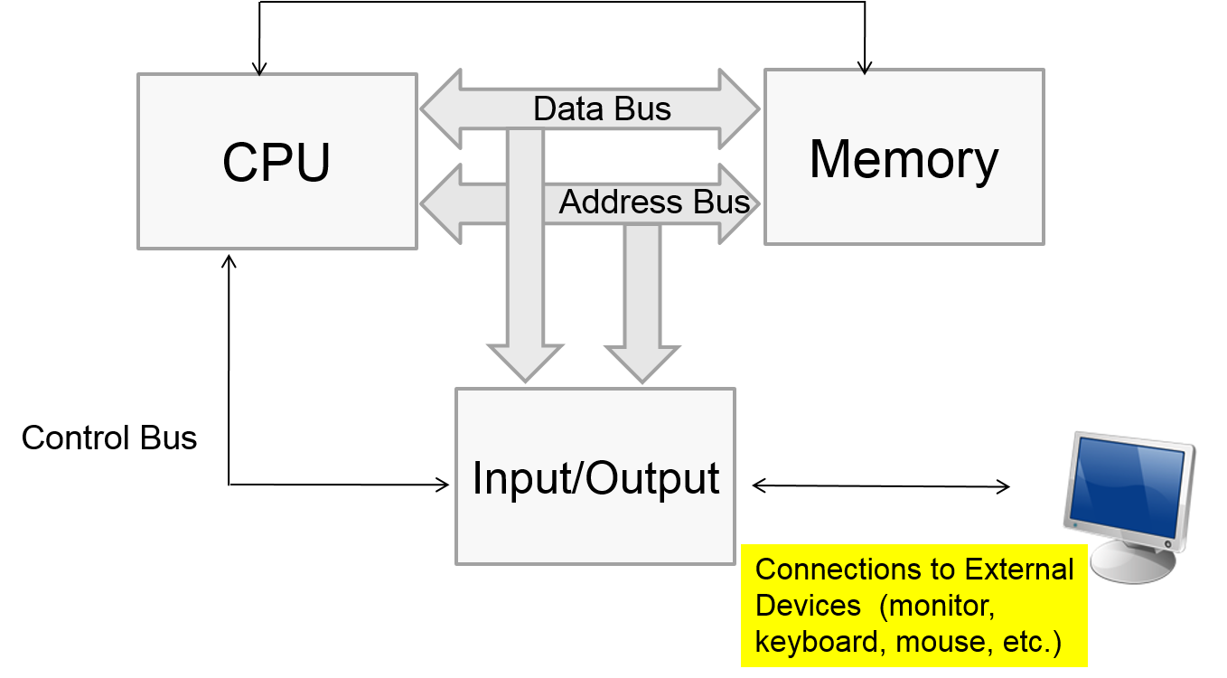
Computer Diagram
Figure 4.3
(J. Blackwood, 2011, CC BY-NC-SA 3.0)
Notes:
Now that all elements - the motherboard, input and output devices, RAM , hard disks, the CPU, motherboard buses, and CPU buses - have been discussed, let’s look at them logically, in a diagram.
The diagram on this slide depicts the CPU, which has access to the motherboard's data and address bus, which gives the CPU access to the memory and to input and output devices.

Slide 16
CPU Performance - 1
Optimizes its performance through creation of processes and threads
A process is a running program
A thread is a specific task running within a process
  Example: Word may save changes to a file and subsequently print that file
  Each operation represents a thread within Word’s process
Notes:
The CPU optimizes its performance through the creation of processes and threads. A process is a running program, such as Microsoft Word. A thread is a specific task running within a process.
For example, Word may save changes to a file and then subsequently print that file. Each of these operations represents a thread within Word's process.

Slide 17
CPU Performance - 2
Number of possible states of a thread
  Examples: running, waiting, stopped
Example – Blocked Thread
  Requests to print something but the printer is currently in use
  CPU moves on to another process/thread and waits for the blocked thread to resume (in which case the blocked thread enters the resume state)
Gives the appearance that the CPU is performing more than one operation at a time, when in fact,
it is not
Notes:
Threads can exist in a number of states at any given time. For example, a thread may be running, waiting, stopped, or blocked.
Why would a thread be in a blocked state? A thread might be blocked, for example, if it presents a request to print something while the printer is currently in use. In the interim, while the given thread is blocked, the CPU moves on to another process or thread, and waits for the blocked thread to resume. In this case, the blocked thread enters the resume state so that it can print. This process makes it appear that the CPU is performing more than one operation at a time when in fact, it never does so.

Slide 18
The Evolving CPU
Today's motherboards support installation of multiple CPUs, each containing multiple cores
This is an evolving technology as CPU vendors such as Intel and AMD produce increasingly efficient CPUs without significantly changing motherboard architecture
Notes:
For a number of years, it seemed that the functionality of CPUs grew at an exponential rate and so many of us were hesitant to purchase a computer for fear that it would be obsolete within a few months.
Today's motherboards support installation of multiple CPUs on a single motherboard. Each of those CPUs may contain multiple cores.
In this case, the computer is capable of performing more than one thing at a time. This is an evolving technology as CPU vendors such as Intel and AMD work to produce more efficient CPUs without significantly changing motherboard architecture.

Slide 19
Specialized Health Care CPUs
Medical imaging done in CT and MRI scans require specialized architectures
  GE Healthcare Discovery™ CT750 HD computed tomography scanner scans and stores hundreds of terabytes of data
  Features Intel’s Xeon®-based SGI Altix® UV CPU - must discern “the soft tissue and organs at almost a molecular level” and do so in real time
Desktop and server CPUs cannot provide this type of performance
Notes:
Medical imaging done in CT and MRI scans requires specialized CPU architectures. For example, the GE Healthcare CT750 HD Computed Tomography Scanner scans and stores hundreds of terabytes of data at a time. This type of equipment, which features Intel's Xeon-based CPU, must discern the soft tissue and organs at almost a molecular level in real time. For that type of functionality, the CPU has to be optimized for speed and performance. Desktop and server CPUs cannot provide this type of performance.

Slide 20
Computer Hardware
Summary - Lecture c
There different types of data
Data type determines how data is stored in memory and processed by software
Data addressing is used to store and retrieve data
Central Processing Unit (CPU) is the most important component of a computer system
There are CPUs designed specifically for the health care applications
Notes:
This concludes lecture c of Computer Hardware. In summary, this lecture discussed:
Different types of data – their representation, storage, and addressing within a computer
How data type determines the way in which data is stored in memory and processed by software
Data addressing, which is used to store and retrieve data
The Central Processing Unit, or CPU, and its functionality
CPUs designed specifically for the health care applications

Slide 21
Computer Hardware
Summary
The major components of a computer system
There are input and output devices designed for health care applications
All data is represented, stored and manipulated in binary format
There are data types
CPU functionality and its interaction with other components of a computer
Notes:
This also concludes the unit, Computer Hardware. In summary, this unit covered
Major components of a computer system
CPUs and input and output devices designed specifically for health care applications
How data is represented, stored, and manipulated in binary format
Data types
Data representation and addressing
And, CPU functionality and its interaction with other components of a computer

Slide 22
Computer Hardware
References – 1 – Lecture c
References
Microsoft [homepage on the Internet]. Windows Embedded; cited March 2011. Available from: http://www.microsoft.com/windowsembedded/en-us/default.mspx.
Shortliffe, EH., & Cimino, JC. (2006). Imaging Systems in Radiology. In: Hannah JH, Ball MJ, editors. Biomedical Informatics (2nd ed.). (pp. 634-635). New York: Springer Press.
Notes:
References slide. No audio.

Slide 23
Computer Hardware
References – 2 – Lecture c
Charts, Tables, Figures
  4.1 Figure: Example of data-addressing. Blackwood, J. (2011). This content is licensed under the Creative Commons Attribution-NonCommercial-ShareAlike 3.0 Unported License.
  4.2 Figure: CPU Block Diagram. Moore, J. Retrieved November 7, 2011 from http://www.lions-wing.net/lessons/hardware/hard.html. This content is licensed under the Creative Commons Attribution-NonCommercial-ShareAlike 3.0 Unported License.
  4.3 Figure: CPU with access to the motherboard's data and address bus; Connections to External Devices (monitor, keyboard, Mouse, etc.). Blackwood, J. (2010). This content is licensed under the Creative Commons Attribution-NonCommercial-ShareAlike 3.0 Unported License.
Notes:
References slide. No audio.

Slide 24
Introduction to Computer Science
Computer Hardware
Lecture c
This material was developed by Oregon Health & Science University, funded by the Department of Health and Human Services, Office of the National Coordinator for Health Information Technology under Award Number 90WT0001.
Notes:
No audio.

