Slide 1
Introduction to Computer Science
Basic Computing Concepts Including History
Lecture d
This material (Comp 4 Unit 1) was developed by Oregon Health & Science University, funded by the Department of Health and Human Services, Office of the National Coordinator for Health Information Technology under Award Number 90WT0001.
This work is licensed under the Creative Commons Attribution-NonCommercial-ShareAlike 4.0 International License. To view a copy of this license, visit http://creativecommons.org/licenses/by-nc-sa/4.0/.
Notes:
Welcome to the Introduction to Computer Science: Basic Computing Concepts Including History. This is lecture d.
The component, Introduction to Computer Science, provides a basic overview of computer architecture; data organization, representation and structure; structure of programming languages; networking and data communication. It also includes the basic terminology of computing.

Slide 2
Basic Computing Concepts Including History
Learning Objectives - 1
Define what a computer is (Lecture a)
Describe different types of computers, including PCs, mobile devices, and embedded computers (Lecture a)
Define common elements of computer systems (Lecture a)
Notes:
The learning objectives for this unit, Basic Computing Concepts Including History, are to:
Define what a computer is;
Describe different types of computers, including PCs, mobile devices, and embedded computers;
Define the common elements of computer systems;

Slide 3
Basic Computing Concepts Including History
Learning Objectives - 2
Describe typical hardware and software options for desktop, laptop, and server systems for home and business use with an emphasis on health care systems (Lecture b)
Explain the development of computers and the Internet, including health care systems, up to the present time (Lectures c and d)
Notes:
Describe typical hardware and software options for desktop, laptop, and server systems for home and business use with an emphasis on health care systems; and
Explain the development of computers and the Internet, including health care systems, up to the present time.

Slide 4
Personal Computers
Up until 1970s, large computers and mainframes were used by government, large industries and universities
Reduced size and cost of microprocessors led to computers for personal use
People who had been programming large machines at work and school could now own their own computers at home!
Notes:
This lecture will conclude the discussion of the development of computers, the Internet, and health care systems.
Up until the 1970s, computers were large, expensive, and were used by governments, large corporations, and universities. Over time, improved technology reduced the size and cost of microprocessors which led to computers for personal use.

Slide 5
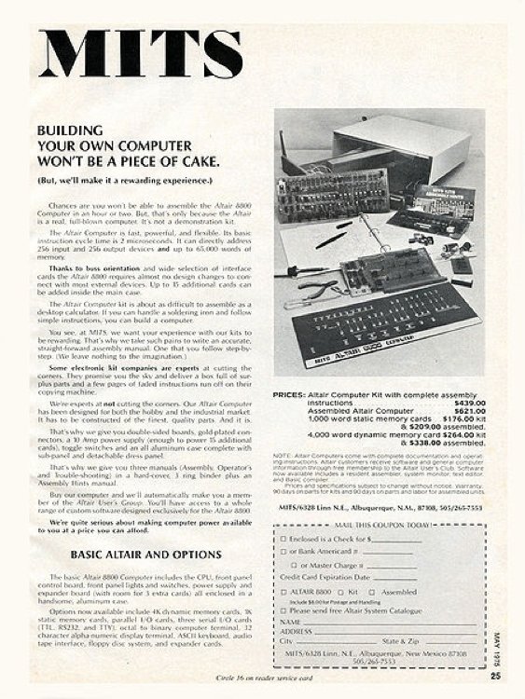
First Personal Computer
Altair 8800
Available in 1975 as a kit or fully assembled
Programmed with switches
Output was given with flashing lights
Very popular with hobbyists
  Bill Gates and Paul Allen started Microsoft with compiler for Altair
(MITS, nd. Public domain PD-US)
Notes:
The first available personal computer was the Altair 8800. It was available in 1975 as a kit or fully assembled. It was programmed with switches and output was given with flashing lights. Hobbyists, many of whom had worked with large computers at their jobs, flocked to these kits. Bill Gates and Paul Allen were some of these original hobbyists who developed a compiler for the Altair. They launched Microsoft to sell this compiler.

Slide 6
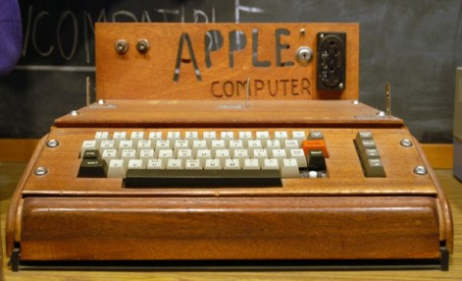
Apple
Steve Jobs & Steve Wozniak started Apple Computer Company in 1976
Apple I (1976) kit; user had to provide keyboard, power supply, monitor
(Uthman, 2003. (CC BY-SA 2.0) )
Notes:
At the same time Steve Jobs and Steve Wozniac started Apple Computer Company in 1976. The Apple I was their first offering and it was a kit. On this slide, there’s a picture of the Apple I computer that shows how rudimentary it was. The Apple I sold for six-hundred sixty-six dollars and sixty-six cents, which they thought was an interesting number. It included an etched printed circuit board, a bag of parts, and a 16-page assembly manual. The user had to provide his or her own keyboard, power supply, and monitor which was usually a modified television set. When a Mountain View computer store called The Byte Shop ordered 50 units, Wozniac and Jobs attracted the funding to start Apple Computer. Apple I was not the first PC, but was certainly one of the most popular.

Slide 7
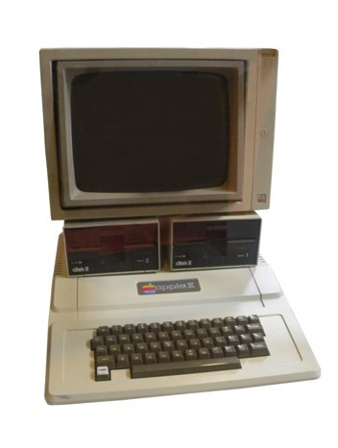
Apple II
Apple II (1977) came with keyboard, monitor and floppy drive
Apple II (Rama & Musée Bolo, 2010. CC BY-SA 2.0)
Notes:
It was followed by the Apple II in 1977 which came out with a keyboard, monitor, and floppy drive. The photo shows that it looks much more like the personal computers we know today.

Slide 8
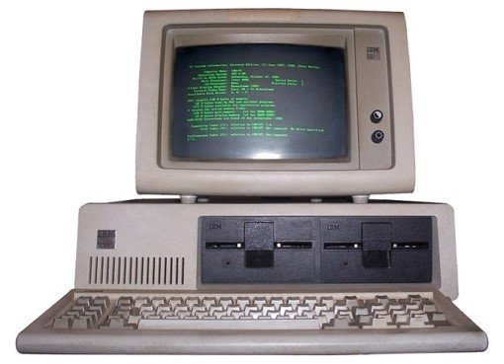
IBM Personal Computers
First IBM Personal Computer
  Based on Intel 8088 chip
  Used off the shelf parts, software
    Launched success of Microsoft
    OS
  For business or personal use
Lacked proprietary architecture; "clones“ emerged
(Boffy, 2006. CC BY-SA 3.0)
Notes:
At the time that the Apple computers were becoming popular, IBM was watching very carefully and decided it wanted to get into this market as well. IBM knew that in order to be competitive, they had to be quick. They didn’t have time to develop their own hardware and software, so instead they used parts that were already available. The first IBM PC was based on the Intel 8088 chip. It used off the shelf parts and software including compilers and operating systems from Microsoft. This in turn launched the success of Microsoft. Because its architecture wasn’t proprietary, it lend to the development of what were, at the time, called clones. Anyone could put together a PC using the same parts and design that IBM did; these were called clones. IBM PCs and clones were used for business and personal use and contributed to the personal computer becoming so popular.

Slide 9
Changes in System Memory
1 KB for early home systems
16 to 32 GB common for today’s home systems
Demonstrates Moore’s “law”: trend showing that the number of components that can be placed on a circuit doubles every two years
Observation by Gordon Moore, Intel co-founder, in 1965 (Schaller, R.R., 1997).
Notes:
Another major change in computer technology over time is the amount of internal system memory. Early home systems might have had approximately 1 kilobyte (KB) of system memory; today, 16 to 32 gigabytes (GB) is common. That is an increase of several million‐fold from the systems of the 1970s. A commercial computer server can be easily purchased today with 96 GB of internal memory.
Increasing available memory is a demonstration of Moore’s Law, which is an observation that the number of components that can be placed on a circuit doubles every two years. This observation was made by Gordon Moore, the co‐founder of Intel, in 1965.

Slide 10
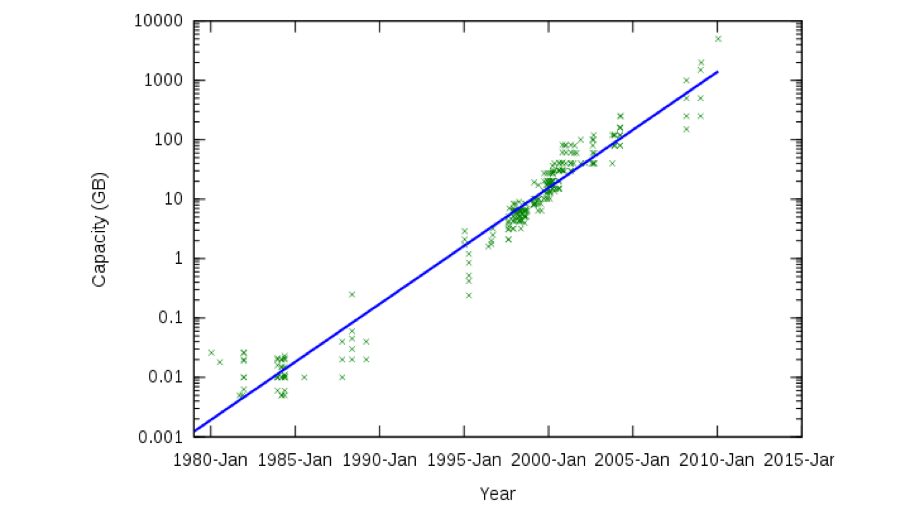
Changes in System Storage
(Hankwang 2009, CC BY-SA 3.0)
Notes:
Significant changes in storage capacity have also occurred. While many forms have been developed over the years, this discussion will focus on the most common medium – the magnetic disk in a hard drive. A 1956 article by Welsh and Porter describes a system that stores 250,000 12‐digit words per drum – or a bit more than a quarter kilobyte. The chart above shows the growth to current capacities of disk drives in the terabyte range, or thousands of billions of bytes, available today for home systems. Note that this chart is on a logarithmic scale versus linear – the capacity growth has been immense.

Slide 11
Changes in System Connectivity
Early computers were stand-alone systems
Connected by telephone lines in 1970s and 1980s
Internet for personal use through dial-up connections in 1990s
  Slow speed – 56 Kbps typical
  Still available today
Wireless hotspots and WiMAX
Notes:
The final trend is system connectivity. Early systems were stand‐alone; they were not connected to one another or accessible from an off‐site location. In the 1970s and 1980s, remote access and connectivity was beginning to be provided via dial‐up connections. It became possible to connect a terminal at a remote location and display approximately ten characters per second, and speeds began to increase. As with all other trends, the rate of growth was rapid–from 28 and 56 Kb dial‐up connections, to the broadband speeds for home connections of hundreds of megabits per second today.
Wireless connections are quite readily available. Wireless hot‐spots, where computer users can access a public wireless connection, are accessible, and Worldwide Interoperability for Microwave Access, or WiMAX, is one technology that can provide connectivity up to 54 Mbps in some areas.
Note that dial‐up connections are still in use where broadband or wireless connections are not always available. However, with the rapidly increasing number of mobile devices that use cell phone connections, as well as the growing expectation of being able to access systems and services from anywhere, not from just a wired connection--this is likely to change.
To summarize, significant growth has occurred in the availability and capabilities of computer systems since their inception in the 1940s. Expectations are that the trend will continue.

Slide 12
Software
These machines needed software to run programs
The operating system is necessary for coordinating with the hardware
  DOS was developed for Apple
  QDOS was developed for Intel chip
    Bought by Microsoft
    Became MS-DOS for IBM PC
Notes:
Software was an integral part of the popularity of PCs. The most important piece of software on a computer is its operating system or OS. The OS coordinates the hardware and all the other software on a system. The disk operating system, or DOS, was developed for Apple by Shepardson Microsystems for coordinating the use of the Motorola chip in the Apple products. IBM needed an OS for their PC based on the Intel chip. It approached Microsoft, which didn’t have an OS at the time. They did have compilers available for it, but not an OS. Bill Gates recommended talking with Digital Research which did have one, but Digital Research didn’t return IBM’s call. In the meantime, Microsoft acquired QDOS from Seattle Computer Products, which Microsoft distributed to IBM along with their compilers and called MS-DOS. The rest, of course, is history. The smart, quick maneuvering by Bill Gates and Paul Allen helped launch the success of Microsoft with the initial IBM PC.

Slide 13
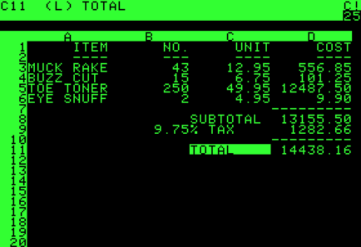
First Popular
Software Program
VisiCalc was developed by Harvard Business School students Dan Bricklin and Bob Frankston in 1978
Spreadsheet program for PC
100,000+ copies were sold the first year
(Gortu, 2005)
Notes:
The first popular software program was VisiCalc. It was developed by Harvard Business School students, Dan Bricklyn and Bob Frankston in 1978 and it was a spreadsheet program for the PC. Many businesses were very interested in spreadsheets for their many calculations. Over 100,000 copies of it were sold the first year. Other spreadsheet programs soon followed; Lotus 1-2-3 in 1982 and Excel in 1985. Word processing, which had been done on separate, dedicated machines, made a huge impact on the PC world. Word Star was first in 1979, followed by Word for MS-DOS, and WordPerfect. Word processing is now one of the biggest applications for PCs.

Slide 14
The Internet - 1
In the meantime, the beginnings of the Internet were starting
In 1969, ARPANET connected 4 universities
  Sponsored by the U.S. Government for connecting researchers
  Motivated by the Cold War
By 1971,15 sites were on the network
By 1980s, network had over 1000 sites; term Internet was born
Notes:
In the meantime, the first steps in developing the Internet were happening. In 1969, the advanced research projects agency network, or ARPANET, connected 4 universities. It was a project sponsored by the U.S. Government for connecting researchers. By 1971 there were 15 sites on the network, and by the 1980s, there were over 1000 sites on the network. That’s when the term Internet actually started being used, instead of ARPANET, to refer to the network.

Slide 15

The Internet - 2
Historic World Wide Web Logo
(Pé, 2007. PD-US)
Other networks formed and
eventually all merged to become the Internet
In 1989, Tim Berners-Lee developed the World Wide Web software
In 1992, Congress votes to allow commercial activity on the Internet
In 1993, first web browsers were released
In 1997, PubMed was launched
Notes:
Other networks were formed at the same time and eventually all merged together to become what we know today as the Internet. In 1989, Tim Berners-Lee developed the World Wide Web software that is an interface to the Internet. In 1992 Congress voted to allow commercial activity on the Internet. Up until this point, only government sponsored institutions and universities could use the Internet. In 1993, the first web browsers were released and in 1997, PubMed, which offered free, online access to Medline, was launched.

Slide 16
The Perfect Storm in the 1990s
Advancing technology led to faster, cheaper, and smaller personal computers
  More people bought computers
Microsoft introduced Windows
  Computer interaction easier with a mouse and graphical user interface
Internet was open to commercial use and browsers made exploring websites easy
The Internet Boom!
Notes:
The combination of several different factors led to the Internet boom of the late 90s. Personal computers became faster, cheaper, and smaller as technology advanced. This meant that more households and more people could afford to purchase them. Microsoft advanced their operating system and introduced Windows, which had a graphical interface. Now users could interact with a computer using a mouse, which made navigating a PC much easier for most users. The Internet was open to commercial use, and web browsers made exploring websites easy. And this all led to the huge Internet boom, but it also led to the ubiquitousness of computers in our society today.

Slide 17
Early Electronic Medical Records
Dr. Morris Collen began storing patient data at Kaiser Permanente in the late 1960s
COSTAR was developed at Massachusetts General in 1968
Health Evaluation through Logical Processing (HELP) was started at LDS Hospital in 1967
The concepts and plans that eventually became VA VistA were developed in 1970s
Notes:
This slide presents a brief history of early electronic medical records. Dr. Morris Collen began storing patient data at Kaiser Permanente in the late 1960s. Computer-Stored Ambulatory Records, or COSTAR, was developed at Massachusetts General in 1968. It is still in use today, and one of its defining features is its clinical guidelines reminders.
Health Evaluation through Logical Processing, or HELP, started at LDS Hospital in 1967. HELP also provided decision support, such as an automated antibiotic consultant. This tool helped physicians prescribe antibiotics more effectively and appropriately, which resulted in reduced dose cost and adverse events over time. The concepts and plans that eventually became the Veterans Administration’s VistA were also developed in the 1970s. VistA is a public domain software and was the first that used a graphical user interface for electronic medical record software – it is still in use today.

Slide 18
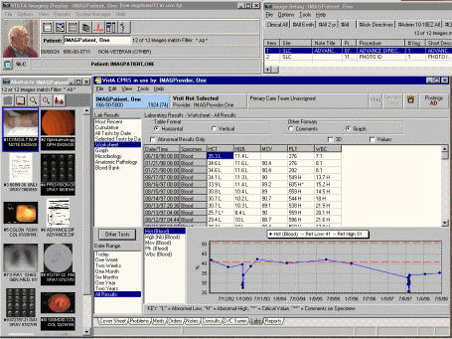
Electronic Medical
Records
Become more pervasive in 1990s
In 1996, HIPAA was passed establishing rules for accessing and storing electronic medical records
VistA screenshot (Hribar, 2010)
By 2000, 16% private physicians, < 10% hospitals used EMRs
By 2005, 25% private physicians used EMRs
Notes:
As all these advances in computing and the Internet were happening, electronic medical records, or EMRs, got their foothold. More versions of them were being developed in the 1990s, and they became more user-friendly with the addition of graphical user interfaces. HIPAA which is the Health Insurance Portability and Accountability Act enacted in 1996, included provisions for establishing standards for electronic medical records.
In 2000, only 16% of private physicians and less than 10% of hospitals used EMRs. By 2005, 25% of private physicians used EMRs and the number has since been increasing.

Slide 19
Since Then…
Personal Data Assistants introduce hand-held computing
  Smartphones replace PDAs
Wireless networks are widely available
  Mobile computing is now pervasive
Social networking sites connect people
Computers and the Internet are ubiquitous
HITECH Act passed in 2009 to provide incentives for EMR use starting in 2011
Notes:
Computing has continued to advance since then. Some of highlights are listed here. Personal data assistants introduced hand-held computing, and cell phones have replaced PDAs. All of us now are very familiar with iPhones and Blackberrys, which are small computers that we carry around with us every day and do most things that we can do on a laptop or desktop, but with limited screen size and limited memory. Wireless networks are now widely available so mobile computing is pervasive. We now expect to be able to connect to the Internet everywhere and all the time.
Social networking is another phenomenon that has developed through the use of the Internet and computers which now connect people all over the globe. Computers and the Internet are ubiquitous.
In 2009 the HITECH Act was passed as part of the Economic Stimulus Recovery Plan. It provides incentives for EMR use starting in 2011. This act led to massive increases in adoption of electronic medical records and electronic health records in clinical settings in our society.

Slide 20
Tablets
Commercially available since late 1980s
Small and thin
Designed to use without keyboard
Limited adoption – until recently
  Apple iPad over 3,000,000 units sold in first three months
  Apple iPad 2 over 1,000,000 units sold in first 3 days
Is it a trend?
Notes:
Tablets are a relatively new size and shape, or form factor for computing – at least for common use, although they have been available since the late 1980s. They are designed for portability, tend to be small and thin, and do not necessarily require a keyboard to use. Adoption of tablets had been rather limited until the Apple iPad was released in 2010. It sold over three million units in the first three months it was available, and the iPad 2 sold over a million units in the first weekend it was available. This raises the question – are tablets a fad, or a real trend in technology adoption?

Slide 21
Mobile Devices
PDAs
Telephones
Internet access
Will the tablet and mobile device merge?
Notes:
Many mobile devices use touch screen technology. Some devices also have integrated keyboards as well as an alternative input device. These devices can be portable data assistants, or telephone systems such as the iPhone, which integrate telephone capabilities with Internet access such as web browsers and e‐mail clients, not to mention millions of applications available for personal use. Some of these applications can be used for medical purposes, such as drug references.
The question that arises is whether tablets and mobile devices will eventually merge – as the capabilities of mobile devices increase, is a tablet and a mobile device redundant? Think of a typical user – would they want to carry multiple devices for access to similar applications? Is it really necessary to carry a mobile device for its telephone capabilities, as well as a tablet for other tasks? It is likely that the two will merge into a device that has the capabilities of both in the near future. It may be larger than a current mobile device but smaller than a tablet – perhaps new technologies will allow size expansion as needed.

Slide 22
Voice Recognition
Science fiction in the 1960s
Some support for computer systems
Mobile device usage
  Siri starting on the iPhone 4S
Vocera
Notes:
Voice recognition technology has been used – at least in fiction – since the 1960s. Commercial applications currently exist, and voice recognition is built into some operating systems. Note that the quality of voice recognition is still not at a level to replace, for example, a medical transcriptionist. However, limited success has been achieved in specialized applications. Some current mobile devices can support voice recognition. The most well-known example is Siri, which first became available on the iPhone 4S. It is capable of responding to voice commands related to messaging, making phone calls, searching the web, checking the weather, and more. Both Macintosh and Windows operating systems have dictation and text-to-speech applications available.
One device called, Vocera, is used in hundreds of hospitals. It provides clinical staff with intelligent mobile communication with wearable, hands-free Vocera Badge. The Vocera badge is worn by users and simple voice commands are recognized for communication between the users.

Slide 23
Motion Interfaces
Latest advances seen in mobile phones and gaming systems
User interfaces include device or remote device orientation and accelerometer sensors
  Mobile phones
  Nintendo Wii
Motion detection interfaces
  Microsoft Xbox 360 Kinect gesture keyboarding
Notes:
Some of the more recent changes in human interaction with technology have been enabled through newer technology. Most current mobile phones contain orientation software and accelerometers, enabling the system to know how it is being held and how quickly it is moving. This allows users to interact with applications without touching a keyboard, virtual or physical, or the device screen. One step beyond this is a remote device which sends this information to the system wirelessly, as in the Nintendo Wii. This permits interactive games that do not require users to be directly connected to the computing system. In addition to providing entertainment, interactive games are available which encourage and direct personal fitness – a direct benefit to health.
This concept is taken one step further in gaming technology. The Microsoft Xbox 360 Kinect allows users to interface with the system without a device through motion sensing. Microsoft’s patent application refers to this as “gesture keyboarding”, allowing a user to make gestures that are recognized and acted on by the system.
Since the capability for a user’s gestures to be recognized is now available, what would it would take for the user to be recognized? Imagine walking up to a medical record terminal, being recognized by the system, and starting a preferred application, without needing to touch the system at all.

Slide 24
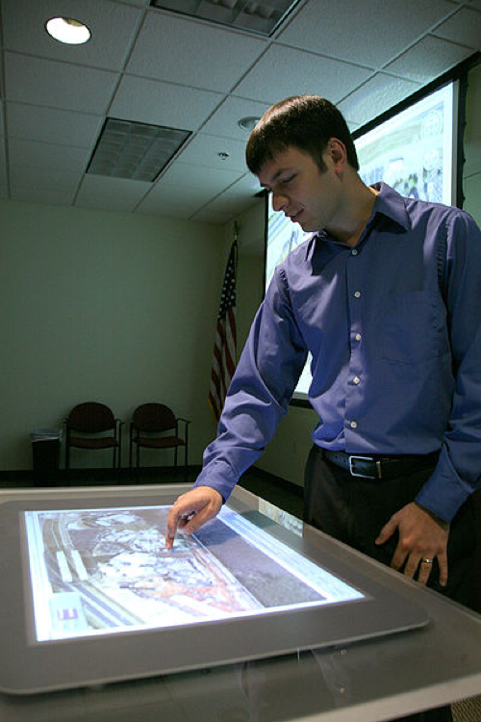
Tables and Walls?
Think large
Why be limited to a computer screen?
(Ford 2009, PD-US)
Notes:
There are advantages to thinking large, rather than small. For example, a larger interface can increase the ease of sharing of information, or clarity in display. Why be limited to a computer screen? This slide shows another option, a table‐top system at the Future Warfare Center's Simulation Center.

Slide 25
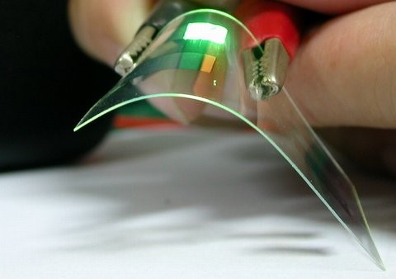
Flexible Hardware
Flexible, ultra-thin displays in development
Flexible keyboards now available
Organic Light Emitting Diode (OLED) displays
Smart textiles
OLED device in development (Meharris, n.d.)
Notes:
Finally, another new trend is flexible hardware. Rather than the rigid devices in common use, new flexible devices may be available in the very near future. Roll‐up keyboards are already available today, and there is current research into Organic Light Emitting Diode (OLED) displays which will allow for a flexible computer display. There is also research into smart textiles – fabric with sensors and pixel displays.
With the reduction in component size and the addition of flexible technology, suddenly many more options can be considered. Will computers fold up in the future and be stuffed into pockets like a handkerchief? Will computers be part of our clothing one day?
The image on the slide shows an experimental OLED.

Slide 26
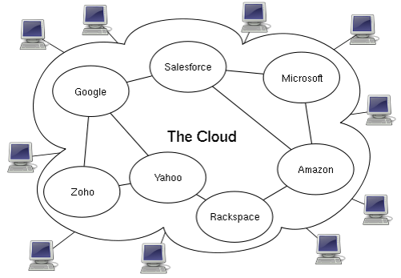
The Future?
Computing technology will continue to become faster, more powerful and smaller
How will mobile and cloud computing evolve?
More ubiquitous?
More embedded computers?
Difficult to say for sure…
(Johnston, 2009. CC BY-SA 3.0)
Notes:
So where is this all heading? What’s the future of computing? If you knew that, you would become very wealthy! We don’t know exactly where things are going, but we do know some things. We know that computer technology is going to continue to become faster, more powerful, smaller, and presumably cheaper. We know that mobile computing is here to stay. The concept of cloud computing, which is all the data on the Internet, is going to be a hot topic for a while. Are computers going to become even more ubiquitous, than they already are? How are they going to do that? Are there going to be more and better computers? What’s in store for health care technology? It’s difficult to say for sure, but we do know that it will be interesting. We’ll all have to stay tuned.

Slide 27
Basic Computing Concepts
Including History
Summary – Lecture d
Personal computers developed in 1970s
Altair 8800; Apple I; Apple II; and IBM PC
Internet boom of the 1990s
Technology continues to develop
Notes:
This concludes lecture d of Basic Computing Concepts Including History.
In summary, personal computers were first developed in the 1970s. The Altair 8800 was the first, then the Apple I, Apple II, and the IBM PC. About the same time, the Internet was growing. In the next two decades, computers became faster, cheaper, more usable, and more connected. This all culminated in the Internet boom of the 1990s. Technology is still developing; it is difficult to predict what future developments are in store.

Slide 28
Basic Computing Concepts
Including History
Summary
Computers are electronic devices that input, calculate and output data
Include PCs, smart phones, embedded computers
Purchasing a new personal computer requires research
Computers have evolved from simple counting and calculating tools to the complex, fast electronic systems they are today
Notes:
This also concludes the unit Basic Computing Concepts Including History.
In summary, this unit defined computers as electronic devices that input, calculate, and output data. Computers include not only personal computers, but also smart phones and the computers that are embedded in most electronic devices today. Some examples are appliances, automobiles, DVD players, just to name a few.
Purchasing a new personal computer today requires doing some research.
First, the buyer needs to consider what applications will be running on the computer; this will help determine options like the video card, monitor, amount of memory, and hard disk. Then, the buyer needs to set a budget. Online sites provide reviews and buying guides to help determine the best system for the buyer's budget.
Finally, the computers of today evolved over hundreds--even thousands--of years, from the simplest tools for counting, to the complex systems they are today.

Slide 29
Basic Computing Concepts Including History
References – 1 – Lecture d
References
Bricklin, D. (2010). Visicalc. Retrieved November 18, 2011, from http://bricklin.com/visicalc.htm.
Collen, M. F. (1995). A History of Medical Informatics in the United States: 1950 – 1990. Indianapolis: BooksCraft, Inc.
Computer History Museum. (2006). History of the Internet. Retrieved November 18, 2011, from http://www.computerhistory.org/internet_history/.
Cringely, Bob. Triumph of the Nerds. Ambrose Video; 2002.
Electronic Health Record. (2011, March). In Wikipedia. Retrieved March 22, 2011, from http://en.wikipedia.org/wiki/Electronic_health_record.
History of Computing Hardware. (2011, March). In Wikipedia. Retrieved March 22, 2010, from http://en.wikipedia.org/wiki/History_of_computing_hardware.
History of Computing (2011, March). In Wikipedia. Retrieved March 22, 2010, from http://en.wikipedia.org/wiki/History_of_computing.
Notes:
No audio.

Slide 30
Basic Computing Concepts Including History
References – 2 – Lecture d
References
Kass-Bartelmes, B.L., &., Ortiz, E. (2002, June). Medical Informatics for Better and Safer Health Care. Research in Action, Issue 6. Retrieved from https://archive.ahrq.gov/research/findings/factsheets/informatic/informatics/informatria.html.
VistA. (2011, March). In Wikipedia. Retrieved March 22, 2011, from http://en.wikipedia.org/wiki/VistA.
Images
Slide 4: MITS Altair 8800 computer. MITS (nd.) Holley, M. (1975). http://commons.wikimedia.org/wiki/File:Altair_Computer_Ad_May_1975.jpg. Retrieved Nov. 2011 from the Wikimedia Commons website: http://commons.wikimedia.org/. Public domain image (PD-US).
Notes:
No audio.

Slide 31
Basic Computing Concepts Including History
References – 3 – Lecture d
Images
Slide 5: Apple I computer. Uthman, E. (2003, March) http://en.wikipedia.org/wiki/File:Apple_I_Computer.jpg. Retrieved Nov. 2011 from the Wikimedia Commons website: http://commons.wikimedia.org/. This file is licensed under the Creative Commons Attribution-Share Alike 2.0 Generic License.
Slide 5: Apple II computer. Rama & Musee Bolo (2010, July) http://en.wikipedia.org/wiki/File:Apple-II.jpg. Retrieved Nov. 2011 from the Wikipedia website: http://en.wikipedia.org/. This image is licensed under the Creative Commons Attribution-ShareAlike 2.0 France License.
Slide 6: IBM PC. Boffy, B. (2006, August) http://commons.wikimedia.org/wiki/File:IBM_PC_5150.jpg. Retrieved Nov. 2011 from the Wikimedia Commons website: http://commons.wikimedia.org/. This file is licensed under the Creative Commons Attribution-Share Alike 3.0 Unported License.
Slide 13: Visicalc Screenshot. (Gortu, 2005) http://en.wikipedia.org/wiki/File:Visicalc.png. Retrieved Nov. 2011 from the Wikimedia Commons website: http://commons.wikimedia.org/. Public domain (PD-US).
Notes:
No audio.

Slide 32
Basic Computing Concepts Including History
References – 4 – Lecture d
Images
Slide 15: World Wide Web historic logo. Pe, H. (2007, May) http://commons.wikimedia.org/wiki/File:WWW_logo_by_Robert_Cailliau.svg. Retrieved Nov. 2011 from the Wikimedia Commons website: http://commons.wikimedia.org/. Public domain (PD-US).
Slide 18: Vista screenshot. Hribar, M. (2010).
Slide 25: OLED Early Product. (Meharris, n.d.) https://commons.wikimedia.org/wiki/File:OLED_EarlyProduct.JPG. Retrieved from the Wikimedia Commons website: http://commons.wikimedia.org/. This image is licensed under the Creative Commons Attribution-Share Alike 3.0 Unported License.
Slide 26: Cloud computing diagram. Johnston, S. (2009, March). http://en.wikipedia.org/wiki/File:Cloud_computing.svg. Retrieved Nov. 2011 from the Wikimedia Commons website: http://commons.wikimedia.org/. This image is licensed under the Creative Commons Attribution-Share Alike 3.0 Unported License.
Notes:
No audio.

Slide 33
Introduction to Computer Science
Basic Computing concepts Including History
Lecture d
This material was developed by Oregon Health & Science University, funded by the Department of Health and Human Services, Office of the National Coordinator for Health Information Technology under Award Number 90WT0001.
Notes:
No audio.

