Slide 1
Introduction to Computer Science
Databases and SQL
Lecture b
This material (Comp 4 Unit 5) was developed by Oregon Health & Science University, funded by the Department of Health and Human Services, Office of the National Coordinator for Health Information Technology under Award Number 90WT0001.
This work is licensed under the Creative Commons Attribution-NonCommercial-ShareAlike 4.0 International License. To view a copy of this license, visit http://creativecommons.org/licenses/by-nc-sa/4.0/.
Notes:
Welcome to Introduction to Computer Science: Databases and Structured Query Language, or SQL. This is lecture b.
The component, Introduction to Computer Science, is a basic overview of computer architecture; data organization, representation and structure; structure of programming languages; networking and data communication. It also includes the basic terminology of computing.

Slide 2
Databases and SQL
Learning Objectives - 1
Define and describe the purpose of databases (Lecture a)
Describe a relational database (Lecture a)
Describe data modeling and normalization (Lecture b)
Describe the structured query language (SQL) (Lecture c)
Notes:
The learning objectives for Databases and SQL are to:
Define and describe the purpose of databases
Describe a relational database
Describe data modeling and normalization
Describe the structured query language, or SQL

Slide 3
Databases and SQL
Learning Objectives - 2
Define the basic data operations for relational databases and how to implement them in SQL (Lecture c)
Design a simple relational database and create corresponding SQL commands (Lecture c)
Examine the structure of a health care database component (Lecture d)
Notes:
Define the basic data operations for relational databases and how to implement them in SQL
Design a simple relational database and create corresponding SQL commands
And, examine the structure of a health care database component

Slide 4
Representing Data - 1
Identify entities (tables)
Identify attributes (columns)
Identify table relationships
Notes:
This lecture introduces the topics of data relationship types and structures, database normalization, and building a database.
A database contains a set of tables each containing data. Each table is modeled by an entity – some unit of data that can be classified and have stated relationships to other entities. For example, a table can be a list of contacts.
Within a table, rows are the entries, and columns are attributes that need to be defined. The relationships between different tables also need to be defined.

Slide 5
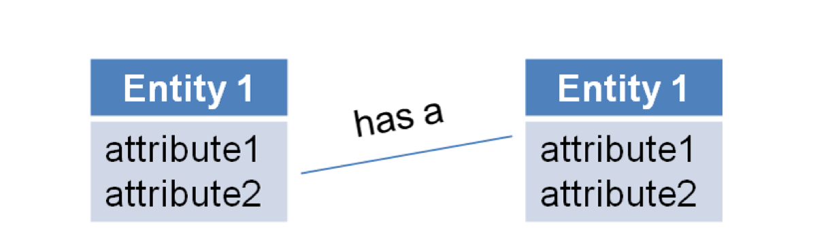
Representing Data - 2
Identify entities (tables)
Identify attributes (columns)
Identify table relationships
Figure 1.1. Entity-Relationship Diagram (ER diagram)
Notes:
Data can be modeled using an entity-relationship diagram, also known as an ER diagram or ERD. These diagrams show the entities, the attributes, and the relationships between entities. The relationships are shown using lines and can also be represented in words, such as "has a".
For example, if there are two tables, one for storing information about a patient…

Slide 6
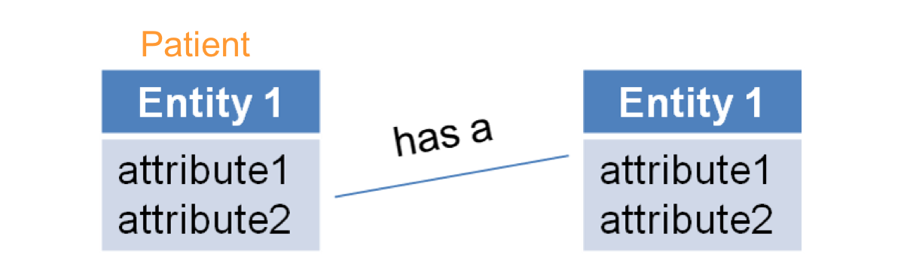
Representing Data - 3
Identify entities (tables)
Identify attributes (columns)
Identify table relationships
Figure 1.2. Entity-Relationship Diagram (ER diagram) with Patient table
Notes:
…and another for storing information about insurance companies…

Slide 7
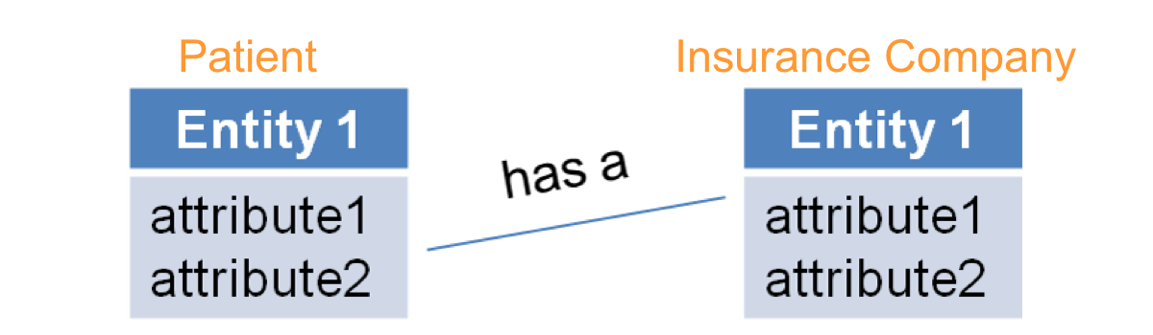
Representing Data - 4
Identify entities (tables)
Identify attributes (columns)
Identify table relationships
Figure 1.3. Entity-Relationship Diagram (ER diagram) with Patient and Insurance Company tables.
Notes:
…then that relationship can be described as "has a" relationship since a patient has an insurance provider. This relationship can be represented as a simple line, but the next slide will show how it can be represented differently.

Slide 8

Relationships - 1
One-to-one
One-to-many
Many-to-many
Notes:
Relationships can be of three types or cardinalities: one-to-one, one-to-many and many-to-many.
In a one-to-one relationship, each entry in a table is linked to exactly one entry in another table and vice-versa. One-to-one relationships are not very common in databases because two such tables would usually be merged into one. A one-to-one relationship is represented by a simple line.
The one-to-many relationship is commonly used in databases…

Slide 9
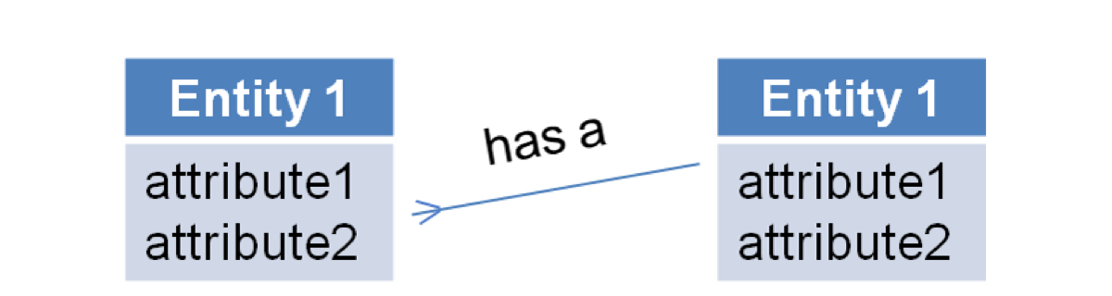
Relationships - 2
One-to-one
One-to-many
Many-to-many
Figure 1.4. Entity-Relationship Diagram (ER diagram) with one-to-many relationship.
Notes:
…In this case, each entry in the first table is linked to one entry in the second, but each entry in the second table is linked to multiple entries in the first table.

Slide 10
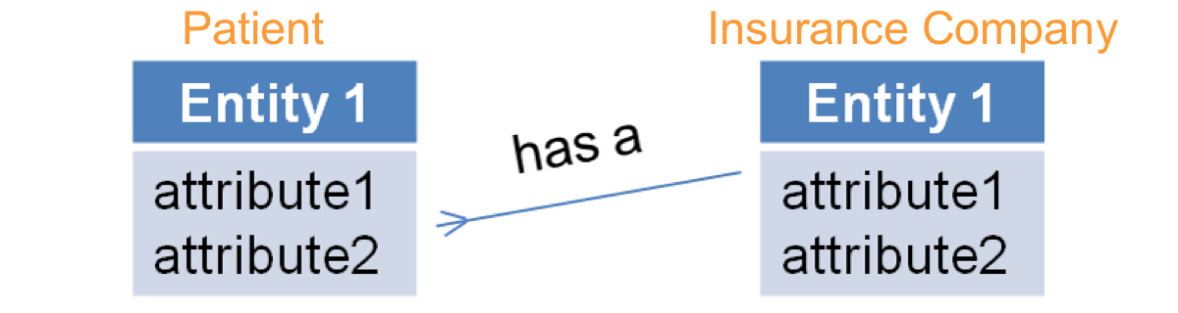
Relationships - 3
One-to-one
One-to-many
Many-to-many
Figure 1.5. Entity-Relationship Diagram (ER diagram) with one-to-many relationship between Insurance Company table and Patient table.
Notes:
In the example of a patient and an insurance company, it can be assumed that a patient may have only ONE insurance provider. Therefore, each entry in the patient table is linked to just one entry in the second table.
But, there may be multiple patients in the patient table who have the same insurance provider. One-to-many relationships are represented by a line with a crow's foot on one end. That crow’s foot points to the table that has the multiple links back to the other table. In this example, multiple patients can have one insurance provider, so the crow's foot is pointing to the patient table.

Slide 11
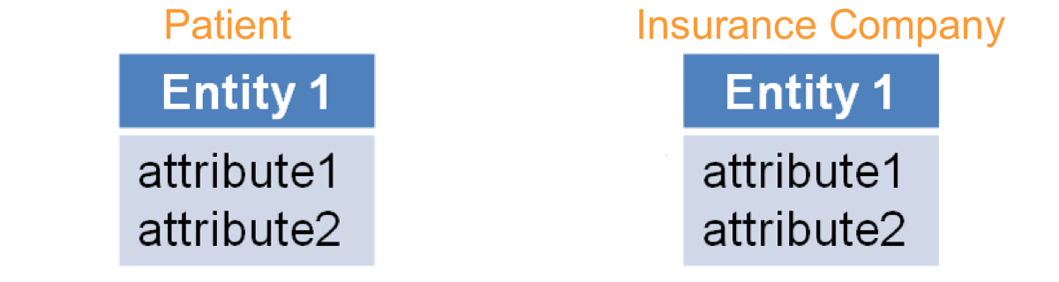
Relationships - 4
One-to-one
One-to-many
Many-to-many
Figure 1.6. Entity-Relationship Diagram (ER diagram) with tables for Patient and Insurance Company.
Notes:
Now if a patient has more than one insurance provider, the relationship is considered to be many-to-many.

Slide 12
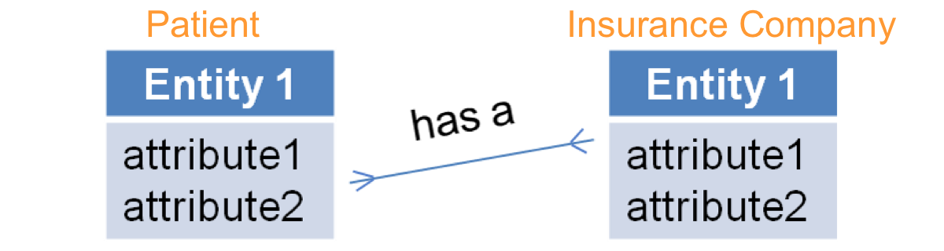
Relationships - 5
One-to-one
One-to-many
Many-to-many
Figure 1.7. Entity-Relationship Diagram (ER diagram) with many-to-many relationship between Patient and Insurance Company tables.
Notes:
In this case, an entry in the patient table can be linked to multiple entries in the insurance table and each entry in the insurance table can be linked to multiple entries in the patient table.
Many-to-many relationships are represented by a line with a crow's foot at each end.

Slide 13
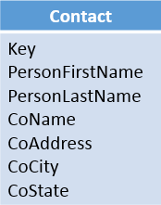
Simple Database
Structure
One entity/table
Create a unique row identifier
Attributes
  Key (integer)
  Person’s first name (varchar)
  Person’s last name (varchar)
  Company name (varchar)
  Company address (varchar)
  Company city (varchar)
  Company state (char)
Figure 2. Contact attributes.
Notes:
Consider a database containing contacts data: for each contact, the name and company information are recorded.
A simple database structure can be created using a single entity that looks like the contact file. The data about a contact comprise the attributes of the contact entity. A key, identification number, is then added to uniquely identify each row. The contact’s name is not necessarily unique, so it cannot be used to identify each entry. For example, a user must be able to tell the difference between a “Maria Perez” who works at “Community Hospital” and a “Maria Perez” who works at “Main Medical Center”.
The data types associated with each data element also need to be specified. For the names and addresses, character data type, char or varchar, should be used; the key is usually an integer value, since it is more efficient to do numeric comparisons than text comparisons.

Slide 14
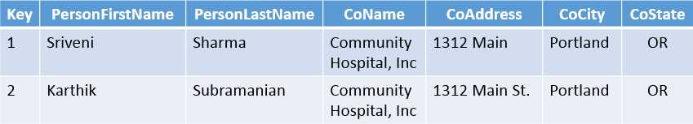
Contact Table
Figure 3. Contact table.
Problems
  Company data is stored in multiple locations
  Company data may be inconsistent
  Significant work to update data when company information changes
Notes:
This slide shows an example of a contact table with some entries in it. The attributes of the table are the columns. Each entry in the table is a row.
However, the company data is stored in multiple locations, and as a result, it is easy for the company data to be entered inconsistently. Additionally, if the general information about the company changes, such as a relocation to a new address or a name change, the entries in all the rows will need to be changed.

Slide 15
Database Normalization
Prevent data inconsistency
Prevent update errors
Eliminate data redundancy
Notes:
To address these issues, the database can be normalized. Normalization is a process that helps ensure that the database design is optimized and the data is consistent by reducing the possibility of update errors and reducing data redundancy.
Early concepts of data normalization were defined by E. F. Codd, in the journal “Communications of the ACM” in 1970.

Slide 16
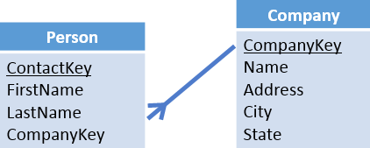
Normalized Database Structure
Figure 4. Normalized database structure.
Two tables: Person and Company
Each has a unique row identifier – a primary key
Need to link the company to the contact
Notes:
In this case, errors can be reduced by looking again at the data. The relationship between the people and their companies is a simple relationship; however, separating this information into two sets - one for the information about the person and the other for information about the company – would provide more distinct access to the details of each set.
By separating the single database table into two tables, there are no longer multiple copies of the company information within one table. This action meets some of the requirements of database normalization by eliminating redundant copies of the company information and by creating a structure that can prevent the problem of inconsistent company data in the database.
As with the single table design, there needs to be a key, or unique identifier, for each of the two tables. Just as it is possible to have two people with the same name at different companies, it is possible to have two different companies with the same name in different parts of the country. Therefore, the company name should not be used as the unique identifier. Instead, an integer key will be used for the company table and shorter names for some of the attributes in both tables can be used now that the attributes that belong to a person and to a company have been separated.
One more step is needed to connect the person to the company. To do this, a field can be added to the person table for the integer key representing the company, or the CompanyKey, associated with that particular contact. In the person table, this CompanyKey would be considered a foreign key which refers to the primary key in the company table. A foreign key is a field or group of fields in one table that uniquely identifies a row in a different table. Specifying foreign keys in tables is how relationships are built within a database.
Note that the cardinality of this relationship is one to many. Each person has one company, but each company may have more than one person related to it.

Slide 17
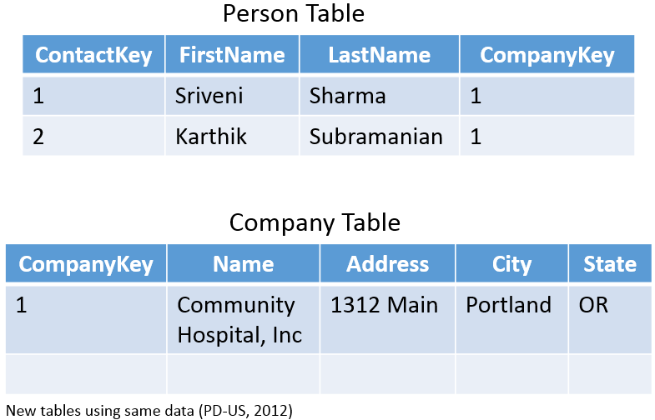
New Tables
Figure 5. Top: New “Person” table using same data as previous “Contact” table. Bottom: New “Company” table using same data as previous “Contact” table.
Notes:
This slide shows what the two tables would look like now using the same previous data. The person table now has fewer columns than the old contact table; instead of storing the company name, company address, company city, and company state, it just stores the company key. The company table includes a key along with the name, address, city, and state.
The person table has two entries, like the old contact table--one for Bill and one for Albert. The company table has only one entry, however, for Community Hospital, Inc. Both contacts are from the same company, so they both have the same value in the CompanyKey column. Presumably for a larger dataset there would be multiple entries in the company table.

Slide 18
How Do We Do This?
Database Management System
  Create
  Maintain
  Use
Many available (NOT an exhaustive list)
  Oracle
  Microsoft SQL Server
  IBM DB2
  MySQL
  PostgreSQL
Notes:
This lecture has shown some examples of data models and diagrams as well as sample tables. There are several steps to turn this design into a database. First, a database program and its database management system, or DBMS, need to be installed on a server. This database management system will allow the database administrator to create and maintain the database, and users to access the database. There are several different database management systems, listed on this slide: commercial ones like Oracle, Microsoft SQL Server, and IBM DB2, and open source ones like MySQL and PostgreSQL, or Postgres, for short.

Slide 19
Building a Database
Database Management System Tools
  Create tables
  Create relationships
  Control access
  More…
Structured Query Language (SQL)
  Database management
  Access to data
Notes:
After the database and DBMS are installed, then tables and relationships can be created. DBMSs often include software tools that allow users to create tables, add relationships, control access to the tables, and other functionality such as adding procedures and triggers. The Structured Query Language, or SQL, is a querying language that also provides database management functionality as well as ways to access, insert, update, and delete data stored in the database. SQL will be covered in more detail in another lecture.

Slide 20
Databases and SQL
Summary – Lecture b
Databases can be modeled using entity relationship diagrams
Relationships can have 3 different types of cardinality
Normalization avoids duplicate data
Relationships are created using foreign keys
Notes:
This concludes lecture b of Databases and SQL. In summary, this lecture demonstrated how databases can be modeled using entity-relationship diagrams and how to use those diagrams to design a simple database. Data relationships can have three different cardinalities: one-to-one, one-to-many and many-to-many. The design of a database can be improved through normalization – a structure that removes duplicate data that would have otherwise been stored in multiple rows. Examples were provided of one-to-many relationships and how relationships are created using foreign keys.

Slide 21
Databases and SQL
References – Lecture b
References
Chen, P.P. (1976). The Entity-Relationship Model - Toward a Unified View of Data. ACM Transactions on Database Systems, 1(1).
International Organization for Standardization. (2008). Information technology -- Database languages -- SQL (No. ISO/IEC 9075-(1-4,9-11,13,14)).
Kent, W. (1983). A simple guide to five normal forms in relational database theory. Communications of the ACM, 26(2), 120-125.
Figures
Figures 1.1-1.7: Entity-Relationship Diagrams. (2012). Public domain.
Figure 2. Contact attributes. (2012). Public domain.
Figure 3. Contact table. (2012). Public domain.
Figure 4. Normalized database structure. (2012). Public domain.
Figure 5. Top: New “Person” table using same data as previous “Contact” table. Bottom: New “Company” table using same data as previous “Contact” table. (2012). Public domain.
Notes:
References slide. No audio.

Slide 22
Introduction to Computer Science
Databases and SQL
Lecture b
This material was developed by Oregon Health & Science University, funded by the Department of Health and Human Services, Office of the National Coordinator for Health Information Technology under Award Number 90WT0001.
Notes:
No audio.

