Slide 1
Introduction to Computer Science
Computer Programming
Lecture e
This material (Comp 4 Unit 4) was developed by Oregon Health & Science University, funded by the Department of Health and Human Services, Office of the National Coordinator for Health Information Technology under Award Number 90WT0001.
This work is licensed under the Creative Commons Attribution-NonCommercial-ShareAlike 4.0 International License. To view a copy of this license, visit http://creativecommons.org/licenses/by-nc-sa/4.0/.
Notes:
Welcome to Introduction to Computer Science: Computer Programming. This is lecture e.
The component, Introduction to Computer Science, provides a basic overview of computer architecture; data organization, representation, and structure; structure of programming languages; networking, and data communication. It also includes the basic terminology of computing.

Slide 2
Computer Programming
Learning Objectives - 1
Define the purpose of programming languages (Lecture a)
Differentiate between the different types of programming languages and list commonly used ones (Lecture a)
Explain the compiling and interpreting process for computer programs
(Lecture b)
Notes:
The learning objectives for this unit, Computer Programming, are to:
Define the purpose of programming languages.
Differentiate between the different types of programming languages and list commonly used ones.
Explain the compiling and interpreting process for computer programs.

Slide 3
Computer Programming
Learning Objectives - 2
Learn basic programming concepts including variable declarations, assignment statements, expressions, conditional statements and loops (Lectures c, d)
Describe advanced programming concepts including objects and modularity (Lecture e)
Notes:
Learn basic programming concepts including variable declarations, assignment statements, expressions, conditional statements, and loops.
And describe advanced programming concepts including objects and modularity.

Slide 4
Object-Oriented Programming
Object-oriented programming (OOP) is a popular paradigm. Examples:
  C++, C#, Java, Python, Ruby
Supports important software engineering principles
Graphical user interface (GUI) programming naturally conforms to OOP
Notes:
This lecture focuses on advanced programming concepts.
Object-oriented programming, or OOP, is a programming paradigm that is very popular today. Languages like C++, C#, Java, Python, and Ruby are object-oriented. OOP was first used in the 1960s but did not become popular until the 1980s and 1990s. Its popularity can be attributed to several factors. First, it supports software engineering principles of modularity, which makes the programs easier to develop and maintain. Second, most commercial applications developed today contain a graphical user interface, or GUI, for short. GUIs are composed of windows, buttons, and other widgets that are naturally expressed as objects. For that reason, many of the libraries that support GUI programming, for example, Windows Application Programming Interfaces, or APIs, are written in OOP languages.

Slide 5
Objects
Objects have:
  Identity (name)
  Attributes (instance variables)
  Behavior (methods)
OOP is a way of organizing code
  Data and related methods stored together
OOP allows for code reuse
  Modularity
  Inheritance
Notes:
Objects in programming are similar to objects in our natural world. Objects have an identity; they are all called something, like "chair" or "desk“, so that people can refer to them. Similarly, each object in a computer program has a name corresponding to a unique memory location where the object is stored. Natural objects have attributes; for example, a chair has attributes like height, color, and position. Objects in programs have data associated with them called instance variables. Finally, objects have behavior; behavior means “the things that objects can do”. Most people do not necessarily think that a chair has behavior, but it does – it supports the person sitting in it. Similarly, objects in programs have behavior – these are the methods that are defined for the object.
OOP is just one of many programming paradigms. It is one way of expressing a program for a given problem, but it is certainly not the only way. It is helpful to think of OOP as a way of organizing a program so that the data and related methods are stored together. This particular type of organization allows for code re-use, both because it is modular but also because it allows for something called inheritance. Inheritance means that objects or classes inherit data and/or methods from other classes. This allows for less code redundancy.

Slide 6
Classes vs. Objects
Classes are the code definition for objects
They are the "blueprint“ for objects
Objects are created when the program runs
  Instantiation
  Similar to declaring a variable
Notes:
It is important to understand some terminology with respect to objects. Objects are not created until a program runs. Writing code for objects involves classes. Classes are the code definition for objects and are considered the blueprints for an object. When a class is used – meaning an object of a class is created – the class instantiates that object. It is similar to declaring a variable except that the data type is the class type, instead of a primitive type for a variable.

Slide 7
Procedural vs OOP - 1
Procedural Version
double circleArea(double radius)
{
return 3.14*radius*radius; }
}
OOP (class) Version
class Circle
{
double radius;
void setRadius(double rValue)
{
radius = rValue;
}
double calcArea()
{
return 3.14*radius*radius;
}
}
Procedure: radius is passed into circleArea as a parameter
Class: Radius is stored with the CalcArea method
How to add circumference calculation?
Notes:
Here are two different ways to write a code segment that calculates the area of a circle. The left presents a procedure that has been defined to do this. It has an input parameter for the radius and returns the calculated value of the area, pi times radius squared.
On the right side of the slide is a class that has been defined for a circle. It has an instance variable that stores the radius and has two methods – one to set the value of the radius and one to calculate the area of the circle. Note that the “calculateArea” method does NOT need any input parameters since it stores the value of the radius in the instance variable.
From this example, it is not clear that either approach is better than the other. But suppose it is necessary to add a method that will calculate the circumference of the circle.

Slide 8
Procedural vs OOP - 2
Procedural Version
double circleArea(double radius)
{
return 3.14*radius*radius; }
}
OOP (class) Version
class Circle
{
double radius;
void setRadius(double rValue)
{
radius = rValue;
}
double calcArea()
{
return 3.14*radius*radius;
}
}
Notes:
To implement the procedural programming approach, we would add another procedure for the circumference calculation. Once again, it would be necessary to have an input parameter for the radius, or diameter. For the OOP approach, just add another method to the Circle class. Nothing else would need to be changed, and this method would not need input parameters, since it would use the value of the instance variable radius in the calculation. To calculate both the area and circumference of the same circle, in other words, for the same radius, it probably makes more sense to program the solution using the Circle class. This would store the two methods together along with the radius.

Slide 9
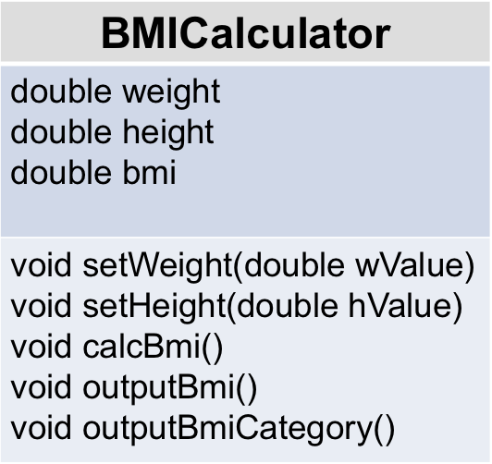
OOP Designs
OOP programs are designed using tools
Unified Modeling Language (UML) is very common
Example for class of BMICalculator
Figure 1: class “BMICalculator”
(Hribar, 2011)
Notes:
OOP programs are often designed using tools such as Unified Modeling Language, or UML. A UML diagram gives the basics about the class – the name; the attributes, also known as instance variables; and the methods. This is very useful when building a design with all the classes in a program. It gives a snapshot of how the different classes are related and what they do.
On the right side of the slide is an example design for a class called “BMICalculator.” In this class, assume three instance variables – doubles that store the weight, height, and body mass index, or BMI, for the class. Now, assume the following methods for this class:
“setWeight” - sets the value of the weight instance variable
“setHeight” - sets the value of the height instance variable
“calcBMI” - calculates the BMI and stores it in the bmi instance variable
“outputBMI” - prints the value of the bmi instance variable to the screen
“outputBMICategory,” - which outputs to the screen the weight category for the BMI that is stored in the instance variable
Note that this design is NOT for the program written in the previous two lectures for calculating BMI. That program was a simple program that did not include any classes with instance variables and methods, just a class with a main method. Instead, this is what a class might look like if a class were to be used for calculating BMI.

Slide 10
Inheritance
Inheritance is a powerful feature of OOP
Classes can inherit methods and instance variables
Makes coding less redundant
Allows for polymorphism
Notes:
Inheritance is a very powerful feature of OOP. It allows us to define classes based on the definitions of other classes. Classes can inherit methods and/or instance variables from another class. This allows for a lot less code redundancy because it defines instance variables and methods for a class that can be included in many other classes without having to rewrite them in the other class definitions.
Another powerful feature of inheritance is polymorphism. This is a concept that is difficult to understand in the abstract; the basic idea is that the same method call will trigger different methods to run, based on the class type of the object. It is not necessary to understand polymorphism at this time, but it is important to know that it is possible with OOP and inheritance.

Slide 11
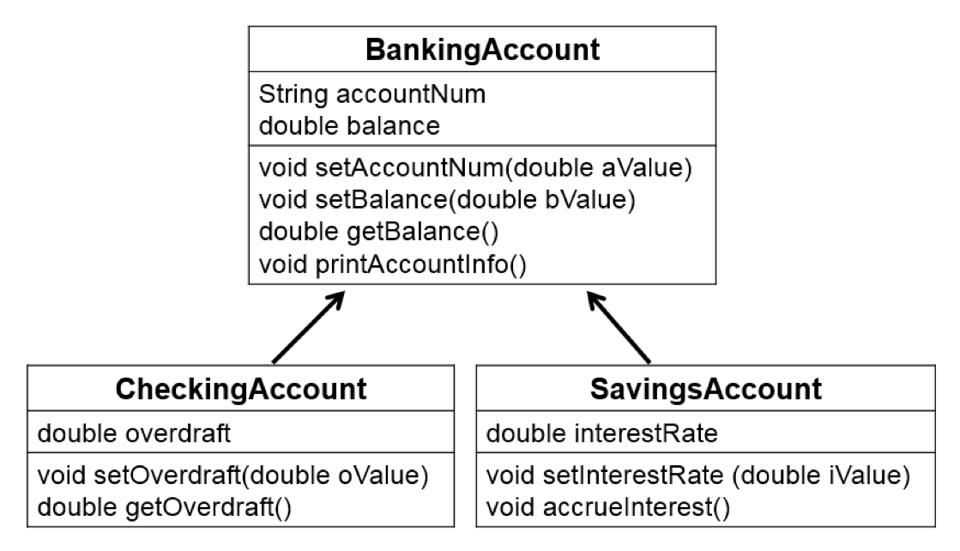
UML Diagram: Inheritance
Figure 2: Sample UML diagram.
(Hribar, 2011)
Notes:
Here's a sample UML diagram that shows inheritance. In this diagram, the base class or the parent class is the “BankingAccount” class. It has two instance variables defined – one for the account number and the other for the balance of the account. It also has four methods – one to set the value of the account number; another to set the value of balance; a third to get the value of balance; and finally, a fourth method to print all the account information to the screen.
There are two child classes: “CheckingAccount” and “SavingsAccount.” These two child classes inherit all the methods and instance variables from their parent “BankingAccount,” but they also add more instance variables and methods to their classes. For example, “CheckingAccount” has three instance variables – the two inherited ones from “Banking Account” and one defined specifically for it, named overdraft. Similarly, it has six methods – four that it inherited plus the two that are defined for it, named “setOverdraft” and “getOverdraft”.
“SavingsAccount” inherits the two instance variables from “BankingAccount” and has one additional one – “interestRate.” It also inherits four methods and has two additional methods – “setInterestRate” and “accrueInterest.”
The important concept to remember about inheritance is that the base class or the parent class defines instance variables and methods that are inherited by the child classes. This eliminates the need for the child classes to redefine these instance variables and methods in their own classes, which leads to less code redundancy. But, the child classes can also add their own instance variables and/or methods to the inherited ones. In this example, both “CheckingAccount” and “SavingsAccount” have instance variables named “accountNum” and “Balance”, but only “CheckingAccount” has an instance variable named “Overdraft”—“SavingsAccount” does not have this instance variable. Similarly, the “SavingsAccount” class has an instance variable “interestRate” that the “CheckingAccount” class does not.

Slide 12
Modularity
Separation of code into components such as objects
Non-OOP languages implement modularity
  Procedures
Allows for
  Reuse of code
  Maintainability
Notes:
Modularity is the separation of code into individual components. Objects provide modularity in OOP languages, but non–OOP languages support modularity, too. Procedures, subroutines, and functions are all examples of modules in code. The purpose of modularity is to organize the code into separate components, each of which accomplishes a particular task. This allows for code reuse – the component is defined once but can be called many times. Also, when the program is divided into components, it is easier to maintain and comprehend the code. Any changes to one component will have minimal effects on other components. Also, if changes to the program are required, it is easier to identify which component needs to be modified since each component has its own purpose. For example, if the format of a program's output is incorrect, the programmer would know to look at the component that produces output.

Slide 13
Encapsulation
Objects can declare methods and instance variables to be private or public
  Typically, instance variables are private
  Some (all) methods are public
Class definition controls
  Valid ranges for values
  Rules for setting values, calling methods
  Details of implementation are hidden
Interface is public methods and documentation
Notes:
Encapsulation builds on modularity to provide what is called "information hiding". Objects can specify whether instance variables and methods are public or private. If they are private, they cannot be accessed directly outside of the class. Typically, instance variables are private and some or all methods are public. When an instance variable is private, it cannot be accessed from outside the class, which prevents other code from changing its value. Instead, the class will provide public methods that can change or retrieve the value of the instance variable.
When a class or object is well-encapsulated, the details of the implementation of the class are hidden from any other code that will use that class. Also, instance variables can be changed and accessed only by the public methods of the class. These public methods control what valid values are for the instance variables and when the methods can be called. If the variables were public and could be modified by any code, there would be no guarantee that the values were valid. For example, if there is an instance variable of a well-encapsulated class that is used as the denominator of a fraction, the methods that set this value could ensure that it was never set to zero. If the class were not well-encapsulated – say, the instance variable was public and could be changed by any code – there would no longer be a guarantee that the instance variable was not zero.
Any other code that uses this class accesses only what is called the interface of the class. This interface is made up of the public methods of the class and any documentation about the class. When accessing the interface, the focus is only on the details needed to use the class, not on how the class is implemented.

Slide 14
Computer Programming
Summary – Lecture e
This lecture introduced:
  Object-oriented programming
  Inheritance
  Modularity
  Encapsulation
  Differences between classes and objects
Notes:
This concludes lecture e of Computer Programming.
This lecture introduced object-oriented programming and concepts such as inheritance, modularity and encapsulation. The lecture also described the differences between classes and objects.

Slide 15
Computer Programming
Summary
This unit covered:
  The purpose of programming languages
  Different types of programming languages
  The compilation/interpreter process
  Programming language constructs
  Object-oriented programming (OOP)
  How programs are designed and implemented
  What code looks like
  What objects are and why they are used
Notes:
This also concludes the unit titled Computer Programming.
This unit presented the purpose of programming languages, the different types of programming languages, how a program is compiled or interpreted, what common programming language constructs are, particularly in Java, and what OOP is. This unit also offered an understanding of how programs are designed and implemented, what code looks like, and what objects are and why they are used.

Slide 16
Computer Programming
References – 1 – Lecture e
References
Eck, D. (2011). Introduction to Programming Using Java (6th ed.). Retrieved from http://math.hws.edu/javanotes/
Lesson: Object-Oriented Programming Concepts (2011). In The Java Tutorials. Retrieved November 13, 2011. Available from http://docs.oracle.com/javase/tutorial/java/concepts/.
Morley, D., & Parker, C.S. (2010). Chapter 13: Program Development and Programming Languages. In Understanding Computers Today and Tomorrow, 12th Edition introductory. Boston: Course Technology.
Parsons, J.J., & Oja, D. (2010). Chapter 12: Computer Programming. In New Perspectives on Computer Concepts 2011: Comprehensive (13th ed.). Boston: Course Technology.
Gosling, J. (1995, February). Java: An Overview. Reprinted in: Treichel, J. & Holzer, M., (Eds.). Sun Microsystems Laboratories: The First Ten Years 1991−2001. (7-2).
Sierra, K., & Bates, B. (2009). Head First Java (2nd Ed.). O’Reilly Media.
Notes:
References slide. No audio.

Slide 17
Computer Programming
References – 2 – Lecture e
Charts, Tables, Figures
Figure 1: BMI Calculator (Hribar, 2011)
Figure 2: Child classes inherit all methods and instance variables from parent class (Hribar, 2011).
Notes:
References slide. No audio.

Slide 18
Introduction to Computer Science
Computer Programming
Lecture e
This material was developed by Oregon Health & Science University, funded by the Department of Health and Human Services, Office of the National Coordinator for Health Information Technology under Award Number 90WT0001.
Notes:
No audio.

