Slide 1
Introduction to Computer Science
Computer Programming
Lecture d
This material (Comp 4 Unit 4) was developed by Oregon Health & Science University, funded by the Department of Health and Human Services, Office of the National Coordinator for Health Information Technology under Award Number 90WT0001.
This work is licensed under the Creative Commons Attribution-NonCommercial-ShareAlike 4.0 International License. To view a copy of this license, visit http://creativecommons.org/licenses/by-nc-sa/4.0/.
Notes:
Welcome to Introduction to Computer Science: Computer Programming. This is lecture d.
The component, Introduction to Computer Science, provides a basic overview of computer architecture; data organization, representation, and structure; structure of programming languages; networking, and data communication. It also includes the basic terminology of computing.

Slide 2
Computer Programming
Learning Objectives - 1
Define the purpose of programming languages (Lecture a)
Differentiate between the different types of programming languages and list commonly used ones (Lecture a)
Explain the compiling and interpreting process for computer programs
(Lecture b)
Notes:
The learning objectives for this unit, Computer Programming, are to:
Define the purpose of programming languages.
Differentiate between the different types of programming languages and list commonly used ones.
Explain the compiling and interpreting process for computer programs.

Slide 3
Computer Programming
Learning Objectives - 2
Learn basic programming concepts including variable declarations, assignment statements, expressions, conditional statements and loops (Lectures c, d)
Describe advanced programming concepts including objects and modularity (Lecture e)
Notes:
Learn basic programming concepts including variable declarations, assignment statements, expressions, conditional statements, and loops.
And describe advanced programming concepts including objects and modularity.

Slide 4
Control Structures
Control structures determine the execution order of a program
Conditional statements
  if
  case or switch
Repetitive statements – loops
  while
  for
  do while
Notes:
In the programming example of the body-mass index, or BMI, calculator in the previous lecture, every statement was executed in the order it appeared. But this is not always the case, and frequently it is necessary to change the order of statement execution in a program. For example, it might be necessary to have a statement execute conditionally, meaning it only executes if some condition is true. There are two types of conditional statements – “if” and “case-or-switch” statements. At other times, a statement may repeat a section of code; this is called looping. There are different types of loops –for example, ”while,” “for,” and “do while.”

Slide 5
“if” Statements in Java
“if” statement presents a condition
When the condition is true, the body of the “if” statement executes
Example:
  if (weight < 0) //conditions
  { //body of if
  System.out.println("Error!");
  }
Notes:
“if” statements are conditional, which means they execute only if a specified condition is true. An example of an “if” statement in Java is given on this slide.
The first line of the “if” statement begins with “if” followed by a condition in parentheses. When this condition evaluates to true – in this case if weight is less than zero, then the body of the “if” statement executes. The body is the lines of code following the “if” statement, enclosed by curly brackets. In this example, there is only one statement in the “if” body – an output statement of "Error!" There could be multiple statements in the “if” body – as long as they appear between the open and close curly brackets. When the condition is false – in this case, “if” weight is greater than or equal to zero, the body of the “if” statement is skipped.
Note that there is no semicolon after the condition of an “if” statement.

Slide 6
“if” and “else” Statements in Java
“if” statements can include an else clause
“else” clause executes when condition is false
if (weight < 0)
{
System.out.println("Error!");
}
else
{
System.out.println("No error");
}
Notes:
“if” statements can also have an “else” clause that provides the statements that execute when the condition is false. So, this example has the same condition as the “if” statement on the previous slide: When the variable “weight” is less than zero, the message "Error!" will be printed to the screen. When the condition is false – if weight is greater than or equal to zero - the message "No error" will be printed to the screen.
Within the bodies of the “if” statement and the “else” clause, there can be multiple statements.

Slide 7
Nested “if” Statements
“If” statements can have multiple conditions
When number is less than zero, "Negative" and "Done" are printed to the screen
if (number < 0)
{ System.out.println("Negative");
}
else if (number > 0)
{
System.out.println("Positive");
}
else
{
System.out.println("Zero");
}
System.out.println("Done")
Notes:
It is also possible to build nested “if” statements where multiple conditions are checked. When a condition evaluates to true, the body of that “if” statement executes, but the rest of the statements are skipped. For example, in this code segment, if the variable “number” has a value less than zero, "Negative" is printed and the rest of the “if” statements are skipped. The next statement that executes is the one after the “if” statement; in this case, it is printing "Done" on the screen.
If the variable “number” is greater than zero, the statement prints "Positive" to the screen, followed by message "Done". Finally if the variable number is equal to zero, the word "Zero" is printed to the screen, followed by the word "Done".

Slide 8
Conditional Expressions
Use comparison operators
  <, > (less than, greater than)
  <=, >= (less than or equal to, greater than or equal to)
  ==, != (is equal to, is not equal to)
Use logical operators to combine comparisons
  && (AND): Both comparisons must be true
  || (OR): Either comparison must be true
  ! (NOT): Condition must be false
Notes:
“If” statements use conditions, which are expressions that are made up of comparisons. If there are multiple comparisons, they are combined using what are called logical operators. The comparison operators that can be used are:
Less than or greater than
Less than or equal to, or, greater than or equal to
Equal to or not equal to
Note that the equality operator in Java is a double equal sign; recall that a single equal sign is the assignment operator. “Not equal to” is an exclamation point followed by a single equal sign.
If there are multiple comparisons within a single condition, they are combined using logic operators. There is the logic operator, “AND,” which is double ampersands in Java. In order for this logical operator to evaluate to true, both comparisons must be true. The logical operator, OR, is represented in Java by two vertical lines, found above the backward slash on the keyboard. This operator is true when just one of the comparisons is true, or both. The NOT operator is the exclamation point, and it evaluates to true when the comparison is false.

Slide 9
Code Example
Write an “if” statement that will output the category for a calculated BMI
BMI | Category
< 18.5 | Underweight
18.5 – 24.9 | Normal
25.0 – 29.9 | Overweight
>=30 | Obese
Table 1: BMI table.
Notes:
This is an example that uses more complex conditional expressions. The last lecture presented a simple program that calculates the body mass index, or BMI, for a given weight and height. Now, it is time to determine the weight category for BMI. Here is a table that gives the different weight categories for ranges of BMI. For example, a BMI that is less than 18.5 is categorized as “Underweight”. A BMI between 18.5 and 24.9 is “Normal”; a BMI between 25 and 29.9 is “Overweight”. Finally, a BMI greater than or equal to thirty is categorized as “Obese”.
The next slide will present an “if” statement that will output the category for the BMI variable’s value in the previous program.

Slide 10
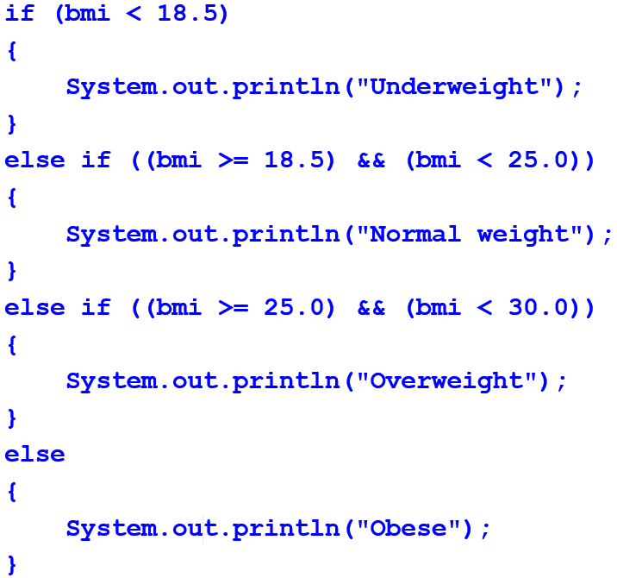
BMI Program Using Nested “If”
Notes:
Here is the “if” statement. It would appear in the program after the BMI was calculated.
The first “if” statement checks for the underweight category, which is for BMI less than 18.5.
The next nested “if” statement checks for normal weight – BMI that is within the range 18.5 to 25.0. Its condition is BMI greater than or equal to 18.5 AND BMI less than 25.0.
The next nested “if” statement checks for overweight – BMI in the range twenty-five to thirty. Its condition is BMI greater than or equal to twenty-five AND BMI less than thirty.
The final category is obese, which is greater than or equal to thirty. But it is not necessary to include that final condition since this statement includes a final “else” statement. This statement executes only if all the other conditions are not true, which means that the BMI must be greater or equal to thirty. Although the condition could be included, it is not necessary.
Note that each condition after the first one is part of an “else” statement containing another “if”. This assures that only one category will be printed out – as soon as one of the conditions is true, the category is output and the rest of the “if” statement is skipped.

Slide 11
“while” Loop
Loops are sections of code that continue to execute while a certain condition is true
“while” loop is the simplest loop
Notes:
This slide looks at loops in Java. Loops are sections of code that are repeated. They will continue to repeat as long as a given condition is true. “while” loops are the simplest loop.
The “while” loop contains a condition, similar to the “if” statement. As in the “if” statement, there is no semicolon after the condition specified in the “while” loop. After the condition, the loop body appears; it is enclosed within the curly brackets. All the statements within the loop body will be executed during each repetition of the loop. When the end of the loop body is reached, the program returns to re-evaluate the condition of the “while” loop. If it is still true, then the loop repeats again. If it is not, then the loop is skipped and the first statement after the loop executes.

Slide 12
“while” Loop - Example
count = 5;
while (count >= 0) // while condition
{
System.out.println(count);
count = count - 1; // value changes
}
Notes:
This slide shows an example of a “while” loop. The example has a variable named “count”, which is assigned the value of five. The variable “count” is used in the condition of the “while” loop. This condition is “count” greater than or equal to zero. The first time through the loop, the condition is true, so the loop executes. The value of “count” is printed and the “count's” value is reduced by one. So, the second time through the loop, “count” is now four, which is still greater than or equal to zero, so the loop executes again. This continues until “count” has been reduced to negative one, at which point the condition is no longer true and the loop is skipped.
Note that the value of “count” must change within the loop or the loop will execute forever – an infinite loop. This is a common coding error, often made by inexperienced programmers.

Slide 13
“while” Loop Example Output
Output from the statement
  5
  4
  3
  2
  1
  0
Notes:
Here is the output from the “while” loop on the previous slide. During each iteration of the loop, the value of “count” is printed and the value is decremented, or reduced, by one. Eventually, the “count” is less than zero, so the loop ends.

Slide 14
“for” Loop - 1
“for” loop is another type of loop
Used when the number of iterations is known
Heading sets loop control variable, compares it, and updates it
Notes:
A “for” loop is another type of loop. The “for” loop starts with the word "for" and is followed by a three-part statement within parentheses. The first part sets the initial value for what is called the loop control variable. The second part is the condition for the loop; it is usually a comparison using the loop control variable. As long as this condition is true, the loop will continue to execute. The final part is the update – it changes the value of the loop control variable. Presumably, this update will eventually change the loop control variable such that the condition becomes false.
“For” loops are useful when the number of iterations of the loop is known.

Slide 15
“for” Loop - 2
Output from example
  0
  1
  2
  3
  4
Example
for (i = 0; i < 5; i++)
{
System.out.println(i);
}
Notes:
In this example of a “for” loop, the loop control variable “i” is initialized to zero. The condition is “i” less than five and the update is to increment “i” by one. i++ is shorthand notation for incrementing “i” by one. The loop body is a single statement that outputs the value of “i” to the screen.
Here is the output from the previous example. “i” started at the value zero and the loop continued while “i” was less than four, incrementing by one each time. During each iteration, the value of “i” was output, so as shown here, the values zero through four were output by the loop.

Slide 16
Example
Modify BMI program
  Output BMI category
  Calculate BMI more than once
Notes:
This program will modify the BMI calculator program by adding the “if” statement for outputting the BMI category and allowing the program to calculate more than one BMI value.

Slide 17
Program Design
1. Read in weight (kg)
2. Read in height (m)
3. Calculate BMI
  BMI =
  weight/(height * height)
4. Output BMI
5. Output BMI category
6. Prompt user whether to calculate another BMI
7. If yes, go back to step 1
8. If no, end
Notes:
Here is the design. The program will still need to read in the weight and height from the user. It will calculate the BMI and then output it. Next, it will determine the category for the BMI and output it. Finally, the program will ask the user if they want to calculate another BMI. If they do, it will go back to step one and repeat. If not, the program will end.

Slide 18
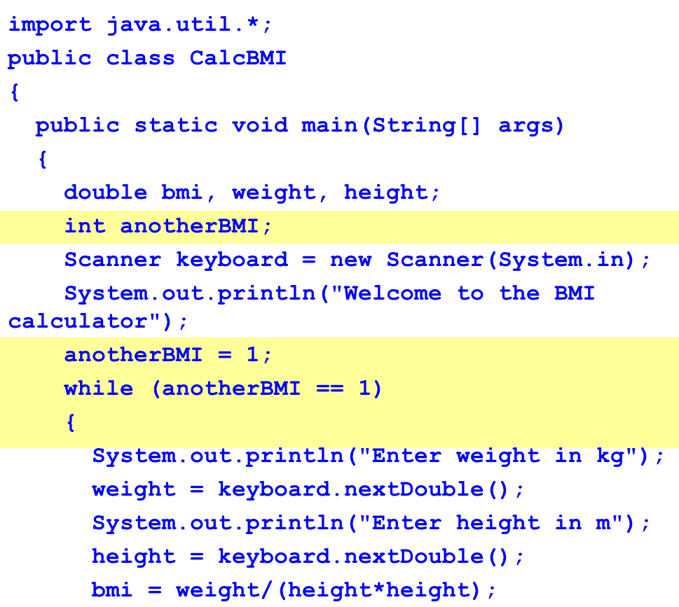
BMI Program, Revised - 1
Notes:
Here is the first part of the new program. The entire program would not fit on one slide, so it is shown on three slides. To indicate what has changed, the added code is highlighted – the yellow highlights here show the changes needed to implement the loop. In this case, the program added another variable called “anotherBMI”; it is an integer variable that can be initialized to one. The “while” loop repeats the BMI input and output loop. The condition of the “while” loop is “anotherBMI” equal to one. The first time through, the program has already initialized “anotherBMI” to one so that the “while” loop will execute. The rest of the code shown on the slide is the same as the code for the original program – getting the weight and height from the user.
The code is continued on the following slide.

Slide 19
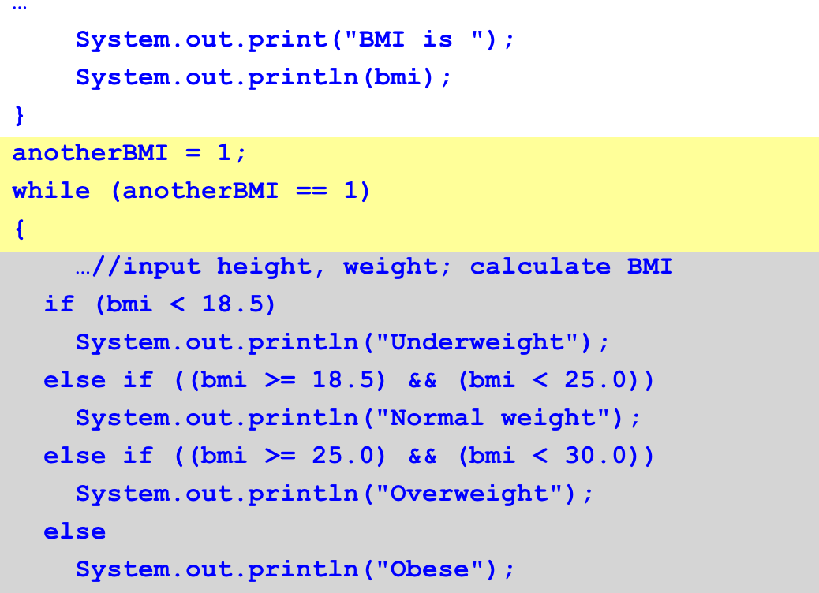
BMI Program, Revised - 2
Notes:
Now, the program will calculate and output the BMI.
It still includes the heading of the “while” loop, which was shown on the previous slide, but it skips showing the height and weight input and BMI calculation.
The next part in the code outputs the BMI category. This code is highlighted in grey. It is the same “if” statement shown previously.
The code is continued on the following slide.

Slide 20
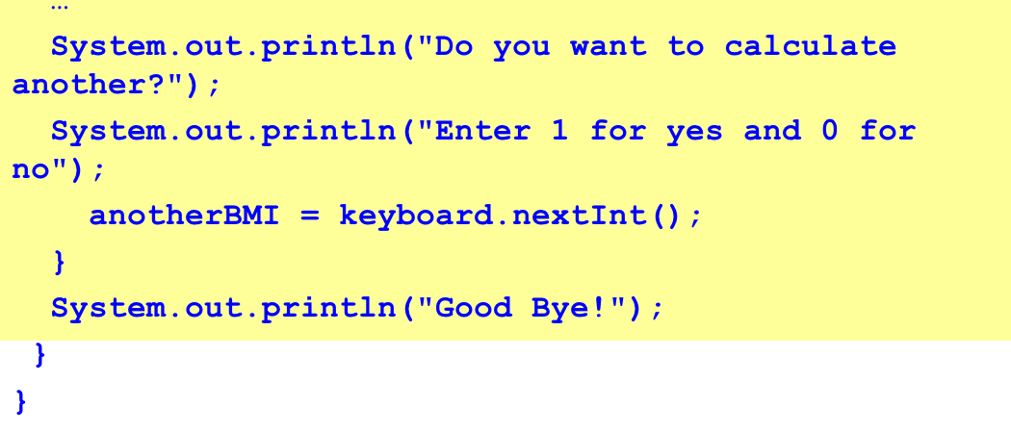
BMI Program, Revised - 3
Notes:
The final part of the loop is also new – this is where the user is asked if he or she wants to calculate another BMI. If the user does want to calculate another BMI, he or she will enter the number one; otherwise the user will enter a “zero”; actually the user could enter anything other than “one” to end the loop. The next value for “anotherBMI” is read in, and the condition for the “while” loop is evaluated again. If “anotherBMI” is one, then the loop will execute again. If not, the loop will be skipped, and the statement following the loop will be executed. In this case, it is a statement that prints "Good Bye!" to the screen.

Slide 21
Sample Output - 1
Welcome to the BMI calculator
Enter weight in kg
68
Enter height in m
1.27
BMI is 42.16008432016864
Obese
Do you want to calculate another?
Enter 1 for yes and 0 for no
1
Notes:
Here is sample output from the program. As before, the input entered by the user is given in purple. As shown here, the user is welcomed to the BMI calculator and asked to enter weight in kilograms and height in meters. The BMI is calculated and printed; in this case it is 42.16. The category for this BMI is "Obese", which also gets printed. Then the user is asked if he or she wants to calculate another.

Slide 22
Sample Output - 2
Enter weight in kg
55
Enter height in m
1.5
BMI is 24.444444444444443
Normal weight
Do you want to calculate another?
Enter 1 for yes and 0 for no
0
Good Bye!
Notes:
The user enters the number one, which means "yes" for this program, and the loop repeats again. The user is once again asked to enter a weight and a height. The BMI is calculated and printed; now it is 24.444, which has the category “normal weight”. Finally, the user is asked if he or she wants to calculate another; this time, the user enters zero, which means "no". The loop is done and the next statement is executed, which outputs "Good Bye!" to the screen.

Slide 23
Data Structures
Data structures are used for storing multiple pieces of data together
Arrays are a simple data structure
Example
  double[] grade = new double[10];
  Array of 10 doubles for storing grades
  grade[1] = 95.0;
Other data structures available
  Linked lists, trees, hash tables
Notes:
The next construct common for most programming languages is data structures. Data structures allow programs to store multiple pieces of data together in one entity. Arrays are a very simple data structure that is supported by most programming languages. Here is an example of an array in Java. It stores ten grades, where each grade is of the data type “double”. The syntax for declaring an array is as follows: first, the data type is specified, in this case “double”; it is followed by the empty square brackets that indicate that the object being declared is an array. Next, the name of the array is provided. “new” means that we are creating a new object; it is followed by another “double”. Finally, square-bracket ten square-bracket mean that the size of the array “grade” is 10, in other words it contains 10 elements. Notice the semicolon at the end of the statement. As we learned in the previous lecture, declaration statements in Java must end in a semicolon.
An index specifies a particular element in the array; it is placed within the square brackets. In this case, we're assigning the value of 95.0 to the element of the array “grade” with index one, i.e. to the first element of “grade”.
There are other, more complex data structures available. Most programming languages have libraries that provide constructs to implement data structures such as linked lists, trees, and hash tables, just to name a few.

Slide 24
Modules
Way of separating code, usually by function
  Allows for reuse
  Easier to maintain
Procedures, functions, methods are all modules
Objects are as well
Notes:
The final construct of most programming languages is a way to separate code into modules. Depending on the language, modules may be called procedures, functions, or methods. The purpose of these modules is to perform some task. The task can be written once in a procedure, and then it can be reused. Also, dividing a program into separate modules provides a more organized structure to the code, making it easier to comprehend and maintain.

Slide 25
Module Example
Example
public void printAreaCircle(double radius)
{
double area = 3.14*radius*radius;
System.out.println("Area is " + area);
}
Notes:
Here is an example of a method in Java. This method calculates and prints the area of a circle; the radius of the circle is provided as an argument to this method. This method can be called multiple times with different values for the radius.
Note that objects can also be considered modules and will be discussed further in the next lecture.

Slide 26
Computer Programming
Summary – Lecture d
Control structures determine the execution order of the program statements
“if” statements allow conditional execution
Loops allow for repeated execution
Data structures allow data to be grouped together
Modules are used to divide code into smaller units by function or purpose, and for convenience and clarity
Notes:
This concludes lecture d of Computer Programming.
In summary, control structures determine the order in which statements of the code are executed. “if” statements are control structures that allow for conditional execution. If the condition of an “if” statement is true, then the statements included in the body of the “if” statement are executed. If it is false, those statements are not executed; the statements following the “else” clause are executed instead, if “else” is included. Loops allow for code segments to be repeated. Data structures are ways to store multiple pieces of data together; arrays are an example of a data structure. Finally, modules are used to divide code into smaller units by function or purpose, and for convenience and clarity. Procedures, methods, and classes are all examples of modules.

Slide 27
Computer Programming
References – Lecture d
References
Eck, D. (2011). Introduction to Programming Using Java (6th ed.). Retrieved from http://math.hws.edu/javanotes/.
Morley, D., & Parker, C.S. (2010). Chapter 13: Program Development and Programming Languages. In Understanding Computers Today and Tomorrow, 12th Edition introductory. Boston: Course Technology.
Parsons, J.J., & Oja, D. (2010). Chapter 12: Computer Programming. In New Perspectives on Computer Concepts 2011: Comprehensive (13th ed.). Boston: Course Technology.
Gosling, J. (1995, February). Java: An Overview. Reprinted in: Treichel, J. & Holzer, M., (Eds.). Sun Microsystems Laboratories: The First Ten Years 1991−2001. (7-2).
Sierra, K., & Bates, B. (2009). Head First Java (2nd Ed.). O’Reilly Media.
Charts, Tables, Figures
Table 1: BMI Table. Example using more complex conditional expressions.
Notes:
References slide. No audio.

Slide 28
Introduction to Computer Science
Computer Programming
Lecture d
This material was developed by Oregon Health & Science University, funded by the Department of Health and Human Services, Office of the National Coordinator for Health Information Technology under Award Number 90WT0001.
Notes:
No audio.

