Slide 1
Introduction to Computer Science
Computer Programming
Lecture b
This material (Comp 4 Unit 4) was developed by Oregon Health & Science University, funded by the Department of Health and Human Services, Office of the National Coordinator for Health Information Technology under Award Number 90WT0001.
This work is licensed under the Creative Commons Attribution-NonCommercial-ShareAlike 4.0 International License. To view a copy of this license, visit http://creativecommons.org/licenses/by-nc-sa/4.0/.
Notes:
Welcome to Introduction to Computer Science: Computer Programming. This is lecture b.
The component, Introduction to Computer Science, provides a basic overview of computer architecture; data organization, representation, and structure; structure of programming languages; networking, and data communication. It also includes the basic terminology of computing.

Slide 2
Computer Programming
Learning Objectives - 1
Define the purpose of programming languages (Lecture a)
Differentiate between the different types of programming languages and list commonly used ones (Lecture a)
Explain the compiling and interpreting process for computer programs
(Lecture b)
Notes:
The learning objectives for this unit, Computer Programming, are to:
Define the purpose of programming languages
Differentiate between the different types of programming languages and list commonly used ones
Explain the compiling and interpreting process for computer programs

Slide 3
Computer Programming
Learning Objectives - 2
Learn basic programming concepts including variable declarations, assignment statements, expressions, conditional statements and loops (Lectures c, d)
Describe advanced programming concepts including objects and modularity (Lecture e)
Notes:
Learn basic programming concepts including variable declarations, assignment statements, expressions, conditional statements, and loops
And describe advanced programming concepts including objects and modularity

Slide 4
Executing Programs
Computers execute machine code
Assemblers translate assembly language into machine code
Higher-level languages must be transformed into machine code
Notes:
This lecture will focus on the compiling and interpreting process for computer programs.
Computers can execute only machine code, which are sequences of ones and zeros. Therefore programs written in any language must be converted to machine code prior to execution.
If a program is written in assembly language, which is a low-level language, an assembler is used to translate the assembly language code into machine code. This is relatively straightforward since the translation happens from a computer-specific assembly language to its corresponding machine code. But what about high-level languages that aren't specific to a particular machine? How are they converted to machine code?

Slide 5
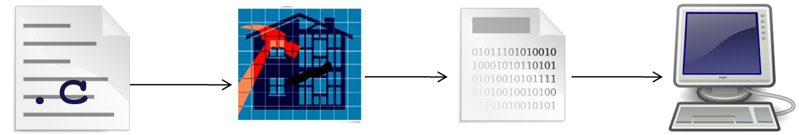
Compiled Languages - 1
(Graphics used: PD-US. Fitzsimon, 2009; Thomas & Cullen, 2001; mihi, 2010; warszawianka, 2010)
Program written and stored in a file(s)
Compiler transforms the program into machine code
Machine code is stored in a new file and can be executed
Notes:
The answer is that higher-level languages are compiled. The compiler is a software application that takes as input a program written in a particular programming language - in the case of the image on this slide, C - and outputs machine code that can run on a computer. If there are any syntax errors in the program file, the compiler will flag them and halt compilation. The programmer will need to fix these errors before the compilation will complete.
This executable program can be run over and over again without needing to be recompiled…until the next update, of course.
When the program is ready for release, its executable version can be distributed.

Slide 6
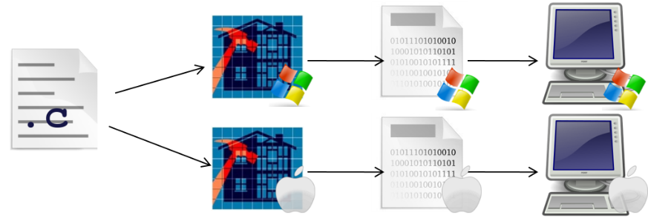
Compiled Languages - 2
(Graphics used: PD-US. Fitzsimon, 2009; Thomas & Cullen, 2001; Fitzsimon, 2007; EdibleKarma, 2008; warszawianka, 2010)
There is a unique compiler for each operating system
Every program must be compiled separately for each operating system on which it will run
Examples: C, C++, FORTRAN
Notes:
Compilers are unique to a given operating system, so there are different C compilers for Microsoft Windows, Apple OSX, and Linux. For distribution purposes, the same C program must be compiled multiple times – for each operating system it will be deployed on.
Examples of programming languages that must be compiled are C; C++; and FORTRAN, among many others.

Slide 7
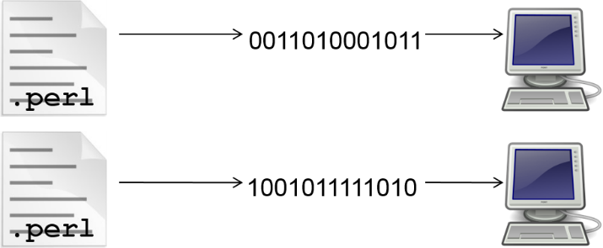
Interpreted Languages - 1
(Graphics used: Fitzsimon, 2009, PD-US; warszawianka, 2010, PD-US)
Interpreted languages are compiled and executed at the same time
Each line is compiled to machine code
  If no errors, executes and goes to next line
  If errors, program ends
Notes:
There is a slight variation on compiling called interpreting. In this case, programs written in an interpreted language are processed one line or one statement at a time.
One line is compiled to machine code and run on the computer. If the compiler finds an error, the program quits with an error message. If not, the statement executes and the next line is compiled and so on.
Note that because the interpretation step and the execution steps happen together, these programs tend to run slower than programs that are compiled. The trade-off is that interpreted languages can be faster to develop since the entire application doesn't need to be compiled before running it. During the development stage, program versions are changed frequently, which can result in a lot of compilation time, particularly for a large application.

Slide 8
Interpreted Languages - 2
The interpreter is unique to an operating system
Any program can be interpreted and run on any computer with an interpreter
Many scripting languages are interpreted
Examples:
  BASIC, Perl, MUMPS (early version)
Notes:
The interpreter for the language is unique to an operating system, but once the interpreter is installed, it can handle any program written in the corresponding language. In other words, users can port, which means to move or copy over, a program written in an interpreted language to any computer, assuming the computer has the interpreter installed. Many scripting languages are interpreted, making programs written in them portable.
Some examples of interpreted languages are BASIC, Perl, and an early version of the Massachusetts General Hospital Utility Multi-Programming System – or MUMPS.

Slide 9
Hybrid Approach
Some languages are compiled to virtual machine code, then interpreted to machine code
Combines speed of compiled language with portability of interpreted language
Examples:
  Java™, Python
Notes:
There is a hybrid approach that combines compilation and interpretation. In this case, programs are compiled to an intermediate type of code that can run on a virtual machine.
This virtual machine then interprets the code. As long as a computer has the virtual machine, it can run any code that is compiled to this intermediate state.
A virtual machine is a program that runs as a process on your computer. It tricks the operating system into thinking it is a real, physical computer.
This hybrid approach is valuable, since it combines the speed of a compiled language with the portability of an interpreted language. The virtual machine and the intermediate code are both optimized so that they run faster than a simple interpreted language would, yet there is more portability than with a compiled language.
Some examples are Java and Python. The next slide will show in detail how Java is compiled and run.

Slide 10
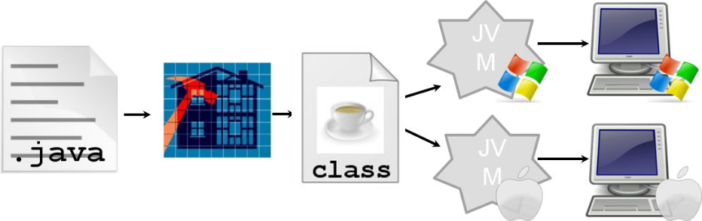
Example: Java
(Graphics used: PD-US. Fitzsimon, 2009; Thomas & Cullen, 2001; Fitzsimon, 2007; EdibleKarma, 2008; warszawianka, 2010)
Java programs are compiled to byte code
The Java Virtual Machine (JVM) runs the byte code
  JVM unique to each type of computer
  Byte code is portable
Notes:
In the case of Java, programs are compiled to what is called byte code, also called a class file. A Java Virtual Machine, or JVM, runs the byte code. Most computers today have Java installed, it is also called Java SE. Java is often installed or updated when visiting a website that uses Java. Web browsers’ use of Java is what made it so popular – any Java byte code contained within an application can run on any computer with a JVM.

Slide 11
Computer Programming
Summary – Lecture b
Compiling creates machine code from a program
Compilers are unique to each computer architecture
Interpreted programs are translated as they execute
Some languages, for example Java, implement hybrid approach of compiling and interpreting
Notes:
This concludes lecture b of the unit on Computer Programming.
In summary, a program written in a high-level language, like C or Java, must be compiled to create machine code. Because machine code is unique to each computer architecture, there must be a unique compiling process for each architecture on which the code is to run. This means that if a user wants a C program to run on different architectures, say a Windows computer and an Apple computer, the program must be compiled separately for each of those architectures.
Interpreted programs are translated differently; they use an interpreter, which is unique to each computer architecture, to translate each statement of the program as the program runs.
The Java programming language uses a hybrid approach that allows Java programs to be portable. It compiles the Java program into a byte code, which is run by the Java Virtual Machine, or JVM. The JVM is unique to each architecture, but once it is installed, any Java program can be run on that computer. This allows Java programs to be portable; they do not have to be compiled separately for each architecture.

Slide 12
Computer Programming
References – 1 – Lecture b
References
Morley, D., & Parker, C.S. (2010). Chapter 13: Program Development and Programming Languages. In Understanding Computers Today and Tomorrow, 12th Edition introductory. Boston: Course Technology.
Parsons, J.J., & Oja, D. (2010). Chapter 12: Computer Programming. In New Perspectives on Computer Concepts 2011: Comprehensive. 13th ed. Boston: Course Technology.
Programming Languages. (2011). In Wikipedia. Retrieved March 17, 2011, from Redirects to: https://en.wikipedia.org/wiki/Programming_language.
Scripting Languages. (2011). . In Wikipedia. Retrieved March 17, 2011, from https://en.wikipedia.org/wiki/Scripting_language.
The Java Language: An Overview. (2007, December). Retrieved March 21, 2011, from http://www.oracle.com/technetwork/java/index.html.
Images
Slides 5-7, 10: Text page icon. [image on the Internet]. Fitzsimon, A. (2009, April 20). Retrieved November 12, 2011 from https://openclipart.org/detail/25528/text-page-icon. This file has been released into the Public Domain.
Slides 5-6, 10: Architecture framework. [image on the Internet]. Thomas, R. & Cullen, P. (2001, April). Retrieved November 12, 2011 from: http://commons.wikimedia.org/wiki/File:Architecture_framework.jpg. This file has been released into the Public Domain.
Notes:
References slide. No audio.

Slide 13
Computer Programming
References – 2 – Lecture b
Images, continued
Slides 5-6: Binary File [image on the Internet]. mihi. (2010, April 21). Retrieved November 12, 2011 from: https://openclipart.org/detail/49411/binary-file. This file has been released to the Public Domain.
Slides 5-6, 10: Computer “tango computer”. [image on the Internet]. Warszawianka. (2010, March 27). Retrieved November 12, 2011 from: https://openclipart.org/detail/34531/tango-computer. This file has been released to the Public Domain.
Slides 6, 10: Apple Logo. [image on the Internet]. EdibleKarma. (2008, February 2007). Retrieved November 12, 2011 from: http://wikimediafoundation.org/wiki/File:Light_Apple_Logo_Free.png. This file has been released to the Public Domain.
Slides 6, 10: Microsoft Windows Logo. [image on the Internet]. Fitzsimon, A. (2007, November 13). Retrieved November 12, 2011 from: http://www.clker.com/clipart-7536.html. This file has been released to the Public Domain.
Slide 10: Java Class. [image on the Internet]. Fitzsimon, A. (2009, May 1). Retrieved November 12, 2011 from: https://openclipart.org/detail/25559/java. This file has been released to the Public Domain.
Notes:
References slide. No audio.

Slide 14
Introduction to Computer Science
Computer Programming
Lecture b
This material was developed by Oregon Health & Science University, funded by the Department of Health and Human Services, Office of the National Coordinator for Health Information Technology under Award Number 90WT0001.
Notes:
No audio.

