Slide 1
Introduction to Computer Science
Computer Programming
Lecture a
This material (Comp 4 Unit 4) was developed by Oregon Health & Science University, funded by the Department of Health and Human Services, Office of the National Coordinator for Health Information Technology under Award Number 90WT0001.
This work is licensed under the Creative Commons Attribution-NonCommercial-ShareAlike 4.0 International License. To view a copy of this license, visit http://creativecommons.org/licenses/by-nc-sa/4.0/.
Notes:
Welcome to Introduction to Computer Science: Computer Programming. This is lecture a.
This component, Introduction to Computer Science, provides a basic overview of computer architecture; data organization, representation, and structure; structure of programming languages; networking, and data communication. It also includes the basic terminology of computing.

Slide 2
Computer Programming
Learning Objectives - 1
Define the purpose of programming languages (Lecture a)
Differentiate between the different types of programming languages and list commonly used ones (Lecture a)
Explain the compiling and interpreting process for computer programs
(Lecture b)
Notes:
The learning objectives for this unit, Computer Programming, are to:
Define the purpose of programming languages
Differentiate between the different types of programming languages and list commonly used ones
Explain the compiling and interpreting process for computer programs

Slide 3
Computer Programming
Learning Objectives - 2
Learn basic programming concepts including variable declarations, assignment statements, expressions, conditional statements and loops (Lectures c, d)
Describe advanced programming concepts including objects and modularity (Lecture e)
Notes:
Learn basic programming concepts including variable declarations, assignment statements, expressions, conditional statements, and loops
And describe advanced programming concepts including objects and modularity

Slide 4
Programming Languages
All software that runs on a computer is a program
  Written using a programming language
  Many different languages available
Similar to natural languages
  Syntax
  Keywords
  Punctuation
Notes:
Any software that runs on a computer is a program, meaning that it is a set of instructions that tell a computer what to do. Every program is written in some sort of programming language. That includes everything from operating systems to word processing programs to small, simple utilities.
There are many different languages available; we will discuss them in detail later in this lecture.
Like natural languages, programming languages have a syntax—a set of specific commands and statements with rules as to how these statements can be used and combined. There are keywords that are used in the statements, and punctuation is used for combining and defining the statements.

Slide 5
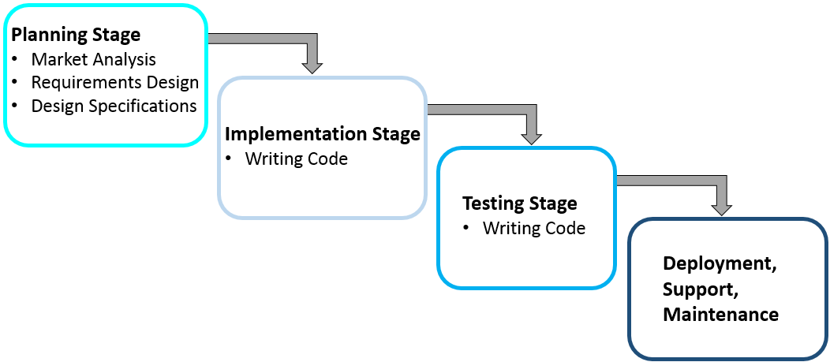
Software Development Stages
Notes:
The process of creating software is complex and time consuming. Ultimately, the end product is the program, but much more goes into the process than just writing the many different programming statements that comprise the software.
The planning/exploratory stage involves exploration of the need for new software, market analysis, formulation of specific requirements, and formulation of initial design specifications. Requirements gathering determines exactly what the software must do to be useful, along with who the stakeholders are. Stakeholders are all the people affected by the software, which includes users, management, executives, and external collaborators, among others. Specifications are high-level descriptions of each module of the future software.
The implementation phase involves the actual programming, also referred to as code writing.
As the software development is in progress, each completed module is tested thoroughly to make sure it functions correctly, properly interfaces with other parts of the program, and meets the formulated requirements. When all modules are completed and tested, the entire program undergoes extensive testing. Finally the software is deployed. As long as the software has users, there must be ongoing support and maintenance for the product, and this often includes further development.

Slide 6
Prototyping
Prototypes are initial versions of program used to collect feedback
  Paper
  Electronic, but not functional program
  Functional program, but limited
Created in initial development phase
Tool for keeping stakeholders involved
Notes:
Prototypes are initial versions of a program that are not fully functional. During any of the first stages of development, prototypes can be used for getting feedback and testing design. They can be as simple as sketches drawn on paper, or electronic prototypes that are not functional, but represent what the program will look like and how it will function. They can even be functional programs, but not yet fully implemented. In any case, the prototypes help the designers and developers communicate their thoughts to the stakeholders. The stakeholders can provide feedback about the prototype that can help refine the design. It can be helpful to have several iterations of prototyping and soliciting stakeholder feedback. This is a good way for stakeholders to stay involved with the design process without having to wait until the program has been implemented.

Slide 7
Software Development Methodology/Frameworks
Frameworks describe process and structure of development
  May include prototyping
Development team follows one particular methodology for development
Some examples
  Waterfall method (Royce, 1971)
  Spiral model (Boehm, 1986)
  Rapid application development (Martin, 1991)
Notes:
Software development methodologies, also known as frameworks, describe how the different stages of development will occur and how prototypes are to be used during these stages. A development team will follow one particular methodology for development; this will guide how the team progresses through the development stages.
There are many different methodologies available. The Waterfall method is one of the first that was widely used. In the waterfall method, each stage of development happens in a linear fashion. Over time, new methodologies built upon the waterfall method to add iteration to the process. It is often the case that development does not follow a linear progression through the stages; a previous stage may need to be revisited. For example, during the implementation phase it may be discovered that a certain function cannot be implemented the way it was designed, requiring the specifications to be reworked.
The spiral model performs the basic stages of development in a repetitive fashion, each for small subsets of the overall problem.
Rapid application development adds frequent prototypes to the mix.

Slide 8
Algorithms
Set of operations that define how a task is to be performed
Any computer program implements an algorithm
Algorithm development started long before computers were invented
Notes:
Algorithms are a key part of software design. An algorithm is a set of operations that define how a task is to be performed. Algorithms can be used to define any task that can be performed, whether it be by humans, animals - cats are thought to follow an algorithm for grooming -, or machines.
Any computer program implements algorithms. The algorithm is the “plan” or “design” for the program. It is important to design an algorithm first, before writing the program. And because algorithms can be written independent of computer programs, algorithm development occurred before there were computers. In the 19th century, Ada Lovelace wrote an algorithm for encoding Charles Babbage’s Analytical Engine to calculate Bernoulli numbers. Even though this algorithm was never implemented for the engine, since the engine was never built, it is considered by many to be the first computer program ever written.

Slide 9
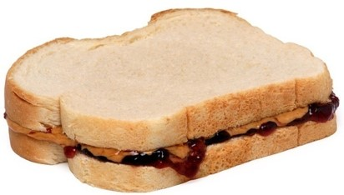
Algorithm Example - 1
Making a peanut butter and jelly sandwich (PB&J)
Get ingredients and tools
Spread peanut butter on one slice
Spread jelly on other slice
Place two slices together
(Amos, 2010, PD-US)
Notes:
Here is an example of an algorithm for making a peanut butter and jelly sandwich. There are just 4 steps to this algorithm—gathering ingredients and tools, spreading peanut butter on one slice of bread, spreading jelly on the other slice and then putting the two slices together. While this algorithm is complete, the steps are general and vague.

Slide 10
Algorithm Example - 2
Making a peanut butter and jelly sandwich
(PB&J)
Get the ingredients and tools
Two slices of bread
Peanut butter (PB)
Jelly
Knife
Spread peanut butter on one slice
Dip knife into PB
Remove knife, bringing
PB with it
Place knife PB side down on bread
Swirl knife to spread PB
Spread jelly on other slice
Place two slices together
Notes:
Contrast that algorithm with this one. In this algorithm, the four steps are the same, but it adds detailed and specific substeps. For example, this algorithm lists exactly which tools and ingredients are needed. Also, it gives very specific steps as to how to spread the peanut butter on a slice of bread. It would be possible to continue this level of detail for spreading the jelly on the other slice, but there is no more room on the slide!
The idea is that algorithms can be as specific as necessary. Some algorithms may not be specific, particularly when the user is deploying an existing tool, library, or program to accomplish that step. Since the tool is clearly defined, the design of that step does not need to be specific.
Sometimes, however, a less-specific algorithm may be difficult to implement. For example, someone who had never made a peanut butter and jelly sandwich before may be confused by the vague statement: “Get the ingredients and tools.” But an experienced peanut butter and jelly sandwich builder probably does not need a detailed list of ingredients and tools; they’ve done it before and the steps are short and easy to remember.

Slide 11
Algorithm Uses
Describes problem solution without the programming syntax
  Pseudocode
  Flowcharts
Plan solution before programming
Can determine/prove
  Correctness
  Execution time
  Required memory and storage
Notes:
Algorithms are used to describe the solution for a problem or task without using the specific programming syntax of a particular programming language. Instead, programmers can use something called pseudocode. Pseudocode consists of simple English statements that represent the steps of the algorithm; this was essentially what was being used in the peanut butter and jelly algorithm. A flowchart is a graphical description of an algorithm.
As mentioned previously, algorithms are used to plan a program before writing any programming statements. Potential problems with the algorithm itself can be found before any implementation occurs. The algorithm can be analyzed for correctness—by asking, does it produce a correct result? How long will it take to complete and how much memory storage will it consume? This information is necessary for determining if the algorithm should be implemented at all. Often, there are alternative algorithms that could be applied for a given problem, and some of them perform better than others.

Slide 12
Coding
Programs/programming statements are generically called code
Writing programs is called coding
Choices for programming languages:
  Functionality of program
  On what platform it will run
  What is available
Notes:
After a programmer has chosen an algorithm, programming can begin. Programs and programming statements are also referred to as code, which is short for computer code. Writing programs is therefore referred to as coding.
There are many different programming languages available; programmers must select one to use. The choice of programming language depends on several factors. First, what is the program going to do? If it will run within a webpage on a client computer, then a scripting language like JavaScript may be best. If it is going to run on a Windows PC, then a Microsoft developed language like C# might be chosen. If a program is to run on multiple different machines, Java might be the best choice. Ultimately, programmers are constrained by what programming languages they have access to. For example, languages like Java are freely available, but developing in a Windows environment requires purchasing software tools that can be expensive.

Slide 13
Programming Language Categories
Low-level
  First Generation
    Machine code (1s and 0s)
  Second Generation
    Assembly language
    Words to describe commands
High-level
  Third Generation
    FORTRAN, BASIC, C, Java
  Fourth Generation
    SQL
    Powerful, complex commands
  Fifth Generation
    Prolog, visual programming
Notes:
Here is a list of five generations of programming languages and some examples of each. In some ways, this list represents the progression of programming languages over time, but not in all cases, for example, some third-generation languages are newer than some fifth-generation languages.
The first-generation languages were machine code, which is the sequence of 1s and 0s that the computer can understand and execute. Needless to say, programming in 1s and 0s isn't easy, so future generations of languages were developed to make programs more understandable to humans. The second generation of languages were assembly languages that translated those 1s and 0s into words. This was a better approach but still somewhat limited, particularly since assembly languages were unique to each type of computer. Third-generation languages added operations to the commands to make the programs more general; now programming languages were no longer tied to a particular computer. This third generation of languages includes older languages such as FORTRAN, BASIC, and C, but also newer languages like Java.
Fourth-generation languages use powerful, complex commands that result in fewer programming statements. Database querying languages such as Structured Query Language, or SQL, are good examples of this. Database querying languages will be covered in depth in Unit 5. Fifth-generation languages attempt to come even closer to natural languages, which is what Prolog was developed to do. Other experts consider programming using visual, interactive environments to be fifth-generation programming.
First- and second-generation languages are considered to be low-level languages; that is, they are closer to the actual machine code that the computer understands. Third-generation and up are considered to be high-level languages; they are closer to natural language than they are to machine code.
We will discuss first- through third-generation languages on the next slides. Fourth and fifth generations are beyond the scope of this unit.

Slide 14
First-Generation Machine Code
Each computer has an instruction set
  Tasks the computer can do
  Unique sequence of 0s and 1s
Applications are groups of instructions
Programmers used to program in 0s and 1s
  Switches
  Punched cards
Notes:
Every computer has its own instruction set, usually a small set of tasks the computer can do. Each instruction is a unique sequence of zeros and ones.
Every computer program or application is ultimately represented as machine code, which are groups of instructions, often numbering in the millions.
When computers were first created, programmers had to program using machine code—there were no other programming languages. How this was done was dependent on the computer. Some computers had series of switches that needed to be turned on or off, corresponding to ones and zeros. Other machines were programmed using punched cards where the punches or no punches in specific positions represented zeros and ones. A stack of these punched cards then became the program and data; cards were fed into the computer using a card reader.

Slide 15
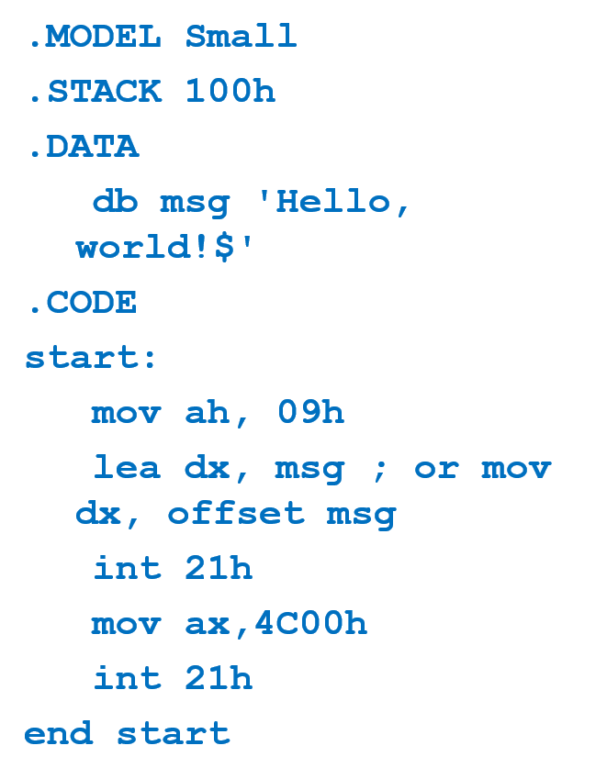
Second-Generation
Assembly Language
Use words to represent instructions
Translate assembly code into machine code
Computer-specific, just as machine code is
Notes:
While sequences of zeros and ones are understandable to a computer, they are not particularly clear to humans. Assembly languages used words to represent instructions and data. The slide displays an example of assembly code, an improvement over zeros and ones but still tedious to read and program. Also, because assembly language is almost a direct translation of machine code, it is unique to each computer system. That means that the same program written to run on a Windows 10 PC would need to be rewritten to run on an iMac. Also, because each statement is a short machine instruction, assembly code is very, very long.

Slide 16
Third-Generation Languages
The next generation of languages added operations
  No longer unique to a computer system
  Programs more portable
Modern programming languages are third generation
  FORTRAN, COBOL, C, C++, C#, Java, VB.Net
Notes:
The next generation of languages moved away from machine code as the basis of the programming statements. Instead, the syntax of the languages focused on operations that could be done, regardless of the underlying machine code. This meant that the same programs could be executed on different types of computer systems.
Many modern programming languages belong to the third-generation category. Third-generation languages include:
FORTRAN, a language developed and used in the scientific and engineering community
COBOL, a language developed and used by the business and financial community
C, a language developed for large systems but now used extensively for other applications as well
C++, an object-oriented version of C
C#, a portable object-oriented language developed by Microsoft
Java], a freely available, portable object-oriented language
VB.Net, an object-oriented version of Visual Basic developed by Microsoft.

Slide 17
Programming Paradigms
Procedural
  BASIC, COBOL, FORTRAN, C
Functional
  LISP, Scheme
Object-oriented languages
  C++, C#, Java, Ruby
Others
  Declarative, event-driven, domain-specific, logic
Notes:
Programming paradigms relate to the style and concepts used for programming. Different languages support different paradigms; often a language will support multiple paradigms.
Procedural programming languages focus on structuring code according to its function. Such language contains a set of procedures, also called subroutines, functions, or methods. A procedure is a series of steps that are performed to accomplish a certain task, or calculate a result. These procedures are called during the execution of the program. The procedural programming paradigm is very popular and many languages support it, including BASIC, COBOL, FORTRAN, and C.
The functional programming paradigm relies on functions for its programming statements. These statements are similar to mathematical functions and formulas. LISP and Scheme are examples of functional programming languages. While functional programming has been predominantly used in academic settings, there are some functional programming languages used in applied sciences and engineering, for example R is designed for statistics, and Mathematica is a multipurpose mathematics package. Also, spreadsheet software such as Excel can be considered functional programming because of its built-in functions and capacity to accommodate user-supplied formulas.
Object-oriented programming, or OOP, is similar to procedural programming except that procedures, or methods, as they are called in object-oriented languages, are grouped with variables that relate to them to form objects. Objects are created during the execution of the program, and all method calls are attached to some object. Object-oriented programming has become very popular, and there are many languages that support it such as C++; C#; Java; and Ruby.
There are many other programming paradigms such as declarative programming used in SQL queries; event-driven programming that is used in programming graphical user interfaces; domain-specific languages such as Hyper-Text Markup Language, or HTML, used in web browsers; and logic programming that represents programming as logic formulas and rules; Prolog is an example of this.

Slide 18
Scripting Languages
Languages that control other applications
  Batch control – shell scripts
  Web browsers – JavaScript
  Text processing – Perl
Some have evolved for general application development
  Perl, Python
Notes:
Another type of programming language that is often used today is called a scripting language. Originally, scripting languages were developed to "program" or control other applications. This was necessary for early systems where programs were batched and run at the same time. Shell scripts are the scripting languages that were developed to do this in UNIX environments. JavaScript is an example of a scripting language that works within web browsers to control how a webpage is displayed. Perl was created for easy processing of text files.
Some scripting languages have evolved to full-fledged application development languages, such as Perl and Python, though they are still referred to as scripting languages because of their origins.

Slide 19
Some Languages Specifically Designated for Health Care
Massachusetts General Hospital Utility Multi-Programming System, MUMPS; Neil Pappalardo first developed in 1960s, standardized in 1977
Meditech Interpretive Information System, MIIS Proprietary implementation of MUMPS, 1969
Multitype Automation Group In Cooperation, MAGIC MEDITECH Corp – founder Neil Pappalardo, 1982
Notes:
Special-purpose languages for health care include MUMPS; MIIS; and MAGIC, which were all developed by Neil Pappalardo, founder of Meditech. Many electronic health record systems are written at least in part using a language from this family of languages.

Slide 20
Computer Programming
Summary – 1 – Lecture a
Programming languages consist of commands computers understand, which are used for coding
There are methodologies designed for software development
An algorithm is a sequence of operations that defines how a task is to be performed
Notes:
This concludes lecture a of Computer Programming.
This lecture covered programming languages, which consist of commands that programs can understand and syntax, the appropriate ways to use the commands. Software is written in a programming language; the development process for creating software is complex. It contains stages for market research, requirements gathering, design, implementation, testing, and maintenance. There are different ways to accomplish these stages; a methodology specifies how the development process will iterate through the stages and when prototypes are used. Program design includes algorithms, which are sequences of tasks.

Slide 21
Computer Programming
Summary – 2 – Lecture a
Programming languages vary in structure and proximity to natural languages
Procedural, functional, and object-oriented are a few common programming paradigms
There are specialized programming languages developed specifically for health care
Notes:
There are many different programming languages; some are high-level or closer to natural language such as Java. Others are more like machine code, the language the computer understands. These are called low-level languages. There are different programming paradigms as well: procedural, functional, or object-oriented programming, to name a few. Finally, some programming languages like MUMPS have been developed specifically for the health care setting.

Slide 22
Computer Programming
References – 1 – Lecture a
References
Boehm, B. (1986). A spiral model of software development and enhancement. ACM SIGSOFT Software Engineering Notes, 11(4), 14-24.
Meditech. [webpage]. Medical Information Technology, Inc. Retrieved from https://ehr.meditech.com/.
MIIS. (2011). In Wikipedia. Retrieved November 13, 2011, from http://en.wikipedia.org/wiki/MIIS_%28programming_language%29.
Morley, D., & Parker, C.S. (2010). Chapter 13: Program Development and Programming Languages. In Understanding Computers Today and Tomorrow, 12th Edition introductory. Boston: Course Technology.
MUMPS. (2011). In Wikipedia. Retrieved March 1, 2011, from http://en.wikipedia.org/wiki/MUMPS.
Parsons, J.J., & Oja, D. (2010). Chapter 12: Computer Programming. In New Perspectives on Computer Concepts 2011: Comprehensive. 13th ed. Boston: Course Technology.
Programming Languages. (2011). In Wikipedia. Retrieved March 17, 2011, from http://en.wikipedia.org/wiki/Programming_languages.
Notes:
References slide. No audio.

Slide 23
Computer Programming
References – 2 – Lecture a
References, continued
Programming Paradigms. (2011). In Wikipedia. Retrieved March 17, 2011, from http://en.wikipedia.org/wiki/Programming_paradigms .
Rapid Application Development. (2011). In Wikipedia. Retrieved November 13, 2011, from http://en.wikipedia.org/wiki/Rapid_application_development.
Scripting Languages. (2011). In Wikipedia. Retrieved March 11, 2011, from http://en.wikipedia.org/wiki/Scripting_languages.
Software Development Methodology. (2011). In Wikipedia. Retrieved November 13, 2011, from http://en.wikipedia.org/wiki/Software_development_methodology.
Waterfall Model. (2011). In Wikipedia. Retrieved November 13, 2011, from http://en.wikipedia.org/wiki/Waterfall_model.
Images
Slide 9: Peanut Butter and Jelly Sandwich. [image on the Internet]. Amos, E. (2010, November 11). Retrieved January 2012, from http://en.wikipedia.org/wiki/File:Peanut-Butter-Jelly-Sandwich.jpg. This file has been released into the Public Domain.
Notes:
References slide. No audio.

Slide 24
Introduction to Computer Science
Computer Programming
Lecture a
This material was developed by Oregon Health & Science University, funded by the Department of Health and Human Services, Office of the National Coordinator for Health Information Technology under Award Number 90WT0001.
Notes:
No audio.

