Slide 1
Introduction to Health Care and Public Health in the U.S.
Regulating Health Care
Lecture c
This material (Comp 1 Unit 6) was developed by Oregon Health & Science University, funded by the Department of Health and Human Services, Office of the National Coordinator for Health Information Technology under Award Number 90WT0001.
This work is licensed under the Creative Commons Attribution-NonCommercial-ShareAlike 4.0 International License. To view a copy of this license, visit http://creativecommons.org/licenses/by-nc-sa/4.0/.
Notes:
Welcome to Introduction to Health Care and Public Health in the U.S.: Regulating Health Care. This is lecture c.
The component, Introduction to Health Care and Public Health in the U.S., is a survey of how health care and public health are organized and how services are delivered in the U.S. It covers public policy, relevant organizations and their interrelationships, professional roles, legal and regulatory issues, and payment systems. It also addresses health reform initiatives in the U.S.

Slide 2
Regulating Health Care
Learning Objectives - 1
Describe the role of accreditation, regulatory bodies, and professional associations in health care in the U.S. (Lecture a)
Describe the basic concepts of law in the United States: the legal system, sources of law, classification of laws, the court system, and the trial process (Lecture b)
Notes:
The learning objectives for Regulating Health Care are to:
Describe the role of accreditation, regulatory bodies, and professional associations in health care in the U.S.
Describe the basic concepts of law in the U.S.: the legal system, sources of law, classification of laws, the court system, and the trial process.

Slide 3
Regulating Health Care
Learning Objectives - 2
Describe legal aspects of medicine involving the Affordable Care Act, professional standards in health care, medical malpractice, Tort reform, and Medicare and Medicaid Fraud and Abuse (Lecture c)
Notes:
Describe legal aspects of medicine involving the Affordable Care Act, professional standards in health care, medical malpractice, tort reform, and Medicare and Medicaid fraud and abuse.

Slide 4
Regulating Health Care
Learning Objectives - 3
Describe key components of the Health Insurance Portability and Accountability Act (HIPAA) and describe efforts to promote patient safety in the U.S. (Lecture d)
Discuss the need for quality clinical documentation for the use of the health record as a legal document, communication tool and a key to prove compliance for health care organizations (Lecture e)
Notes:
Describe key components of the Health Insurance Portability and Accountability Act, or HIPAA, and current issues concerning privacy and patient safety in the U.S.
And, discuss the need for quality clinical documentation for use of the health record as a legal document, communication tool, and a key to prove compliance for health care organizations.

Slide 5
Affordable Care Act (ACA) - 1
Comprehensive health care reform
Passed by Congress and signed into law by President Obama on March 23, 2010
Supreme Court upheld ACA on June 28, 2012
Health Insurance Marketplace began October 1, 2013 – states had option to use federal site or develop their own
Notes:
The affordable care act, or ACA, provided comprehensive health care reform. It was passed by Congress and signed into law by President Obama on March 23, 2010.
It was contested, and the Supreme Court upheld the ACA on June 28, 2012.
The Health Insurance Marketplace began October 1st, 2013, and the states had an option to use the federal website or develop their own enrollment site.

Slide 6
Affordable Care Act (ACA) - 2
20 million people gained insurance coverage via the Affordable Care Act or “Obamacare”
  Expands coverage
    Individual mandates
    Private insurance that allows young adults to stay on parents’ health insurance plans
    Medicaid expansion
  Requires plans to cover people with pre-existing conditions
  Provides free preventive services
Notes:
This act provides millions of Americans more access to affordable health insurance options. Most individuals are required to have health insurance or pay a penalty. The Health Insurance Marketplace allows individuals and small businesses to compare a variety of affordable health plans. Middle- and low-income families now receive tax credits that cover a significant portion of the cost of coverage. The Medicaid program was expanded to cover more low-income Americans. ACA also requires that there are plans to cover patients with pre-existing conditions. And finally, the act provides for free preventive services.

Slide 7
State Medical Practice Acts
Define the practice of medicine
Regulate how medicine will be practiced within the state
Establish medical board
  Set standards
  Create process
  Investigate complaints
Notes:
Every U.S. state, the District of Columbia, and every U.S. territory has its own medical practice act. Each of these acts establishes a state medical board. These boards license physicians and discipline those physicians who break the law. In addition, they investigate complaints about physicians who may be unethical or incompetent.
The organization and the authority of state medical boards vary. In some states, the boards are independent and have authority over all licensing and disciplinary matters. In other states, the board is part of another organization, such as the state department of health. State medical boards usually include volunteer physicians and members of the public.

Slide 8
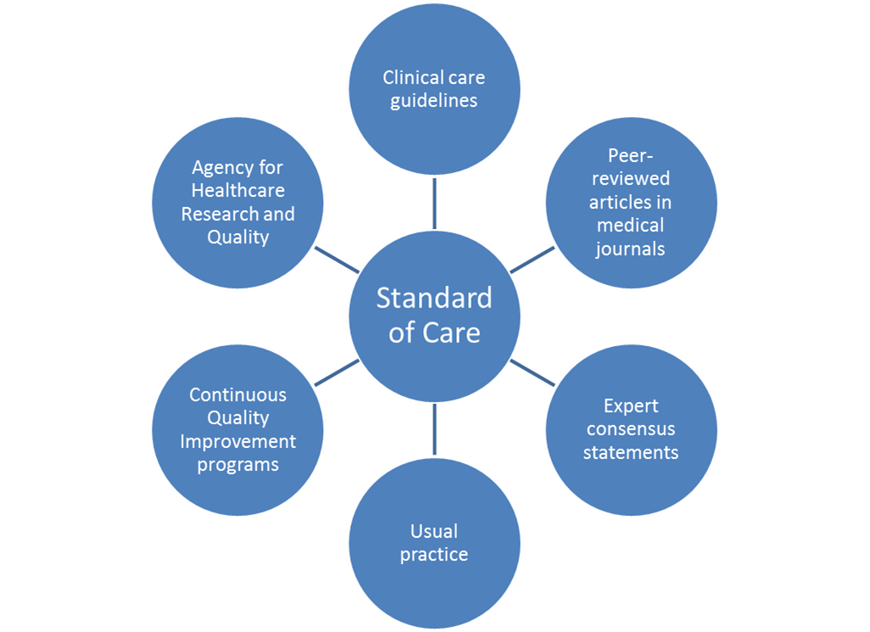
Standards of Care
6.1 Figure: Diagram showing a few of the many sources that can contribute to a medical standard of care. (OHSU, 2010)
Notes:
Legally speaking, a medical standard of care is the level of skill and professionalism that a reasonably prudent physician would provide. A prudent physician is one who is careful, sensible, and uses good judgment. Standards of care usually come from within the medical profession; however, they can also come from entities outside the profession, such as insurance companies. This illustration on this slide shows just a few of the many sources that can contribute to a medical standard of care.

Slide 9
Informed Consent
Requirement that patient be fully informed and give consent to treatment
Process of communication between doctor and patient
Required legally and ethically
Absence can result in liability
  Battery
  Negligence
Notes:
Informed consent is the concept that a patient must be fully informed about the proposed treatment before consenting to or refusing the treatment. This is required both legally and ethically. If the patient is a child or is not mentally competent, someone with legal authority must give consent for that person. Other exceptions exist, including principles that apply when a patient is unconscious or in an emergency situation.
Informed consent should include more than just handing the patient a form to sign. It should be a process of communication between the patient and the health care professional. If a patient gives consent but is not fully informed, or if the patient does not give consent and the procedure is performed anyway, that can result in legal problems for the health care provider.

Slide 10
Informed Consent Process - 1
Physician or other health care professional explains:
  Risks and benefits
  Other options, including no treatment
Opportunity to ask questions and get satisfactory, understandable answers
Notes:
Meaningful informed consent can be given only if the patient is fully informed about the risks and benefits of the proposed treatment, as well as the risks and benefits of other options. The patient must have the opportunity to ask questions and receive understandable answers.

Slide 11
Informed Consent Process - 2
If desired, takes time to discuss the situation with others
Opportunity to communicate the decision to physician or treatment team
Notes:
If the patient wants time to discuss the treatment plan with others, that should be allowed. After deliberating, the patient should have the opportunity to communicate his or her decision to the treatment team.

Slide 12
Informed Consent with
Shared Decision Making (SDM)
SDM: Informed discussion between providers and patient to help patient decide among multiple acceptable health care choices. Discussion must include patient’s priorities and values.
Decision aids facilitate SDM. Include information on options, risks, benefits, and can include a priority-setting activity and coaching.
Notes:
Some states have proposed or passed legislation to require shared decision making be part of the informed consent process. Shared decision making is an informed discussion between providers and a patient to help the patient decide among multiple acceptable health care choices. The discussion incorporates the patient’s priorities and values. Decision aids are tools designed to facilitate the shared decision making process. These aids include information on the options, risks and benefits of the options, and often include a priority-setting activity and some coaching or guidance to prepare for the planned, shared discussion. Patients typically view a decision aid before meeting with their own provider or team of providers to determine the health care choice that best matches their values and preferences.

Slide 13
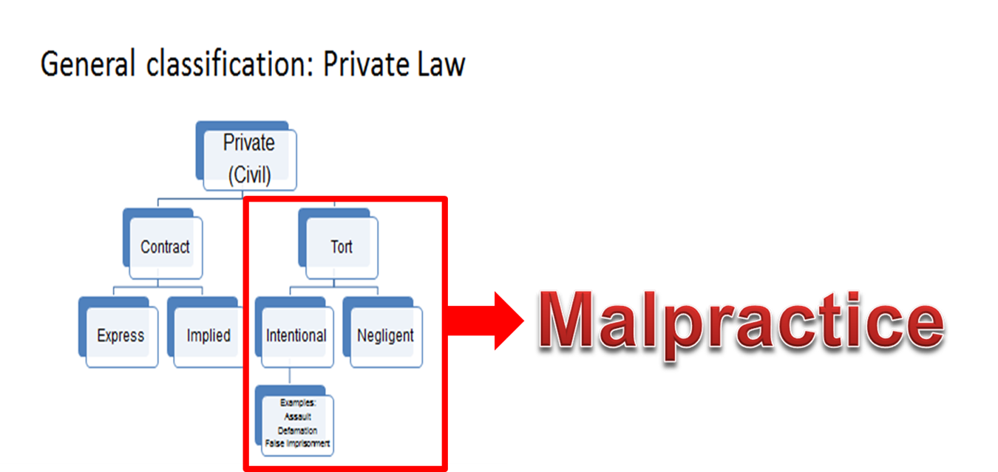
Tort Law and Malpractice
6. 2 Chart: Diagram showing how Tort law is the part of private or civil law that deals with malpractice (OSHU, 2010).
Notes:
A previous lecture in this unit introduced the concept of tort law. This subcategory of civil law deals with something that one person has done to another that has resulted in harm and does not come out of a contractual relationship. The main two types of torts are intentional torts and negligent torts. Most claims of medical malpractice fall under the category of tort law, and the majority of these are based on a theory of negligence.

Slide 14
Elements of Malpractice
Duty of reasonable care to the injured party
Did not meet the minimum standard of care or failed to obtain informed consent
Failure to meet the standard of care was the proximate cause of the injury
The injury resulted in damages
Notes:
The first element of any tort claim is to establish that the defendant had a duty to the injured party. In a medical malpractice claim, the defendant is generally the health care professional or organization that is being accused of negligence. Therefore, the injured person must establish that a professional relationship existed. For example, this could be a doctor-patient relationship, or the patient could simply show that a hospital admitted him or her for treatment. After the relationship is established, a duty of reasonable care is implied.
Next, the patient must prove that the care provided was not up to the minimum standard of care that a reasonably prudent professional would provide in similar circumstances. It is not enough that the patient did not get better, or even that the patient’s condition worsened. The patient must prove that he or she did not receive appropriate treatment and that the health care professional’s failure to provide appropriate treatment was the proximate, or primary, cause of the injury.
Even if treatment was inadequate, the patient does not have a valid malpractice claim unless he or she was harmed. However, the harm does not have to be physical. For example, if the substandard treatment resulted in provable emotional distress, or if the patient had to miss work to receive additional treatment, these could qualify as harm for the purpose of proving a malpractice claim.

Slide 15
Statute of Limitations
Time limit for filing a lawsuit
  Short as 6 months
  Long as 4 years
Discovery rule
  Time limit starts when the malpractice is discovered, rather than when it was allegedly committed
Notes:
The statute of limitations is the time limit a patient has for filing a lawsuit. These time limits vary greatly from state to state, ranging from six months to four years. In many instances, however, the time limit does not start to run when the negligent act is committed. Rather, it begins when the negligent act is discovered. This is known as the discovery rule.
For example, suppose a surgeon leaves a sponge inside a patient. In states that apply the discovery rule, the patient’s time limit for filing a lawsuit would begin when the sponge is discovered, not on the date of the original surgery. As with most of the legal concepts discussed in these lectures, there are many exceptions to these general rules.

Slide 16
“Good Samaritan” Laws
Apply in emergencies
Protect people who do not have an obligation to help
Rescuer must use common sense
Rescuer must not act beyond expertise and capabilities
Notes:
Good Samaritan laws provide malpractice protection for certain people who provide emergency assistance. Like most other laws about medical negligence, Good Samaritan laws vary by state. However, all of them apply to people who do not have a duty to help under the circumstances, such as a driver who happens to come upon a car accident. It is expected that rescuers will use common sense and not act in ways that are beyond their expertise and capabilities. If the person is being paid or expects to be paid for the services, the Good Samaritan law does not apply.

Slide 17
Tort Law Reform - 1
Pre-trial screening panels
  Reviews case at early stage and gives opinion about merit
Certificate of merit
  From qualified medical expert in order to file a lawsuit
Attorney fee limits
  Limits on percentage and/or total amount
Notes:
In response to criticism of the current system of malpractice, many kinds of reforms have been explored by individual states.
A recent report to the Medicare Payment Advisory Commission evaluated the most common tort reform laws. For example, some states require a pretrial screening panel to review the evidence in a case at an early stage and give an opinion about whether the lawsuit is justified.
Before a patient can file a medical malpractice claim in court, a qualified medical expert must document that a valid claim seems to exist, and the patient must present this document, called a certificate of merit.
Attorney-fee limits restrict the amount an attorney can be paid for representing a patient in a malpractice suit. The state might limit the dollar amount the attorney can charge, the attorney’s percentage of the total award, or both.

Slide 18
Tort Law Reform - 2
Periodic payment
Joint-and-several liability reform
  More than one defendant - limits amount that can be recovered from each
Caps on non-economic damages
  Limit payments for pain and suffering
Notes:
Periodic payment allows insurers to pay damage awards in smaller periodic payments, rather than in one lump sum.
Joint-and-several liability reform means that if there is more than one defendant, the patient cannot recover the whole amount from any one of them. Rather, each defendant is responsible for only a limited amount of the total damages.
Non-economic damages are those that cannot easily be expressed in dollar amounts, such as pain and suffering. A cap on these damages limits either the amount of money that the patient can receive or the amount each defendant has to pay.

Slide 19
Tort Law Reform - 3
Results Considered:
  Costs
  Frequency of malpractice claims
  Supply of health care services,
  Quality of care
  Need for physicians to practice so-called defensive medicine
The only tort reform that significantly improved these results was the cap on noneconomic damages
Notes:
The report to the Medicare commission assessed the results of these and two other tort law reforms. The results considered were: costs, the frequency of malpractice claims, the supply of health care services, the quality of care, and the need for physicians to practice so-called defensive medicine, such as sending the patient for excessive testing in order to protect themselves. The only tort reform that significantly improved these results was the cap on noneconomic damages.

Slide 20
Newer Tort Law Reforms
Pre-determined non-economic damages
Administrative compensation systems (“health courts”)
  Neutral expert witnesses
  Knowledgeable hearing officers
Disclosure-and-offer programs
  Mistakes are admitted
  Compensation is offered
Notes:
One proposed reform now being evaluated is for a panel of experts to predetermine what noneconomic damages are appropriate in a lawsuit. In this approach, the various possible medical injuries are listed and ranked by severity. For each level of severity, a range of dollar values is assigned for allowable noneconomic damages.
Health courts are an alternative to the regular court system, and many variations have been proposed. A major difference between health courts and regular courts is that in a health court, the expert witnesses are neutral, instead of being paid by one side or another. Another major difference is that the judge or hearing officer must be knowledgeable about health care matters.
In disclosure-and-offer programs, institutions encourage health care professionals to tell patients about medical errors. In appropriate cases, the institution offers modest compensation so the parties do not need to go to court.

Slide 21
Innovative Tort Reform
“Safe harbor” for adherence to practice guidelines based on the latest medical research
More evidence needed to assess newer reform proposals
Affordable Care Act authorizes $50 million in grants for projects that evaluate the effectiveness of newer tort reform proposals
Notes:
A safe harbor law reduces or eliminates defendants’ liability if they can show that they followed a reasonable standard of care. One proposal is that health care professionals have a safe harbor if they follow evidence-based practice guidelines. These are typically published guidelines that are based on the latest medical research.
The report to the Medicare commission concluded that there is not yet enough evidence to properly evaluate any of these newer reforms. However, the report said the existing evidence is promising enough to justify demonstration projects to gather more information.
The Affordable Care Act authorizes fifty million dollars in grants to states to develop, implement, and evaluate alternatives to tort lawsuits.

Slide 22
Fraud, Waste, and Abuse
Office of Inspector General (OIG) protects integrity of Medicare, Medicaid, other government programs
Fraud: Intentional misrepresentation or concealment of relevant facts
Waste: Unnecessary costs as a result of poor management practices or controls
Abuse: Excessively or improperly using government resources
Notes:
Another venue in which law and medicine interact is in the Medicare and Medicaid programs. The U.S. Department of Health and Human Services has an Office of Inspector General, or OIG, that protects the integrity of Medicare, Medicaid, and other government programs. The OIG defines fraud as gaining a benefit by intentional misrepresentation or concealment of relevant facts. Waste means incurring unnecessary costs as a result of poor management practices or controls. Abuse refers to excessive or improper use of government resources. In cases of fraud, waste, or abuse, the OIG can pursue both criminal and civil penalties.

Slide 23
Federal Fraud and Abuse Laws
False Claims Act
Anti-Kickback Statute
Stark Law
Exclusion Statute
Civil Monetary Penalties Law
Notes:
Five major federal laws address Medicare and Medicaid fraud, waste, and abuse.
Briefly, the False Claims Act prohibits the submission of false or fraudulent claims to the federal government.
The Anti-Kickback Statute forbids asking for or receiving anything of value in exchange for referrals of federal health care program business.
The Stark Law prohibits physicians from referring Medicare or Medicaid patients to clinical laboratories and certain other services in which they have a financial interest.
The Exclusion Statute bans individuals or organizations convicted of certain crimes from being providers in the Medicare and Medicaid programs.
The Civil Monetary Penalties Law authorizes the OIG to impose fines on health care providers who commit fraud, waste, or abuse.

Slide 24
Regulating Health Care
Summary – 1 – Lecture c
Laws that apply to health care are numerous and complicated
System is changing rapidly as a result of the Affordable Care Act and tort reform proposals
Notes:
This concludes Lecture c of Regulating Health Care.
In summary, a number of complicated laws apply to health care. Moreover, the system is changing rapidly because of the Affordable Care Act and the many proposals for tort law reform.

Slide 25
Regulating Health Care
Summary – 2 – Lecture c
Still, health care providers must:
  Obtain informed consent from their patients
  Act consistently with reasonable standards of care
  Avoid Medicare/Medicaid fraud, waste, and abuse
Notes:
However, the basics of health care law remain the same. Health Care providers must obtain informed consent from their patients, and they must provide care that is consistent with reasonable standards. In addition, if they are Medicare or Medicaid providers, they must conduct their practices in accordance with the federal standards for those programs.

Slide 26
Regulating Health Care
References – 1 – Lecture c
References
Agency for Health Care Research and Quality. Patient safety primer: never events. https://psnet.ahrq.gov/primers/primer/3. Accessed January 27, 2017.
American Cancer Society. Informed consent. Updated 07/28/2014. https://www.cancer.org/treatment/finding-and-paying-for-treatment/understanding-financial-and-legal-matters/informed-consent/intro.html. Accessed January 27, 2017.
Code of Ethics for Emergency Physicians. (n.d.). Retrieved January 27, 2017, from https://www.acep.org/Clinical---Practice-Management/Code-of-Ethics-for-Emergency-Physicians/
Kinney ED. The Origins and Promise of Medical Standards of Care. Virtual Mentor: American Medical Association Journal of Ethics. 2004;6(12). http://virtualmentor.ama-assn.org/2004/12/mhst1-0412.html. Accessed January 27, 2017.
Mello MM, Kachalia A. Evaluation of Options for Medical Malpractice System Reform: a Report to the Medicare Payment Advisory Commission (MedPAC). January 29, 2010. http://www.medpac.gov/docs/default-source/contractor-reports/Apr10_MedicalMalpractice_CONTRACTOR.pdf. Accessed January 27, 2017.
Notes:
References slide. No audio.

Slide 27
Regulating Health Care
References – 2 – Lecture c
References
Nolo. Medical Malpractice Basics. http://www.nolo.com/legal-encyclopedia/medical-malpractice-basics-29855.html. Accessed January 27, 2017.
Office of Inspector General. A Roadmap for New Physicians: Avoiding Medicare and Medicaid Fraud and Abuse. https://oig.hhs.gov/compliance/physician-education/index.asp. Accessed January 27, 2017.
Ohio State Bar Association. Law You Can Use: Ohio’s “Good Samaritan” Law Protects Volunteers. Updated 2012. https://www.ohiobar.org/General%20Resources/LawandYou/TLAY_Complete.pdf. Accessed January 27, 2017.
US Department of Health and Human Services. New tools to fight fraud, strengthen Medicare and protect taxpayer dollars. Updated February 11, 2013. https://www.stopmedicarefraud.gov/newsroom/factsheets/medicare-fraud.html. Accessed January 27, 2017.
US Department of Health and Human Services. 20 million people have gained health insurance coverage because of the Affordable Care Act, new estimates show. March 3, 2016. http://www.hhs.gov/about/news/2016/03/03/20-million-people-have-gained-health-insurance-coverage-because-affordable-care-act-new-estimates. Accessed January 27, 2017.
Notes:
References slide. No audio.

Slide 28
Regulating Health Care
References – 3 – Lecture c
Charts, Tables, Figures
6.1 Figure: Diagram showing a few of the many sources that can contribute to a medical standard of care. OHSU (2010).
6.2 Figure: Diagram showing how Tort law is the part of private or civil law that deals with malpractice. OHSU (2010).
Notes:
References slide. No audio.

Slide 29
Introduction to Health Care and Public Health in the U.S.
Regulating Health Care
Lecture c
This material was developed by Oregon Health & Science University, funded by the Department of Health and Human Services, Office of the National Coordinator for Health Information Technology under Award Number 90WT0001.
Notes:
No Audio.

