Slide 1
Introduction to Health Care and Public Health in the U.S.
Public Health, Part 2
Lecture c
This material (Comp 1 Unit 8) was developed by Oregon Health & Science University, funded by the Department of Health and Human Services, Office of the National Coordinator for Health Information Technology under Award Number 90WT0001.
This work is licensed under the Creative Commons Attribution-NonCommercial-ShareAlike 4.0 International License. To view a copy of this license, visit http://creativecommons.org/licenses/by-nc-sa/4.0/.
Notes:
Welcome to Component 1: Introduction to Health Care and Public Health in the US: Public Health, Part 2. This is lecture c.
The component, Introduction to health care in the U.S., is a survey of how health care and public health are organized and services are delivered in the U.S..

Slide 2
Public Health, Part 2
Learning Objectives - 1
Give examples of and explain the general program categories of public health, including communicable disease, chronic disease, terrorism response, and environmental public health (Lecture a)
Discuss the activities and achievements of public health in the realm of communicable disease (Lecture a )
Notes:
The learning objectives for Public Health, Part 2, are to:
Give examples of and explain the general program categories of public health, including communicable disease, chronic disease, terrorism response, and environmental public health,
Discuss the activities and achievements of public health in the realm of communicable disease,

Slide 3
Public Health, Part 2
Learning Objectives - 2
Compare and contrast the different types of terrorism and the different public health responses (Lecture b)
Describe chronic disease activities and achievements of public health, and the work of public health in the realm of environmental health hazards (Lecture c)
Notes:
Compare and contrast the different types of terrorism and the different public health responses, and
Describe chronic disease activities and achievements of public health, and the work of public health in the realm of environmental health hazards.

Slide 4
Chronic Diseases
The success of public health in combating infectious diseases has led to our current situation, where chronic diseases have taken the stage as the leading causes of death in the U.S.
7 of the 10 leading causes of mortality are chronic diseases, led by the top 3: heart disease, cancer, and chronic lower respiratory diseases
Notes:
This lecture will discuss Public Health and chronic disease and environmental hazards.
Infectious diseases have been largely brought under control from a combination of improved sanitation and antimicrobial therapies. But as infectious diseases have lessened in overall population importance, chronic diseases have risen. In 2014, the majority of the ten leading causes of mortality were chronic diseases. The top three causes were all chronic: heart disease, cancer, and chronic lower respiratory diseases.

Slide 5
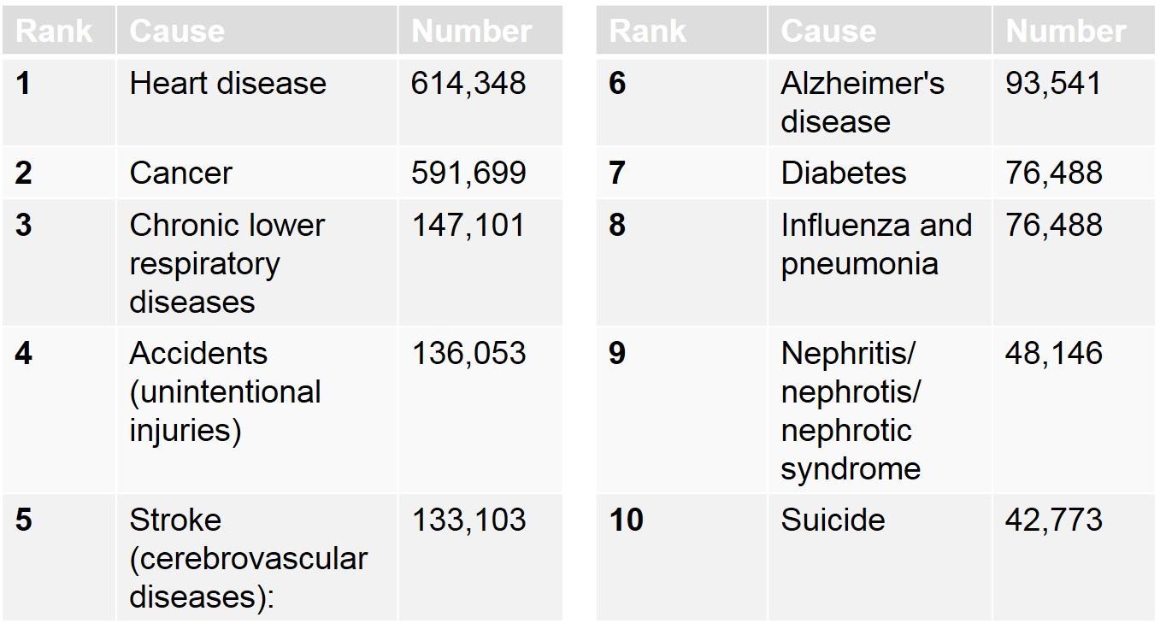
Top 10 Leading Causes of
Mortality in the U.S.
Table 8.1. Top 10 leading causes of mortality in the U.S. Table created with 2014 data published by CDC (CDC, 2016).
Notes:
This slide shows the leading causes of mortality in the U.S. in 2014. Notice the predominance of chronic diseases in this list.

Slide 6
Chronic Disease Topics
  Chronic disease topics include:
  Arthritis
  Asthma & Allergies
  Cancer
  Chronic Fatigue Syndrome
  Diabetes
  Epilepsy
  Heart Disease
  Hemochromatosis
  Hepatitis B
  Hepatitis C
  Iron Overload
  Osteoporosis
  Overweight and Obesity
  Stroke
Notes:
This listing of chronic disease topics illustrates the wide range of conditions that fall into the chronic disease category.

Slide 7
Chronic Disease: Prevention
CDC estimates that 70% of deaths in the U.S. are now caused by chronic diseases
Public health focus: behavior modification
Chronic diseases mainly due to four modifiable health risk behaviors
  Lack of physical activity
  Poor nutrition
  Tobacco use
  Excessive alcohol consumption
Notes:
CDC estimates that 70% of deaths in the U.S. and 86% of health care costs are attributable to chronic diseases. Public health’s efforts at prevention are mainly focused on behavior modification. The modifiable behaviors being targeted are physical activity, nutrition, tobacco use, and alcohol consumption.

Slide 8
Chronic Disease: Education
Since behavior modification is the main public health goal, the tools to effect that are:
  Education and informational materials
    For the public
    For health care practitioners
    For policymakers
  Funding opportunities
  Recommendations, best practices, guidelines
Notes:
With behavior modification as the public health goal, the tools selected include funding opportunities, recommendations such as best practices and guidelines, and education and informational materials for the public, practitioners, and policy makers.

Slide 9
World Health Organization (WHO) and Chronic Diseases
The WHO has developed the “STEPwise Framework”
Planning
  STEP 1: Estimate population need and advocate for action
  STEP 2: Formulate and adopt policy
  STEP 3: Identify policy implementation steps
Implementation
  Table of 3 steps on next slide
Notes:
The World Health Organization, or WHO has developed the Stepwise Framework to enable surveillance of chronic diseases. The framework has two stages: planning and implementation.
The planning stage includes three steps:
Step one involves estimating the population need and advocating for action.
Step two is formulating and adopting policy.
Step three is identification of policy implementation steps.
The implementation stage is presented in a table on the next slide.

Slide 10
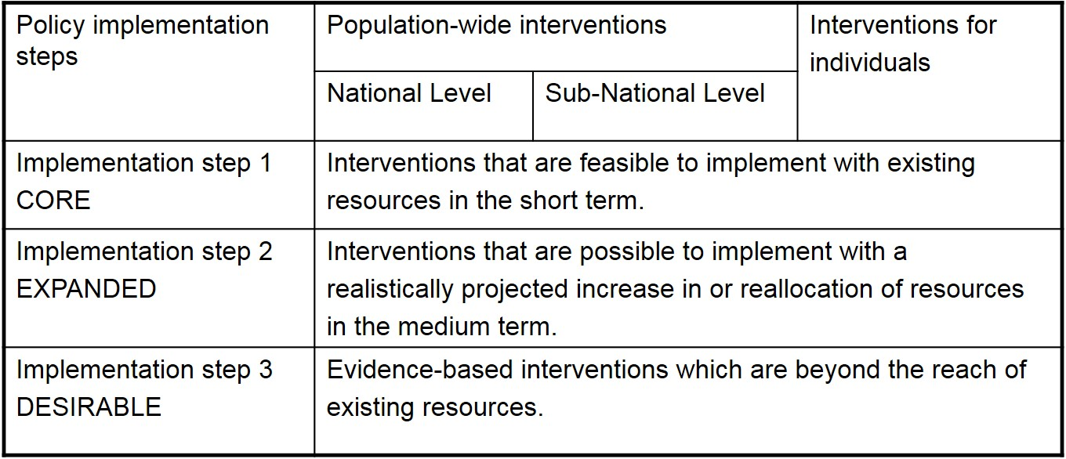
WHO STEPwise Framework
8.2 Table: The STEPwise Framework. Derived from content authored by World Health Organization. (n.d.). Retrieved January 31, 2017, from http://www.who.int/chp/chronic_disease_report/p28_en.jpg
Notes:
The implementation stage of the Stepwise Framework also has three steps, effective at national and sub-national population levels as well as at the individual level.
Step one, Core, includes short term interventions that can be implemented with existing resources.
Step two, Expanded, includes interventions that require an increase in or reallocation of resources.
Step three, Desirable, involves evidence-based interventions which require more than the existing resources.

Slide 11
Environmental Public Health
Environmental public health is vital to population health
Removal of lead from gasoline and from house paint are two of the numerous triumphs of this field
Other critical functions include air and water quality monitoring and education, and hazardous waste management
Notes:
Environmental public health is a critical component of public health, and has made many notable achievements. One of the best known was the removal of lead from gasoline and house paint.
Some critical functions of this branch of public health include air and water quality monitoring and education, and hazardous waste management.

Slide 12
Environmental Topics:
By Means of Contact
Air quality
Food protection
Radiation protection
Solid waste Management
Hazardous waste management
Water quality
Boise control
Environmental control of recreational areas
Housing quality
Vector control
Notes:
Public health environmental topics can be categorized by their means of contact with the population, such as air, food, water, etc.

Slide 13
Environmental Topics:
By Public Health Programs - 1
Air Quality
Bioterrorism Agents
Chemical Agents
Environmental Hazards
Food Safety
Hazardous Substance
Hazardous Waste Health Disorders and the Environment
Herbicides
Hydrocarbons
Notes:
Another categorization method is to organize topics by public health program. This slide and the next list public health environmental programs and topics:
Air Quality
Bioterrorism Agents
Chemical Agents
Environmental Hazards
Food Safety
Hazardous Substance
Hazardous Waste Health Disorders and the Environment
Herbicides
Hydrocarbons

Slide 14
Environmental Topics:
By Public Health Programs - 2
Laboratory Measurements in People
Lead
Natural Disasters
Pesticides
Smoking/Tobacco Use
Urban Planning for Healthy Places
Vessel Sanitation and Health
Water Quality
Notes:
Laboratory Measurements in People
Lead
Natural Disasters
Pesticides
Smoking/Tobacco Use
Urban Planning for Healthy Places
Vessel Sanitation and Health
Water Quality

Slide 15
Overlap of Disease and Environmental Public Health
There is some overlap between chronic diseases and environmental topics. Some examples:
  Smoking, asthma, air quality
  Cancer, environmental hazards and exposure, chemical agents
Overlap exists between communicable diseases and environmental topics
  Bioterrorism
  Water quality and water-related diseases
Notes:
Chronic diseases and environmental hazards actually demonstrate some public health overlap. Consider the interrelatedness of smoking, asthma, and air quality. Another example of interrelatedness involves cancer, environmental hazards and exposure, and chemical agents. Communicable diseases also overlap with environmental topics, such as the relationships between water quality and water-related diseases.

Slide 16
Public Health Silos
Divisions between various facets of public health can be artificial, created for organizational efficiency
  Added difficulty of collaborating across agencies/institutes earns the label “silos” for government departments
Complex relationships exist between facets of public health
Notes:
In fact, divisions between different facets of public health can be artificial, created for organizational purposes. The relationships between different facets of public health are often complex, as illustrated in the previous examples.

Slide 17
Public Health, Part 2
Summary – Lecture c
Discussed the importance and impact of chronic diseases
Considered behavior modification as a remediation tool
Illustrated the World Health Organization’s STEPwise Framework
Reviewed environmental public health topics including overlap with chronic diseases
Notes:
This concludes lecture c of Public Health, Part 2.
In summary, the importance and impact of chronic diseases is discussed. Behavior modification is considered as a remediation tool. The World Health Organization’s Stepwise Framework is illustrated. Environmental public health topics are reviewed, including some overlap with chronic diseases.

Slide 18
Public Health, Part 2
Summary - 1
Discussed communicable diseases, using notable examples
Discussed public health disease outbreak investigations using a simplified food poisoning example
Discussed public health response for four main terrorism categories: bioterrorism, agricultural terrorism, chemical terrorism, radiation terrorism
Notes:
This also concludes the unit, Public Health, Part 2.
In summary, communicable diseases were discussed in detail, using notable examples including smallpox and polio. Public health disease outbreak investigations were discussed using a simplified food poisoning incident. Public health response was discussed for the four main categories of terrorism: bioterrorism, agricultural terrorism, chemical terrorism, and nuclear/radiation terrorism.

Slide 19
Public Health, Part 2
Summary - 2
Discussed categorization of bioterrorism agents and Laboratory Response Network
Discussed importance and impact of chronic diseases
Considered behavior modification as a remediation tool
Illustrated World Health Organization’s STEPwise Framework
Reviewed environmental public health topics, including overlap diseases topics
Notes:
Categorization of bioterrorism agents and the Laboratory Response Network were discussed.
The importance and impact of chronic diseases was discussed. Behavior modification was considered as a remediation tool. The World Health Organization’s Stepwise Framework was illustrated. Environmental public health topics were reviewed, including some overlap with chronic diseases.

Slide 20
Public Health, Part 2
References – Lecture c
References
Centers for Disease Control and Prevention, National Center for Health Statistics, Number of Deaths for Leading Causes of Death. (n.d.). Retrieved January 31, 2017, from https://www.cdc.gov/nchs/fastats/leading-causes-of-death.htm
Centers for Disease Control and Prevention, Chronic Disease Prevention and Health Promotion. (n.d.). Retrieved January 31, 2017, from https://www.cdc.gov/chronicdisease/index.htm
World Health Organization, Health Topics, Noncommunicable Diseases. (n.d.). Retrieved January 31, 2017, from http://www.who.int/topics/noncommunicable_diseases/en/
Charts, Tables, Figures
8.1 Table: Top 10 leading causes of mortality in the U.S. Table created with 2014 data published by CDC (CDC, 2016).
8.2 Table: The STEPwise Framework. (n.d.). (2005) World Health Organization publication: Preventing Chronic Diseases: A Vital Investment. Pg. 28 The Stepwise Framework. http://www.who.int/chp/chronic_disease_report/full_report.pdf?ua=1
Notes:
No audio

Slide 21
Introduction to Health Care and Public Health in the U.S.
Public Health, Part 2
Lecture c
This material was developed by Oregon Health & Science University, funded by the Department of Health and Human Services, Office of the National Coordinator for Health Information Technology under Award Number 90WT0001.
Notes:
No audio

